Slide 1
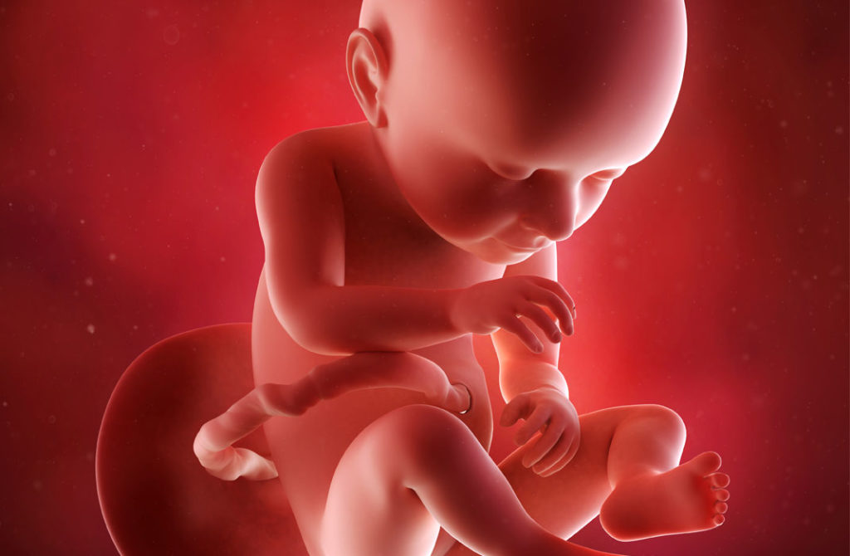
Pregnancy
Fetus, Placenta & Maternal Adaptations

Slide 2
Objectives
Define Pregnancy
Overview of Fertilization & Implantation
Fetal Development & Circulation
Placental Growth & Maturation
Maternal Adaptations to Pregnancy

Slide 3
What is Pregnancy?
The period in which a fetus develops inside a woman's womb or uterus.
Usually lasts about 40 weeks, or just over 9 months, as measured from the last menstrual period to delivery
It begins with fertilization and implantation.

Slide 4
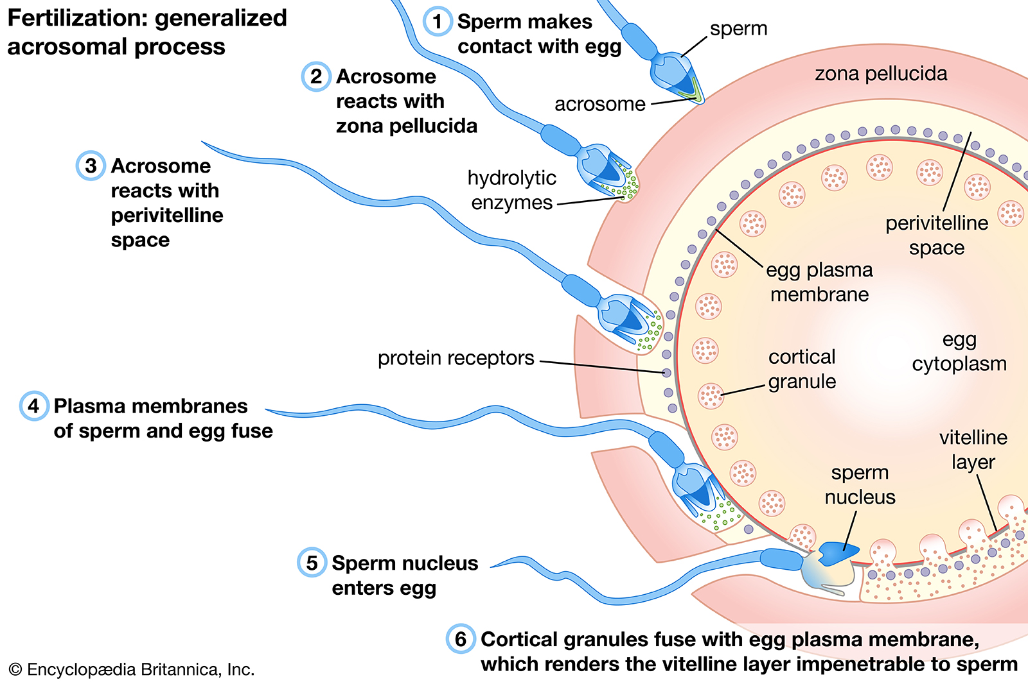
Fertilization
Notes:
Stage 0: Capacitation. Takes place in the female genital tract, maturation of the sperm by estrogens
Consists of 3 phases: 1. Penetration of the corona radiata. 2. the acrosome reaction (dissolution of the spermatic cell membrane and the zona pellucida of the ovum) and impregnation (penetration of the sperm into the ovum)
3. Conjugation: fusion of the sperm and ovum to form the zygote (single cell)

Slide 5
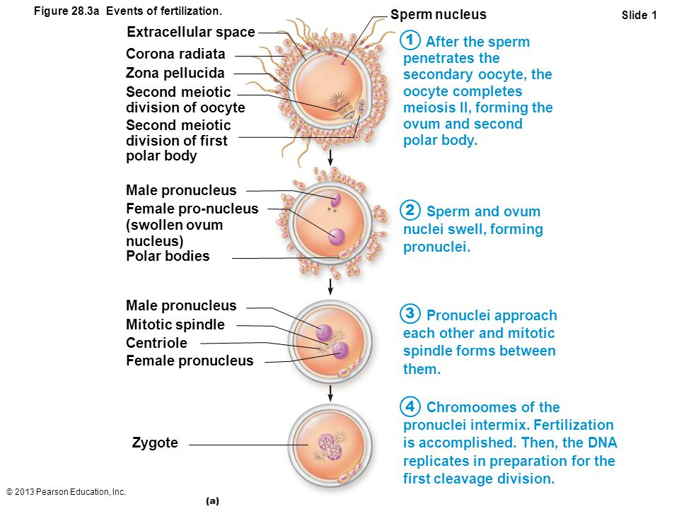
Fertilization

Slide 6
Fertilization usually occurs in the upper end of the fallopian tubes (most commonly in the ampulla) within 1 day of ovulation
16-cell morula is seen 3 days. Inner cells of the morula constitute the inner cell mass, and surrounding cells compose the outer cell mass.
When the morula enters the uterine cavity it becomes imbibed with fluid forming a blastocoele. The embryo is now referred to as a blastocyst

Slide 7
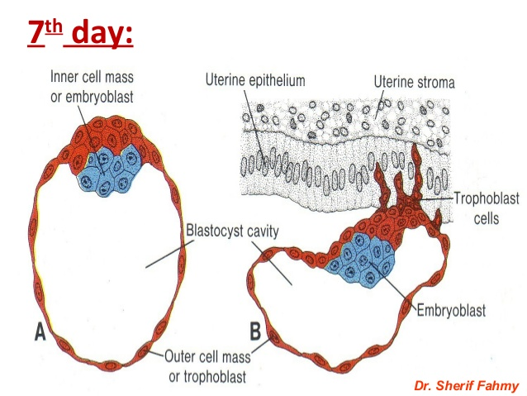
Implantation takes place most commonly into the anterior or posterior wall of the uterus
The trophoblast penetrates the endometrium with the aid of hydrolytic enzymes
This may result in brief implantation bleeding: bloody vaginal discharge occurring during implantation (may be mistaken for menstruation)
The endometrial stromal cell lining is transformed into the decidua (decidual reaction). The decidua provides nourishment to the embryo until the definitive placenta forms.

Slide 8
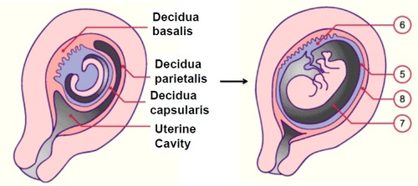
The decidua has three distinct parts:
  Decidua basalis: maternal portion of the placenta
  Decidua capsularis: part that grows over the blastocyst after implantation, appearing as a cap-like structure
  Decidua parietalis: decidua lining the pregnant uterus elsewhere than at the site of implantation

Slide 9
Fetal Physiology

Slide 10
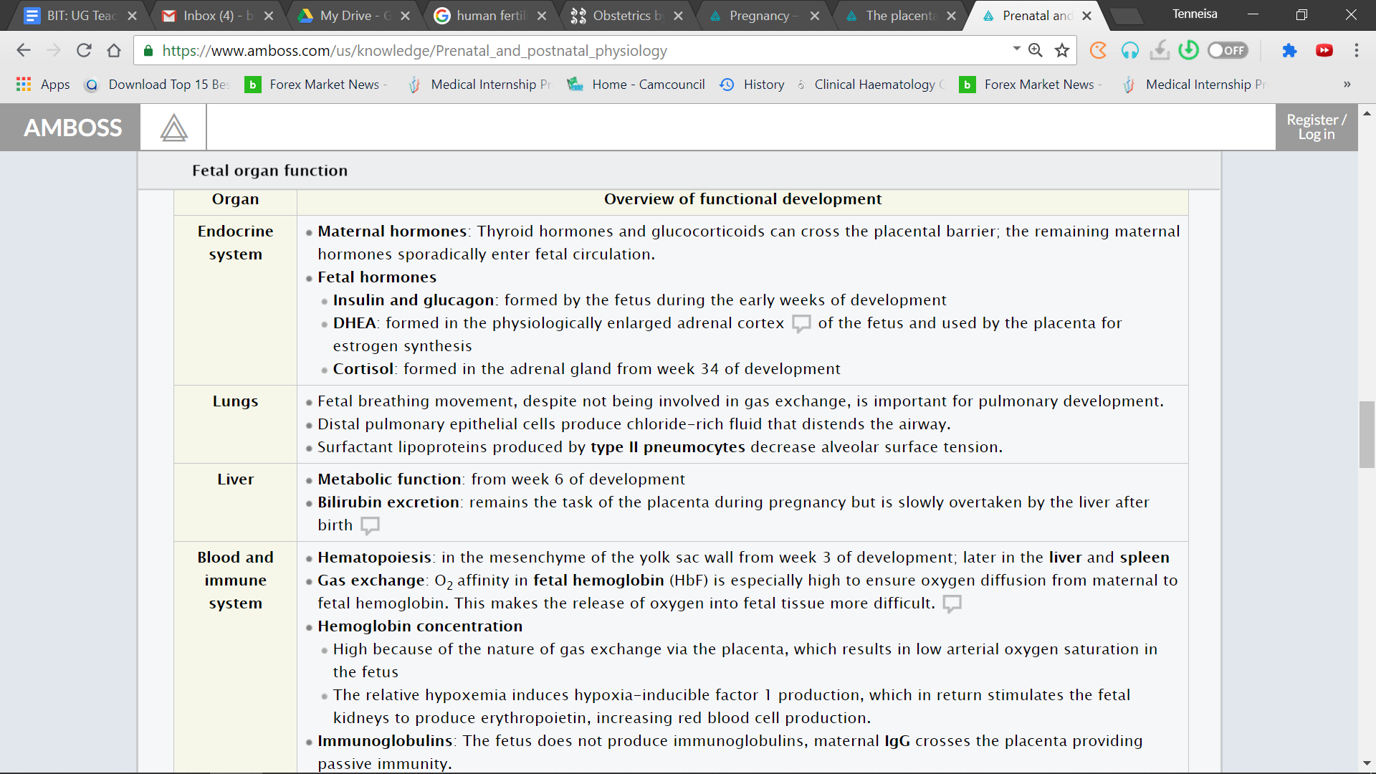

Slide 11
Placenta

Slide 12
Placenta
In humans it is hemo-chorial- maternal blood is separated from fetal blood only by a placental barrier.
Has 2 components: 1. Chorionic sac (trophoblastic layer) and 2. Decidua basalis
Notes:
Structure until the 4th month (from maternal to fetal)
Syncytiotrophoblast
Cytotrophoblast
Basal lamina of trophoblasts
Villous stroma made up of connective tissue
Basal lamina of the endothelium
Capillary endothelium
Structure from the 4th month (from maternal to fetal)
Syncytiotrophoblast
Fused basal lamina from trophoblasts and the endothelium
Capillary endothelium

Slide 13
Functions of the Placenta
Protection against noxious agents
Immunological protection
Gas and nutrient exchange
The syncytiotrophoblast produces hormones:
  HCG (max. concentration at 1o weeks ), HPL, CRH, estrogen, and progesterone.
  The hormones facilitate:
        Continuation of pregnancy
        Maternal adaptation to the pregnancy
        Regulation of uterine circulation
        Fetal development and growth
        Inducing birth

Slide 14
The Mature Placenta
Discoid shape
Weighs 500-700 grams
Maternal surface has 15-20 cotyledons
Umbilical cord is attached near the center of the fetal surface

Slide 15
Uteroplacental Circulation
The trophoblast differentiates into (1) an inner, actively proliferating layer, the cytotrophoblast, and (2) an outer layer, the syncytiotrophoblast, which erodes maternal tissues.
By day 9, lacunae develop in the syncytiotrophoblast. Subsequently, maternal sinusoids are eroded by the syncytiotrophoblast, maternal blood enters the lacunar network.
The lacunar spaces merge → intervillous space

Slide 16
The cytotrophoblast, meanwhile, forms cellular columns penetrating and surrounded by the syncytium. These columns are primary villi.
Secondary villi develop through the migration of extraembryonic mesoderm cells into the center of primary villi
Tertiary villi (terminal villi) connect to the umbilical cord vessels during week 3 of development
Tertiary villi develop through vascularization

Slide 17
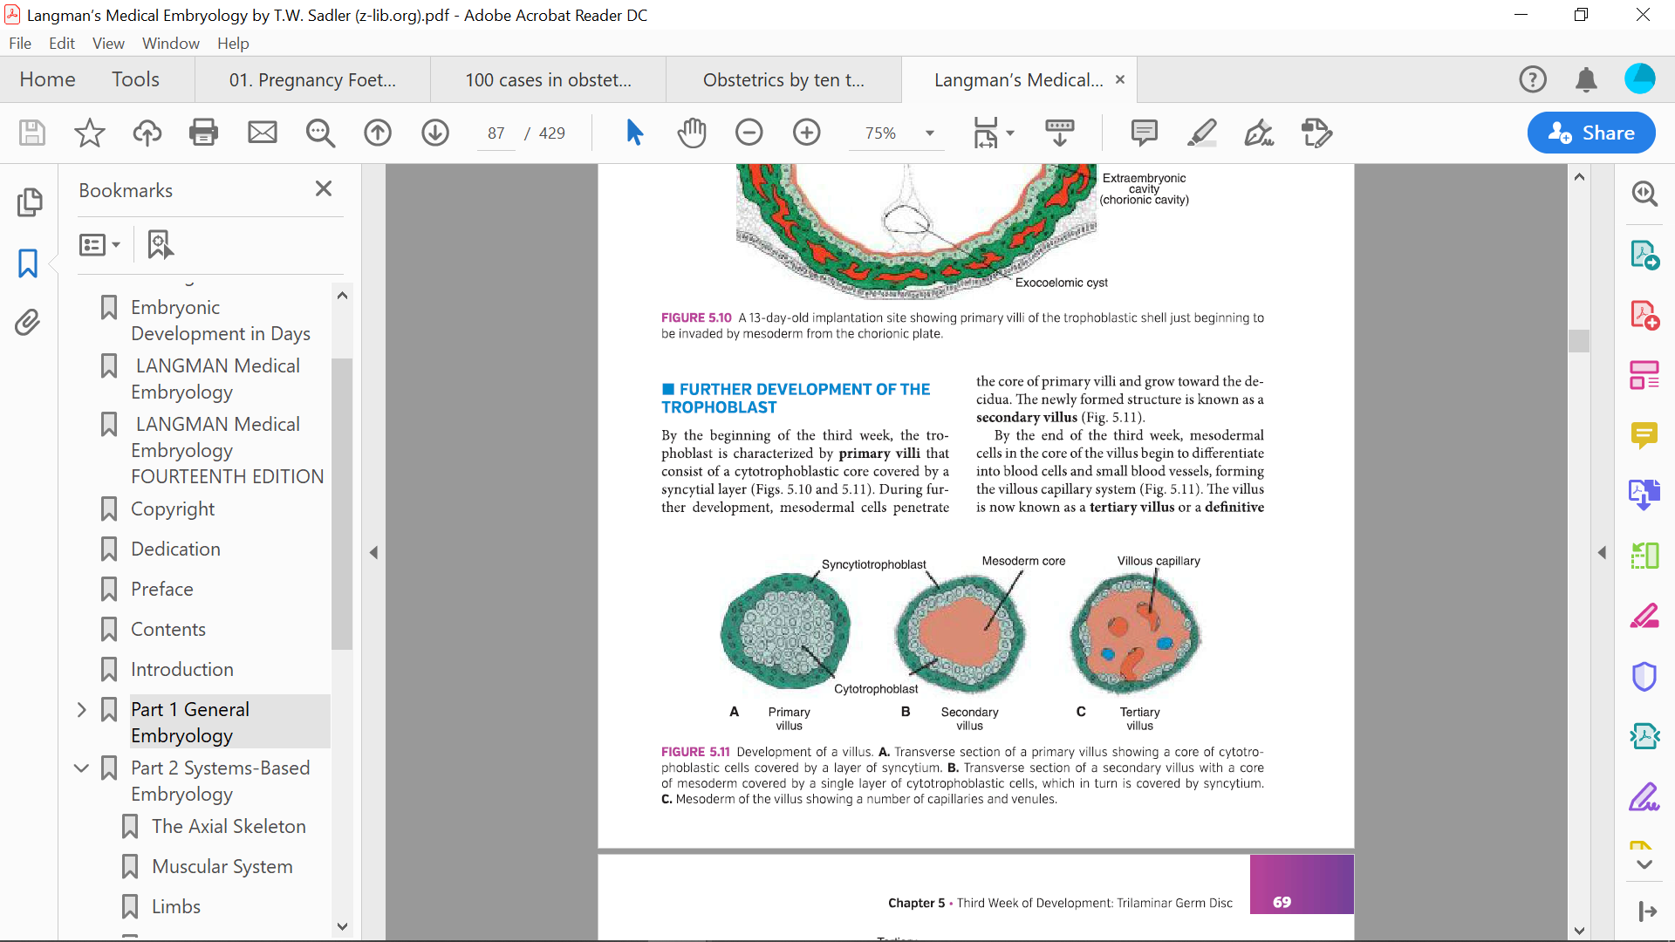

Slide 18
Final Critical Step
The invasion of the spiral arteries by the cytotrohpoblasts. This results in:
  Replacement of the endothelium and most of the tunica media
  Loss of smooth muscle and endothelial lining
  Dilation of the vessels (low resistance)

Slide 19
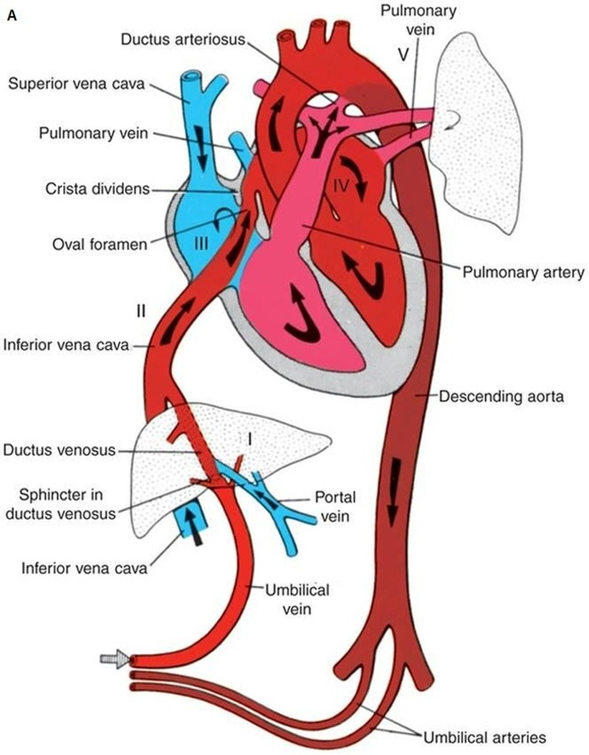
Fetal Circulation
Notes:
The ductus arteriosus originates from the bifurcation of the PA and is kept open due to high levels of Prostaglandin E2. The absence of oxygen keeps the pulmonary vessels closed and at a high resistance to blood flow, so blood instead flows through the ductus arteriosus.
The function of the ductus arteriosus is to return deoxygenated blood to the arterial circulation (bypasses the lungs)
At birth, oxygen intake leads to the dilatation of the PAs as such decreases the resistance of the PAs so blood now takes the path of least resistance. The ductus arteriosus should close to be renamed as the ligamentum arteriosus. O2 should also lead to decrease PGE2 production
The decrease in blood flow (decrease CO) to the arterial circulation causes the LV to increase force of contraction → LVH and dilatation

Slide 20
Placental transfer
Patterns of transfer
  Passive - lipophilic substances
  Active - lipophobic

Slide 21
Oxygen & Carbon Dioxide Transfer
O2
  Higher fetal Hb (16-18g/dl)
    Fetal Hb has decreased affinity for 2-3DPG
    Fetal-Hb O2-dissociation curve to left
    Efficient blood flows
CO2
  Hb-CO2 dissociation increased due to affinity for O2
  maternal pCO2 is reduced via hyperventilation
Notes:
Since oxygen affinity of fetal HbF is significantly higher than that of adult HbA, oxygen diffuses from maternal to fetal blood.

Slide 22
Glucose Transfer
Facilitated diffusion via carrier membrane vesicles
Insulin does not cross the placenta
Fetal hyperinsulinemia promotes transfer of glucose
Maternal hyperglycemia may exaggerate fetal insulin response leading to fetopathy
Notes:
Active transport: amino acids, peptides, hormones, vitamins, fatty acids, inorganic ions
Pinocytosis: proteins, lipids, antibodies (IgG

Slide 23
Umbilical Cord & Amniotic Fluid

Slide 24
Umbilical Cord
Two arteries and one vein suspended in Wharton’s jelly
50-60 cm in length
2 cm wide
Notes:
Which on carries oxygenated blood to the fetus?

Slide 25
Amniotic Fluid
Protective fluid within the amniotic sac that cushions the fetus, prevents adherence of the fetus to the amnion, and serves as a transport medium for nutrients and metabolites and aids in lung maturation.
Initially secreted by the amnion, but by the 10th week it is mainly a transudate of the fetal serum via the skin and umbilical cord.
> 16 weeks’ gestation, fetal skin becomes impermeable to water and the net increase in amniotic fluid is through a small imbalance between the contributions of fluid through the kidneys and lung fluids and removal by fetal swallowing.
Composition (initially a clear liquid)
      Amount: approx. 850–1500 mL by the end of pregnancy (the amniotic fluid is completely exchanged every 3 hours)
      pH: 7–7.5 (slightly alkaline)
      Proteins, glucose, urea
      Hair, dead skin, sebum
      Fetal urine (after first trimester)
Notes:
Clear fluid: Maternal plasma that diffuses through the amniotic epithelium. After the first trimester, the fetal kidneys are developed and produce urine, which contributes to the amniotic fluid.

Slide 26
Maternal Adaptations to Pregnancy

Slide 27
Starts early in pregnancy
Progressive
Every system affected!
Knowledge of normality helps in the care
Factors influencing adaptation/ reversal:
  Age
  Parity
  Previous experience (obstetric)
  BMI
  Comorbidities
  Socio-economic factors
  Ethnic, geographic, climactic variables
  No. and size of conceptus

Slide 28
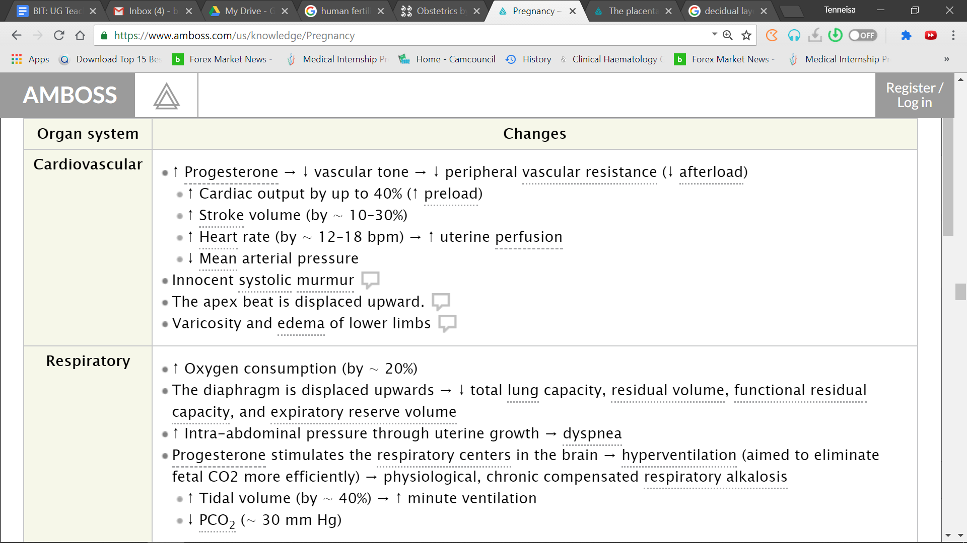
Notes:
Cardio:
Raised cardiac output by 1.5l/min by 10 weeks
50% increase from baseline by 3rd T
Additional 30% in labor and delivery
Raised pulse pressure
May also hear S3
Systolic BP normal
Diastolic falls in 2nd T by 10-15mmhg
Murmur: Increased hyperdynamic state
Displaced apex beat: enlarging uterus (4th ICS MCL)
Varicosity and edema: The uterus presses against the pelvic veins and vena cava, impairing venous return, and subsequently increasing the risk of DVT.
Respi: TV +200ml and VC +200 ml

Slide 29
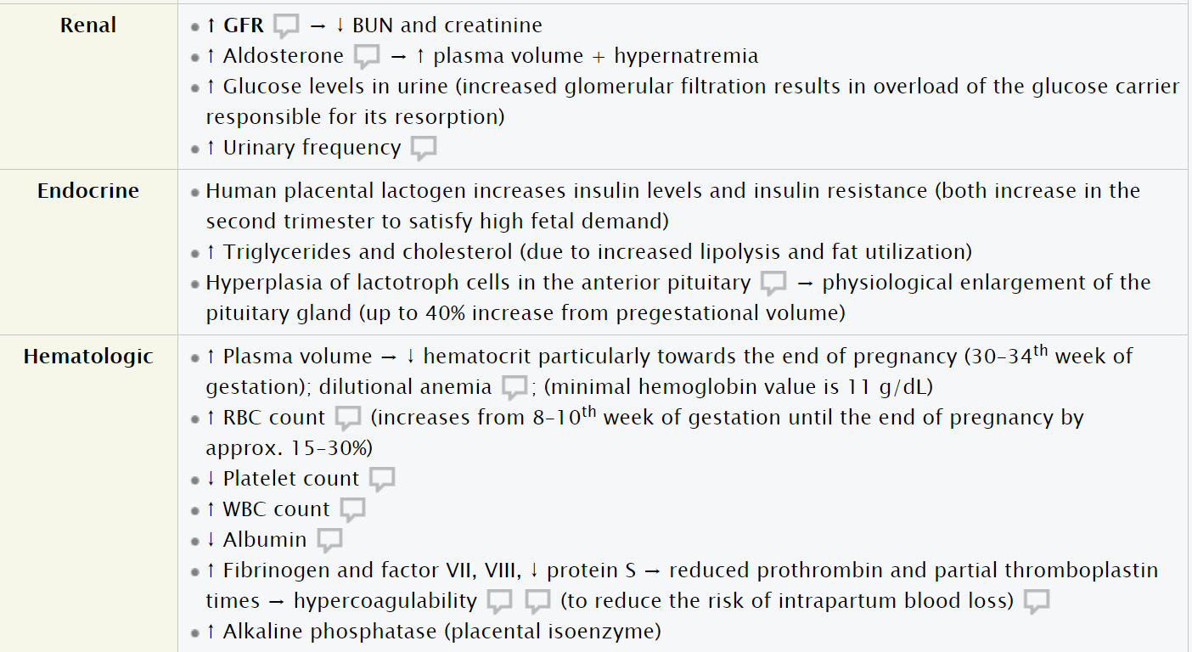
Notes:
Renal:
Decrease in peripheral vascular resistance leads to the activation of the RAAS system, resulting in increased water retention
Incr urinary freq d/t increased GFR and increased intra-abdominal pressure, which results in an increase in urinary bladder pressure.
Kinking and dilation of the ureter → stasis and increased risks for UTI
Endocrine:
Increased hormones: ACTH, HGH, TSH, Prolactin
Decreased hormones: FSH and LH
Hyperplasia of adrenal, thyroid and parathyroids
B-cells of pancreas increase in no.
Hematologic:
Plasma volume increase by 50%
Dilutional anemia is good because decrease in blood viscosity is beneficial for the perfusion of the placenta and kidneys.

Slide 30
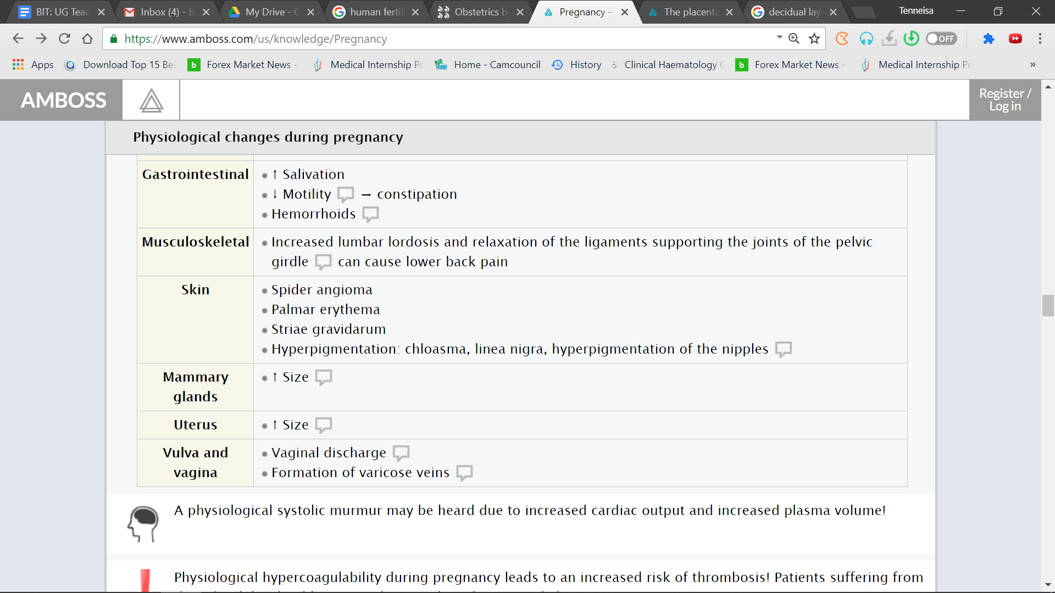
Notes:
Progesterone and estrogen increase vaginal blood supply, thereby increasing Bartholin gland secretions.

Slide 31
Immune Tolerance
The fetus is genetically dissimilar to the mother, it should provoke an immune response
Immune tolerance- process by which both cell mediated and, to a lesser extent, humoral immunity are reduced
This allows normal development of the conceptus
Failure may result in pregnancy loss, or in other pathology, such as pre-eclampsia

Slide 32

Maternal Tolerance
Hollow viscera tend to automatically contract to clear an obstruction. E.g. cholecystitis, ureteric colic.
Progesterone, produced by the placenta, causes relaxation of the uterine muscle
Thus, it facilitates the physical expansion of the uterus up until term

Slide 33

Weight Gain During Pregnancy
The recommendations are determined by the BMI prior to the pregnancy:
  BMI < 18.5 (underweight): 28–40 lb (12–18 kg)
  BMI 18.5–24.9 (normal weight): 25–35 lb (11–16 kg)
  BMI 25–29.9 (overweight): 15–25 lb (7–11 kg)
  BMI ≥ 30 (obese): 11–20 lb (5–9 kg)
Notes:
Abnormal:
Large for gestational age
Pre-Eclampsia

Slide 34
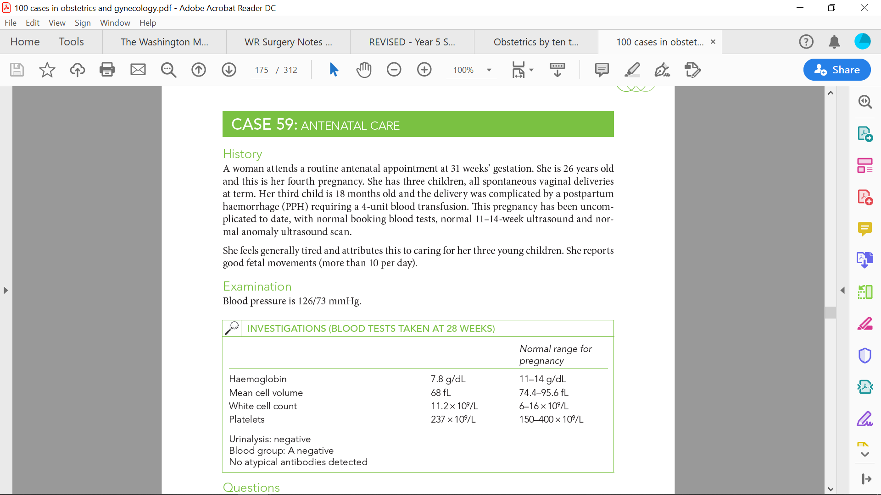
Case History

Slide 35
Review Question #1
Amniotic fluid
  First appears at 12 weeks gestation
  Reaches a maximum volume at 38 weeks
  Has a composition similar to maternal plasma in early pregnancy
  Has an acid pH

Slide 36
Amniotic fluid
  First appears at 12 weeks gestation
  Reaches a maximum volume at 38 weeks
  Has a composition similar to maternal plasma in early pregnancy
  Has an acid pH

Slide 37
Review Question #2
2. Which is true about the placenta?
  Develops mainly from syncytiotrophoblast
  Has approximately 20 cotyledons
  Is covered over the maternal surface by the chorion
  Produces insulin

Slide 38
2. Which is true about the placenta?
  Develops mainly from syncytiotrophoblast
  Has approximately 20 cotyledons
  Is covered over the maternal surface by the chorion
  Produces insulin

Slide 39
Review Question #3
3. Which of the following respiratory volumes and functions increase in pregnancy?
  ERV
  TV
  RR
  RV

Slide 40
3. Which of the following respiratory volumes and functions increase in pregnancy?
  ERV
  TV
  RR
  RV

Slide 41
Review Question #4
4. Which is a characteristic change in the hematological indices during pregnancy?
  Decrease in white cell count
  Increase in MCHC
  Decrease in fibrinolysis activity
  Increase in thrombin level

Slide 42
4. Which is a characteristic change in the hematological indices during pregnancy?
  Decrease in white cell count
  Increase in MCHC
  Decrease in fibrinolysis activity
  Increase in thrombin level
Notes:
There is no significant change in MCH during pregnancy
Mean Cell Hemoglobin Concentration (MCHC) is the average concentration (amount) of Hgb in one RBC. It is calculated as Hgb/Hct

Slide 43
The End!

