Slide 1
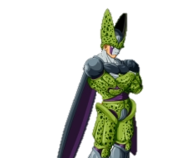
Cell structure Cell Division Gametogenesis
Dr. Donclair Brown
MBBS (Hons.)
Class of 2018

Slide 2
Outline
Cell Structure
Definition
Classification
Organelles
Cell Division
Cell cycle
DNA replication
Mitosis
Meiosis
Gametogenesis
Oogenesis
Spermatogenesis

Slide 3
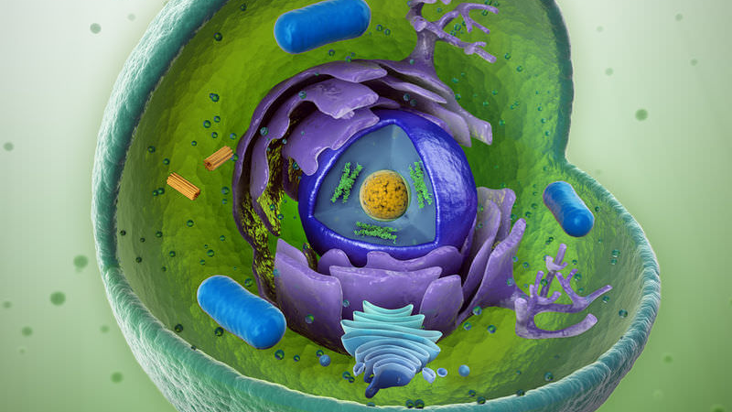
The Cell
Where it all begins

Slide 4
The Cell
Basic unit of all living organisms
Unicellular (Bacteria)
Multicellular (Animals, Plants)
Classified as prokaryotic or Eukaryotic
All are bound by a lipid bilayer with embedded proteins.

Slide 5
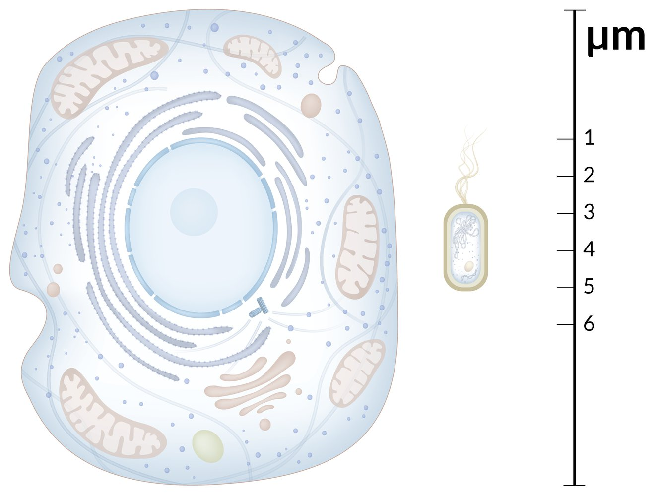
The Cell
Prokaryote
Unicellular, no membrane bound organelles
Eukaryote
Uni/Multicellular, Has membrane bound organelles (nucleus, mitochondria )
Notes:
There are no multicellular prokaryotes.
Eukaryotes are larger and more complex than prokaryotes.

Slide 6
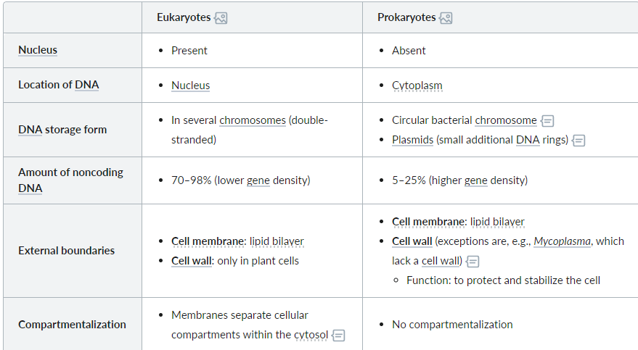
The Cell
Adapted from https://next.amboss.com/us/article/Lo0wcS#Z0b2dbba84cd425084862e30873efee1a
Notes:
See: Amboss “The Cell”

Slide 7
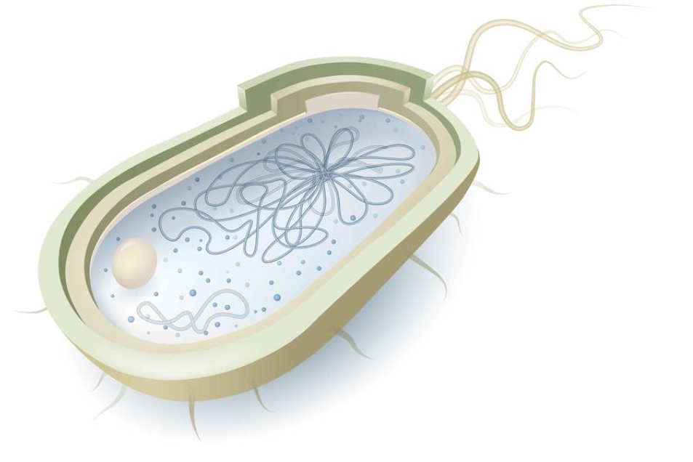
The Cell
Eukaryote
Prokaryote

Slide 8
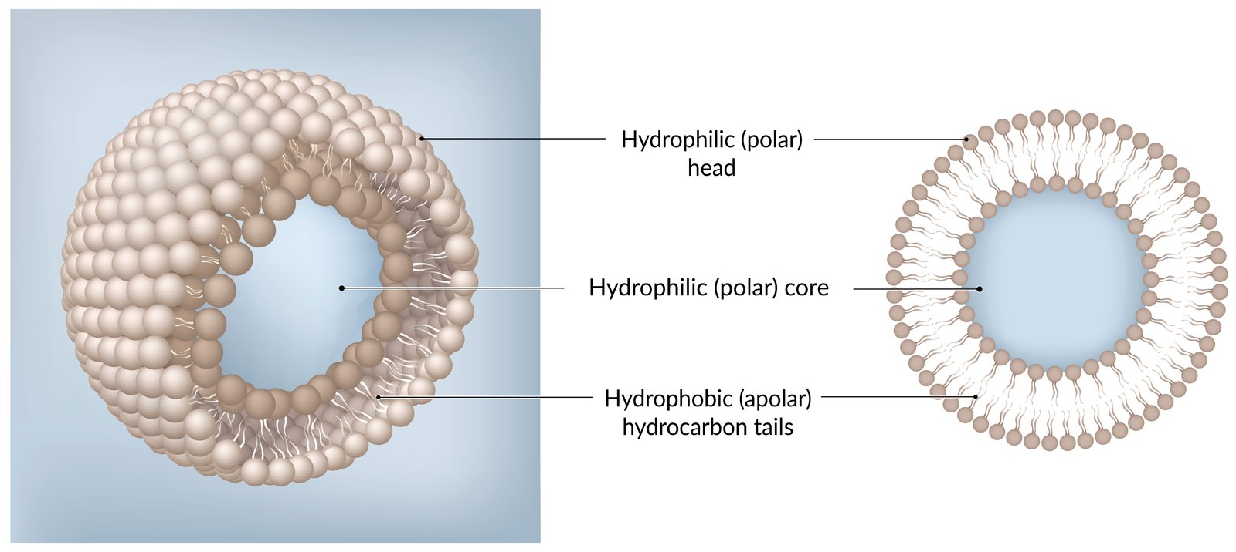
Cell Membrane
Separates the inner cell contents from the external environment.
Organelles have intracellular membranes
May also be covered by a cell wall
Main functions : Protection, Transport, Transduction, Electrical regulation, Cell-Cell adhesion
Made of an amphiphilic lipid bilayer with proteins and cholesterol molecules embedded.
Permeability
Fluidity
Cholesterol stabilizes the membrane
Unsaturated fatty acids increase fluidity
Membrane proteins and glycoproteins serve several functions
Identification
Transport proteins
Structural proteins
Notes:
Most prokaryotic cells have a cell wall enveloping the cell membrane.
Amphiphilic lipids are phospholipids and sphingolipids
Polar head – faces aqueous solution
Non-polar tail – faces other non polar tail
Permeable to non-polar molecules, almost impermeable to polar molecules
Lipids may move freely across the inner layer or outer layer; but needs enzymes to switch layers.
Cholesterol is bulky and prevents the lipids from moving too freely when warm and from clumping too tightly when cold.

Slide 9
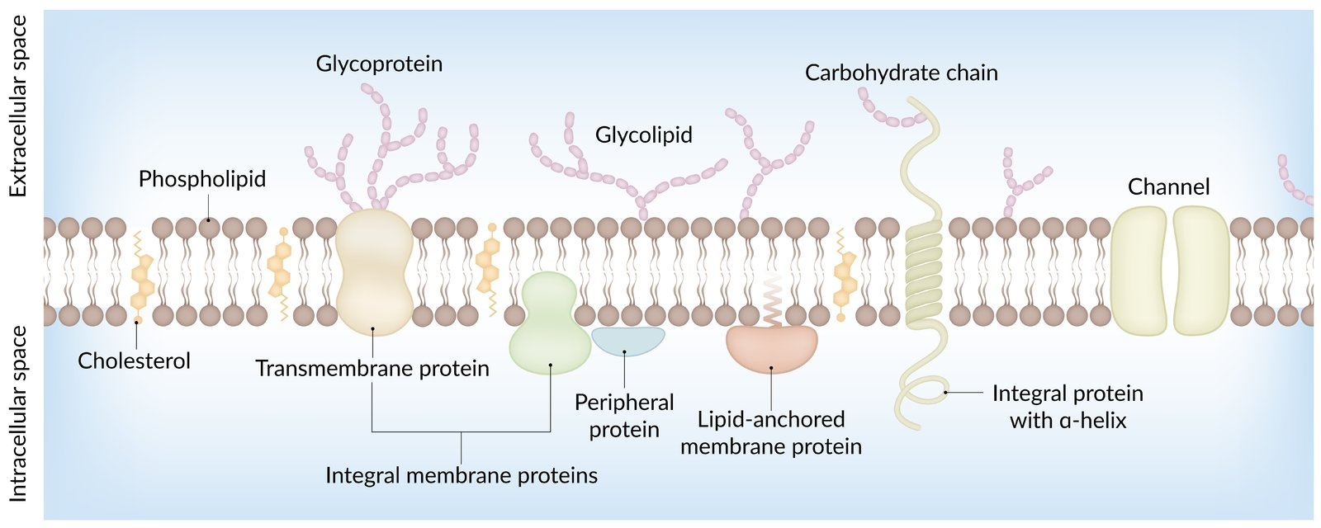

Slide 10
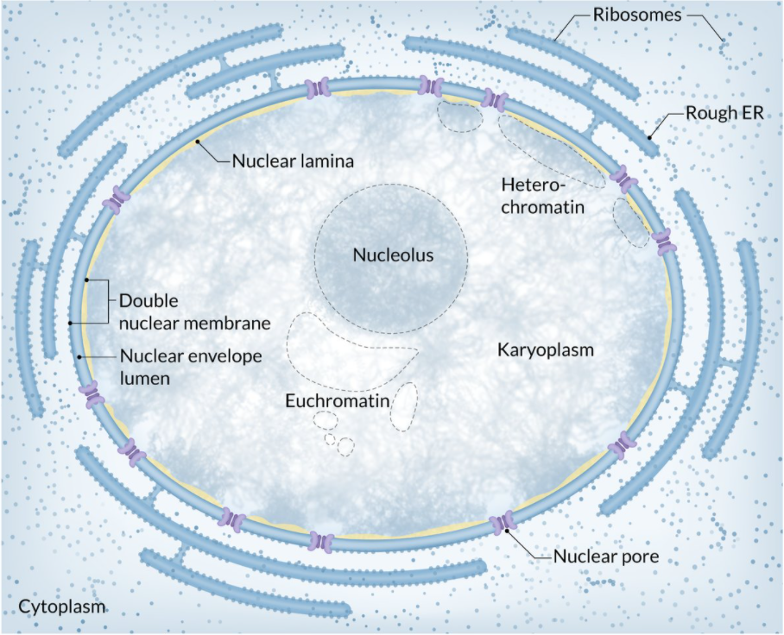
Nucleus
Brain of the cell, containing almost* all the genetic material of the cell.
Site of DNA replication
Site of rRNA synthesis (Nucleolus)
Site of transcription
Packages DNA for protection when not being replicated or transcribed
Surrounded by a porous nuclear envelope
Inner membrane – covered by nuclear lamina
Outer membrane – transitions into the rough ER
Contains:
Chromatin (Euchromatin vs Heterochromatin)
DNA + Histones+ Non-histone proteins
Nucleolus
Nucleoplasm
Notes:
Pores form at fusion points of the 2 membranes and aid in transport of substances between the cytosol and the nucleoplasm.
Chromatin
Euchromatin – Less tightly coiled, DNA accessible for replication
Heterochromatin – Tightly coiled, DNA more easily transported but not replicated

Slide 11
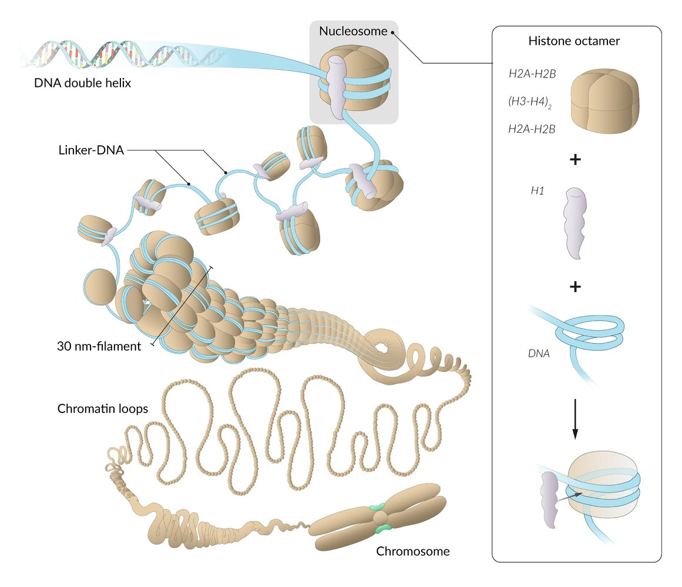

Slide 12
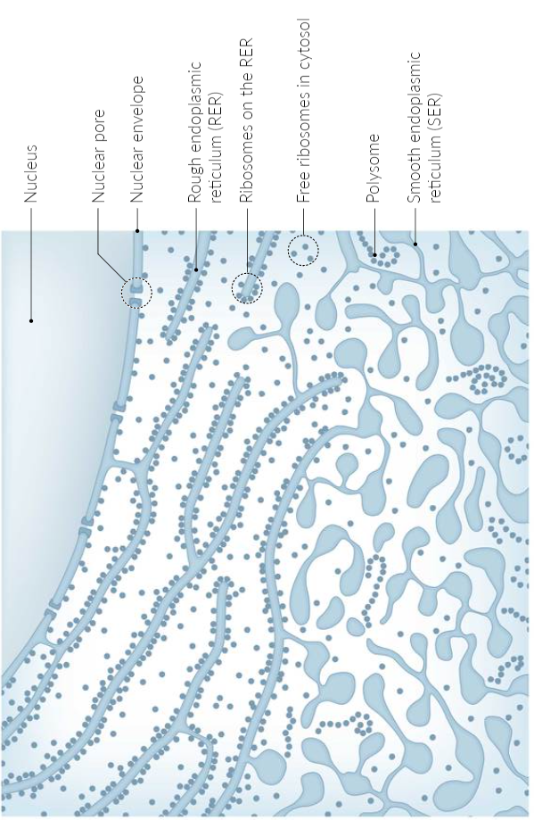
Endoplasmic reticulum
Functions to synthesize various cellular components and products for export.
Rough
Synthesis of membrane, secretory and lysosomal proteins
Proteins packaged into vesicles for exocytosis or modification*
Smooth
Synthesis of phospholipids, fatty acids and steroids
Carbohydrate trafficking
Ca2+ storage
Biotransformation (Detoxification)
Membranous Channels spanning from the outer nuclear membrane
rER – Has ribosomes on the surface
sER lacks ribosomes
Notes:
Proteins modified in the golgi apparatus.
Tissues with secretory functions (exocrine pancreas/Plasma cells/Goblet cells will have higher density of rER.
rER Form Nissl bodies seen in stained neurons
sER found in hepatocytes (detox) , Adrenal cortex and Gonads (Steroid synthesis)

Slide 13
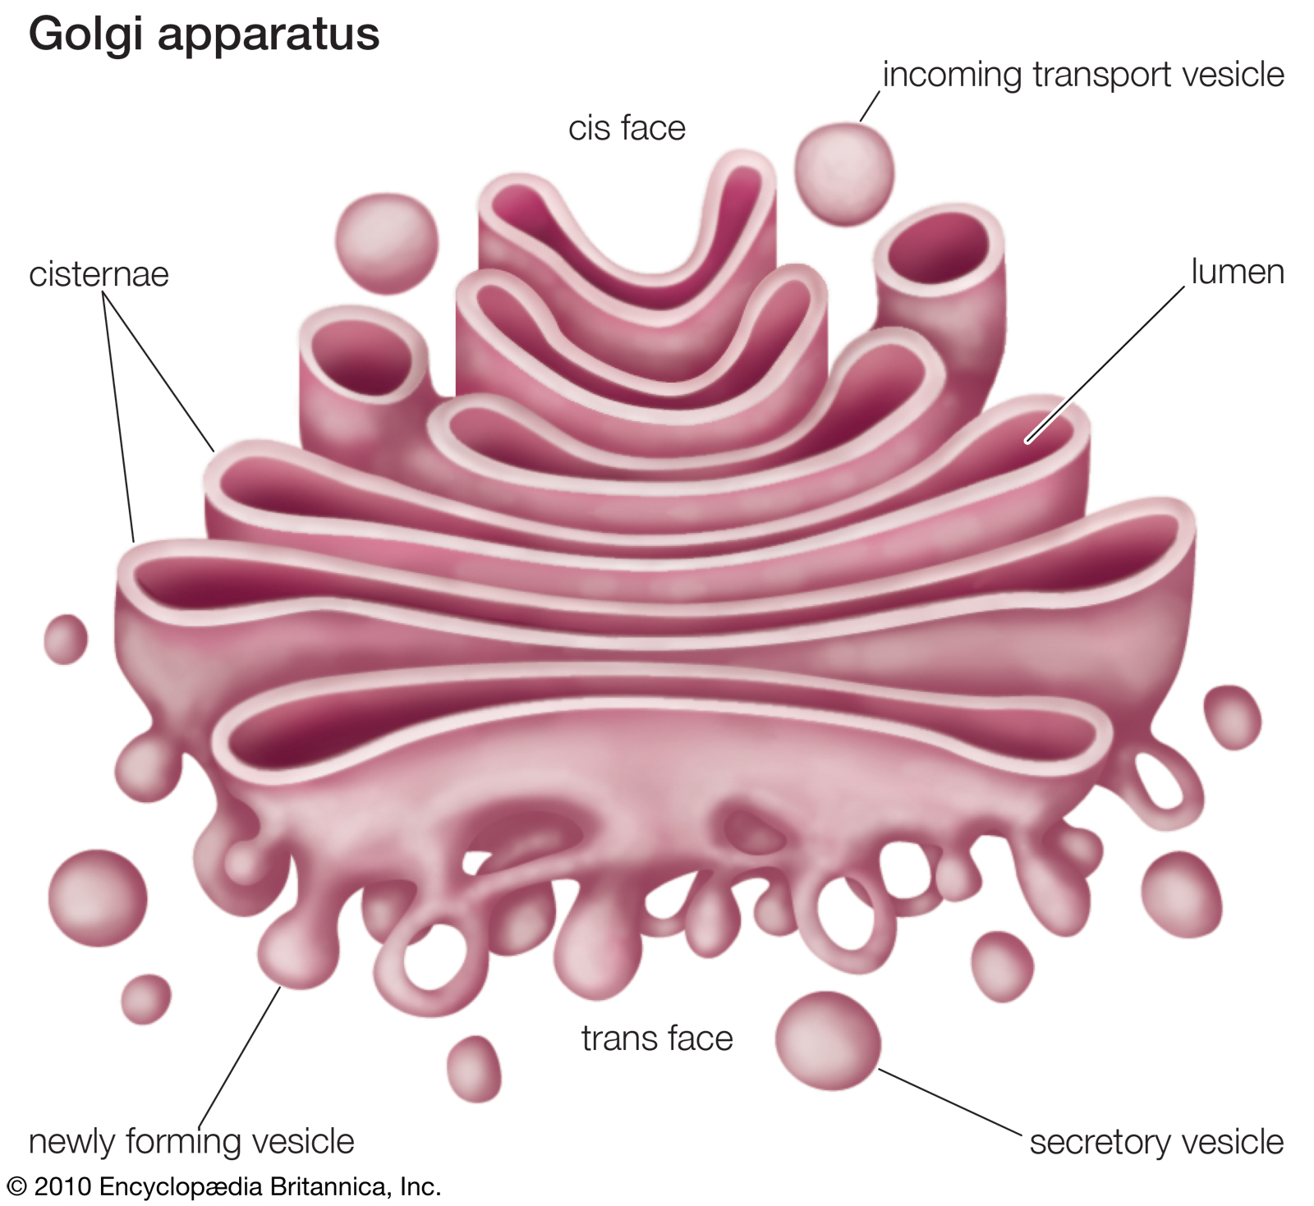
Golgi Apparatus
Function:
Receives proteins and lipid products from the ER and further modifies them before distribution.
Synthesizes and loads lysosomes with enzymes
Structure:
Enveloped, disc shaped vesicular structure
Functional units : Cisternae
Notes:
Modifies glycoproteins, hormone precursors and recycled membrane proteins.
Regulated by vesicular trafficking proteins:
COP I , COP II, Clathrin
Has a Cis face (facing ER) and a Trans face (facing cell membrane)

Slide 14
Mitochondria
The energy centre of the cell
Contains the Respiratory(electron transport) chain needed for cellular energy production. (Along with ATP synthase)
Site of other important metabolic pathways:
Kreb cycle, Beta oxidation, Urea cycle, Heme synthesis etc
Structurally similar to a prokaryotic cell*
Smooth outer membrane and convoluted inner membrane
Outer-porous and permeable
Inner impermeable but has numerous ionic transporters
Surrounds the Mitochondrial matrix
Contains mtDNA and ribosomes
Notes:
Mitochondria thought to be prokaryotes which where engulfed by eukaryotic cells and become symbiotic with the Eukaryotic cell becoming almost completely reliant on the mitochondrion for energy and the mitochondrion becoming dependent on the eukaryotic cell for complete DNA processing. (endosymbiotic theory)
Mitochondria have the ability to produce approx. 15% of the total proteins needed for their function.

Slide 16
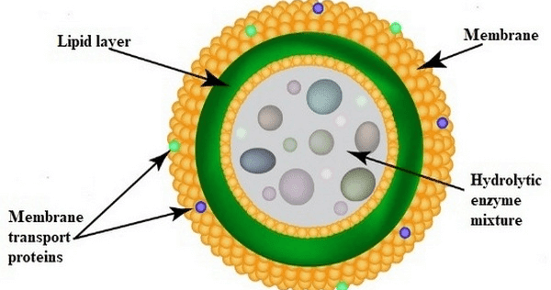
Lysosomes
Function is intracellular digestion
Primary lysosomes will fuse with phagosomes or endosomes to form secondary lysosomes before hydrolysis occurs
Autolysis
Structure:
Lipid bilayer surrounding a vesicle containing filled with hydrolytic enzymes. (lipases, proteases, glucosidases, Acid phosphatase)
Notes:
Enzymes are made in the rER and tagged with mannose 6 phosphate in the Golgi apparatus to start the process of packaging into vesicles.
Autolysis occurs as a response to severe cellular damage or cellular programming
Apoptosis – programmed cell death

Slide 17
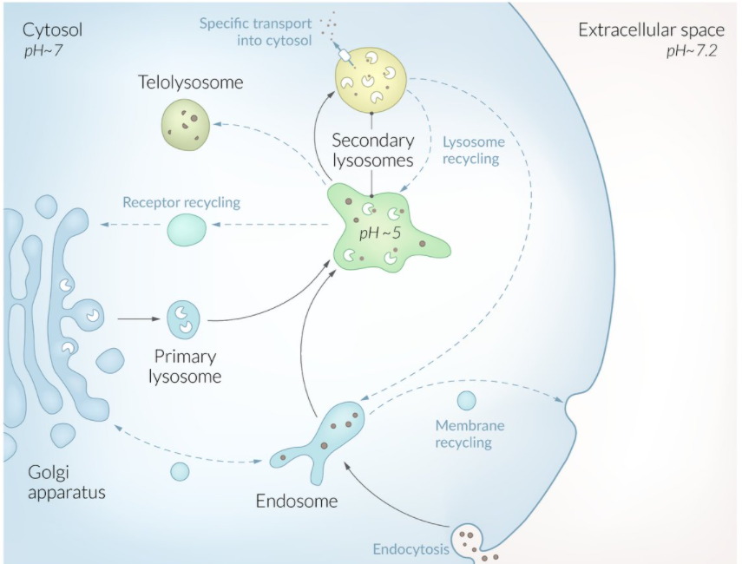

Slide 18
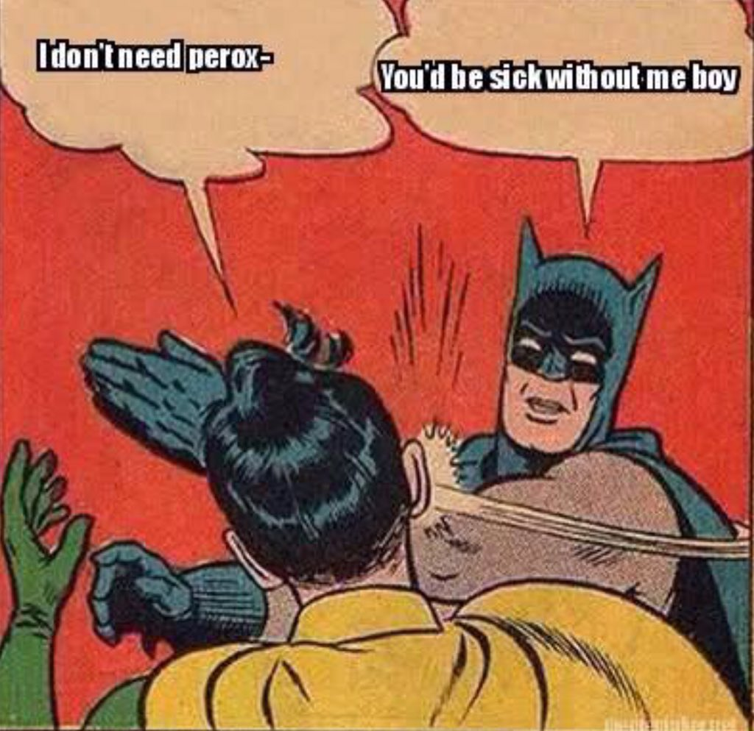
Peroxisomes
Vesicles utilizing O2 to degrade:
VLCFA’s (beta oxidation)
BCFA’s (alpha oxidation)
H2O2 via catalase
Also important in steroid hormone and bile acid synthesis
Structure:
Single membrane bound spherical organelles

Slide 19
Ribosomes
Protein Translation utilizing RNA. (protein synthesis)
rRNA interacts with mRNA, and aminoacyl tRNA to form peptides.
rRNA and protein complexes
Classified by mass in Svedberg units(S)
Large and small subunits
Small : 40S , 30s
Large 60S , 70S
Total 80S, 70S
Notes:
Eukaryotic cells have 80S ribosomes and prokaryotic cells have 70S .
Number given based on behaviour in a centrifuge; so they don’t add like regular numbers.

Slide 20
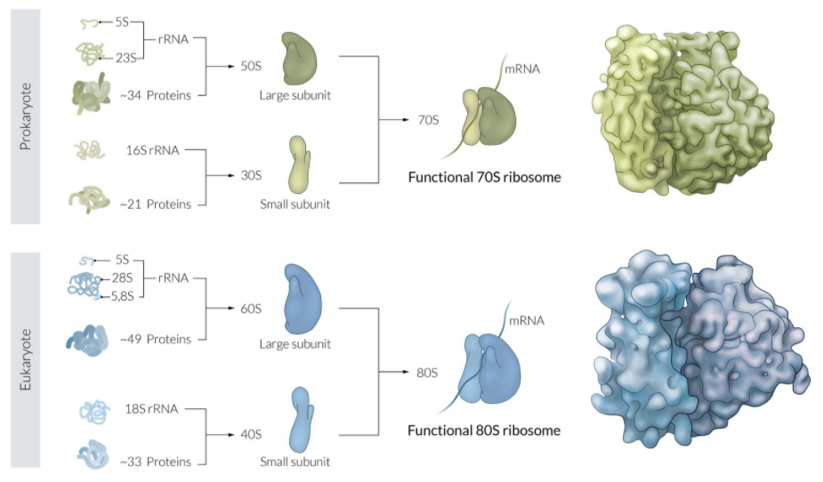

Slide 21
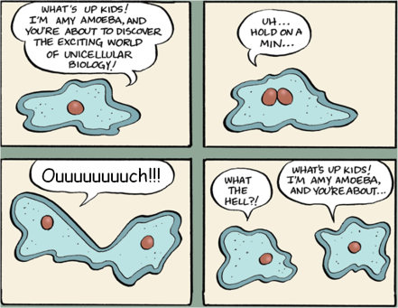
Time to split
An overview of cell division
z

Slide 22
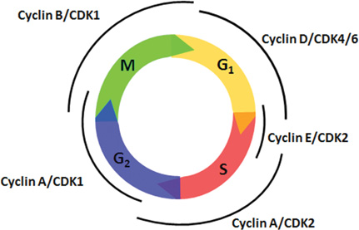
Cell cycle
Events taking place to ensure DNA and cell replication + Cell maturation.
2 main phases
Interphase
G₁, S, G₂ phases
Division
Mitosis or Meiosis

Slide 23
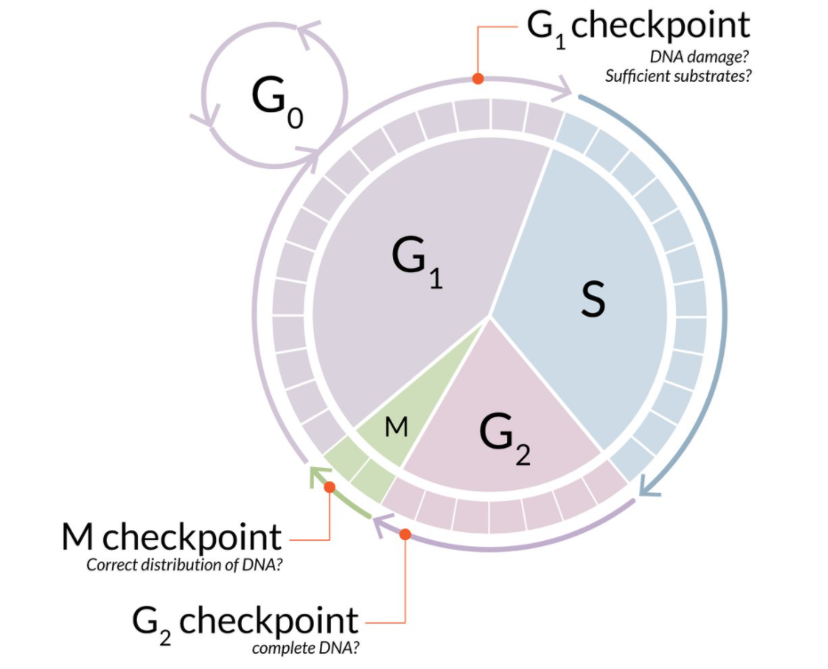

Slide 24
Interphase
G0 is not included in interphase.
G1
RNA, protein and organelle synthesis
Follows mitosis
Repair of individual damaged bases occurs
G1 checkpoint commits cell to division
S
DNA replication
Synthesis of DNA packaging proteins (Histones mainly)
Mismatched base pairs are corrected here
G2
Synthesis of other proteins needed for cell division
Repairs any remaining DNA errors
G2 Checkpoint
Notes:
Repair of individual bases = Nucleotide excision repair
Once cell begins S phase it must complete cell division
Regulatory proteins are called cyclins + Cyclin dependent kinases + Tumor suppressors (P53, Rb)

Slide 25
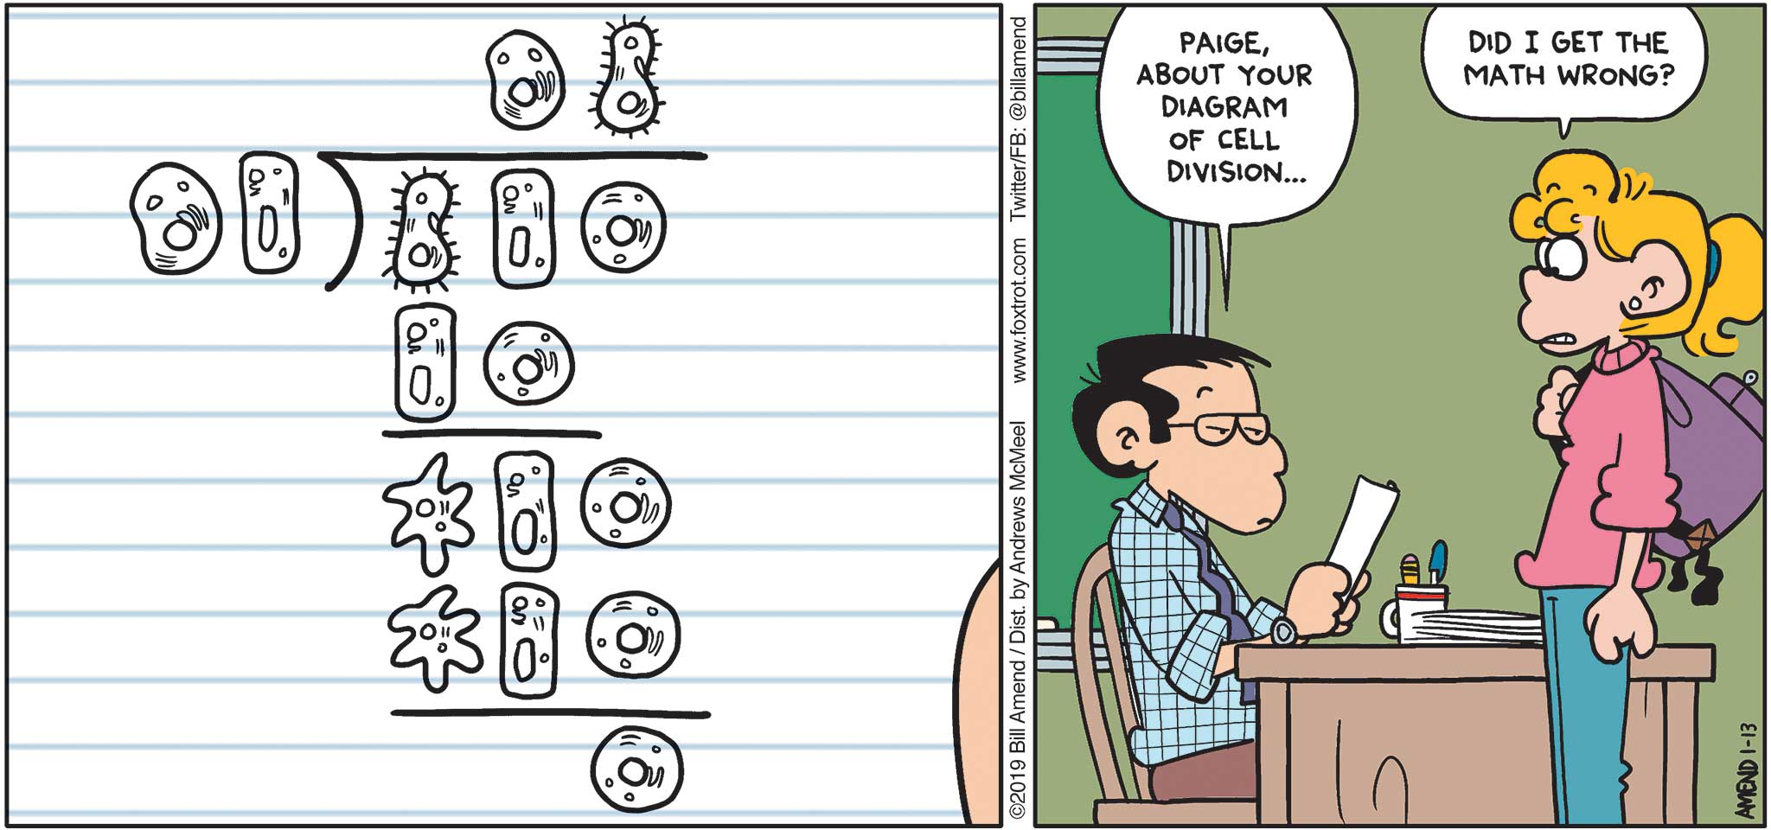
Mitosis
Conservational division
Daughter cells contain the same number of chromosomes as the progenitor cells.
Mitotic index
Ratio of number of cells undergoing mitosis to the total number of cells.
Phases
Prophase
Prometaphase
Metaphase
Anaphase
Telophase
Notes:
High mitotic index seen in cancer cells.
Increasing index = increasing aggression (Tumor Grading)

Slide 26
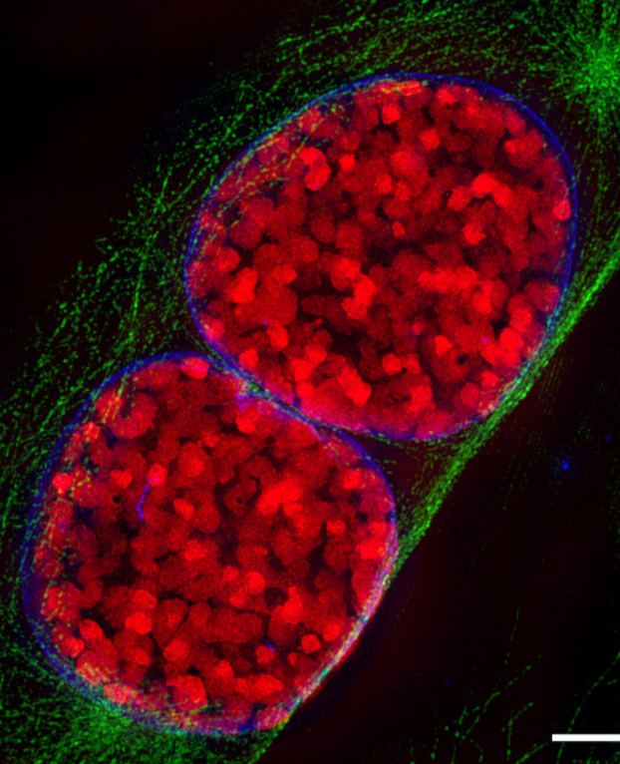
Mitosis (Prophase)
Condensation of chromosomes begins
Centrosomes separate
Mitotic spindle are formed
Prometaphase
Breakdown of nuclear envelope into vesicles
Completion of spindle formation
Notes:
1. Chromosomes exist as sister chromatids joined in the centre by a centromere
2. Centrosomes – centrioles + surrounding matrix. Starting point for mitotic spindle (microtubule based ) which form between the 2 polar centrosomes.

Slide 27
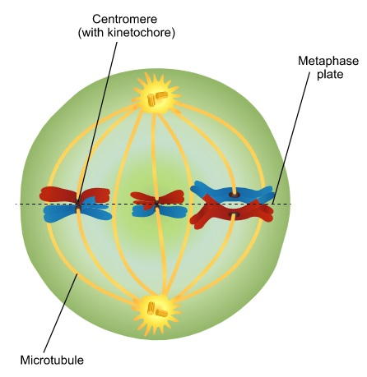
Mitosis (Metaphase)
Chromosomes maximally condensed and align along the equator of the cell.
Notes:
Microtubules (aka kinetochore microtubules) attach to the chromosomes radiating from the centrosome.

Slide 28
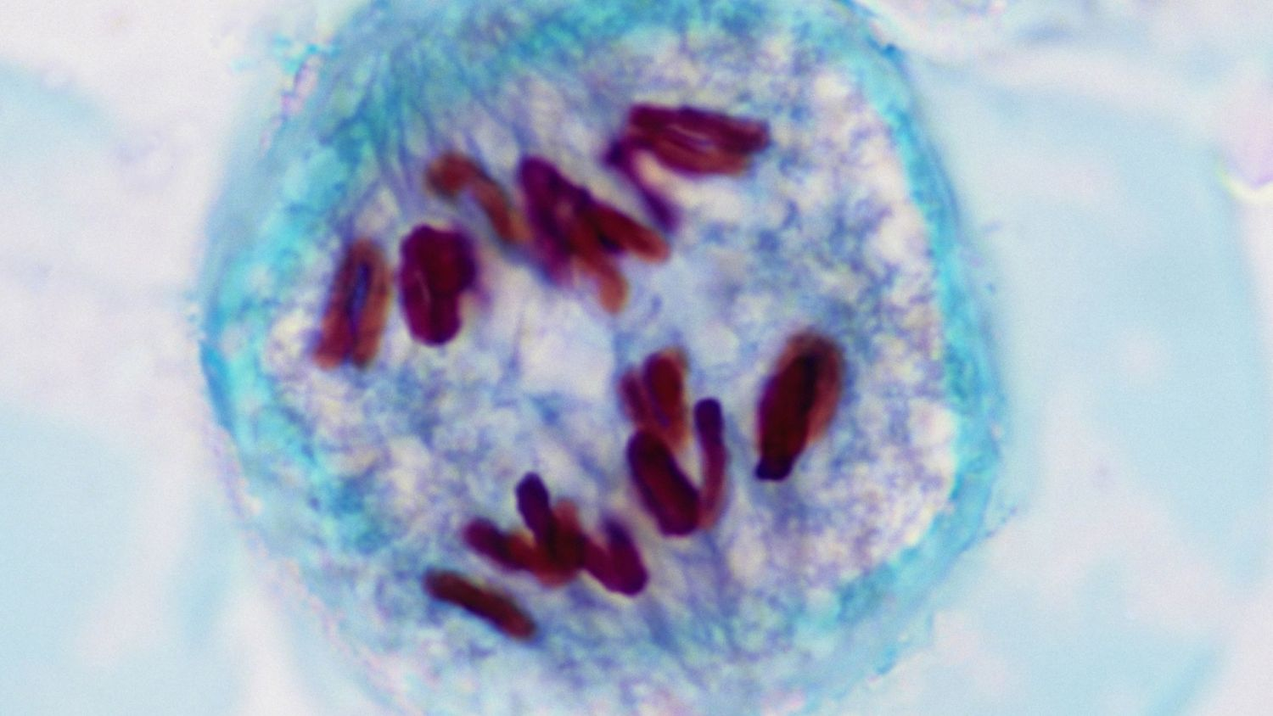
Mitosis (Anaphase)
Separation of sister chromatids due to enzymatic dissolution of the centromere.
Microtubule mediated separation of sister chromatids
Notes:
Kinetochore microtubules – shorten and pull the chromatids apart
Polar microtubules elongate and pushes the poles of the cell apart

Slide 29
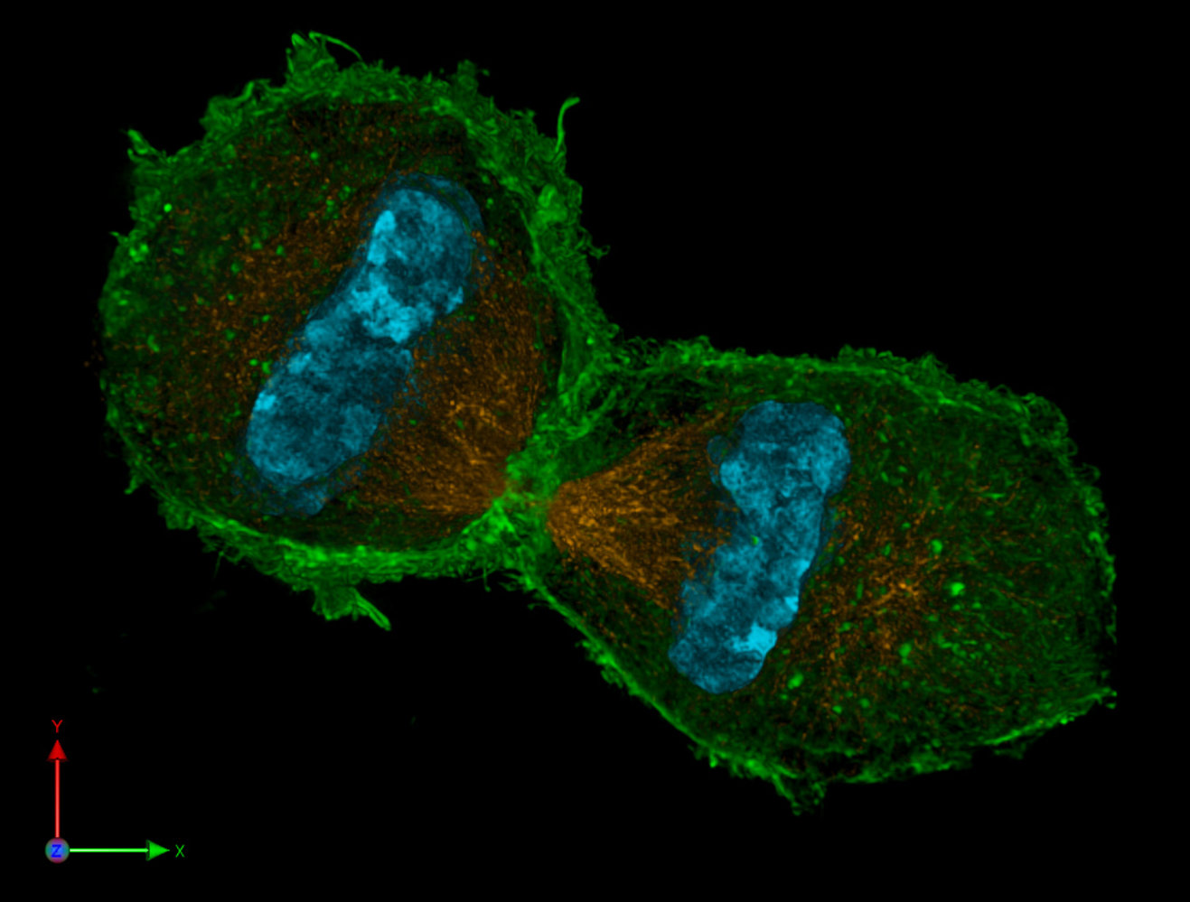
Mitosis (Telophase and Cytokinesis)
Chromosomes de-condense
Spindle disintegrate
Nuclear membranes re-form
Cells divide at the equatorial plane

Slide 30
Mitosis

Slide 31
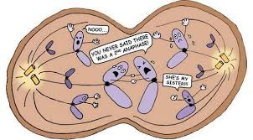
Meiosis
Reductive division
Daughter cells have half the number of chromosomes as the progenitor cells (haploid cells)
Occurs in germ cells
Consists of 2 phases
Meiosis 1 and Meiosis 2
Preceded by interphase and DNA replication
Notes:
Somatic cells are diploid 2n = 46 chromosomes
Sex cells/ Gametes are haploid n = 23 chromosomes

Slide 32
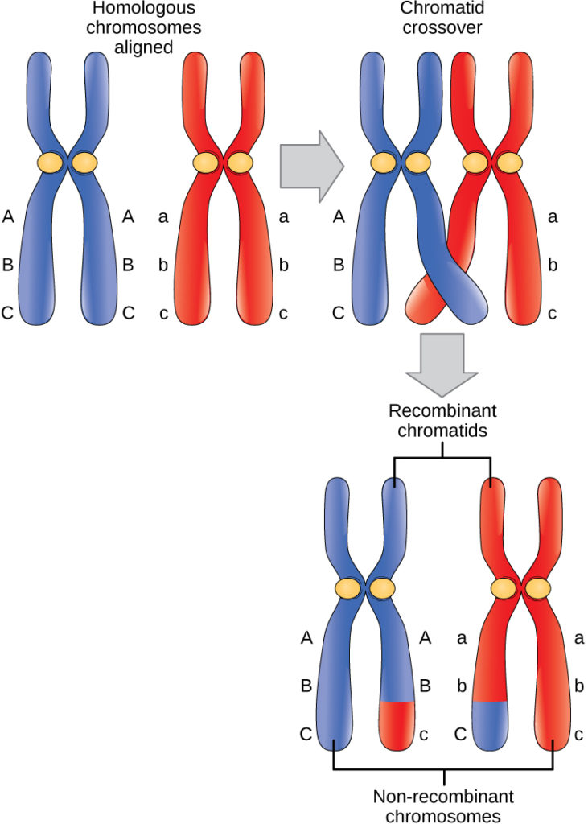
Meiosis I
Homologous chromosomes pair up (synapsis)
Chiasma formation occurs with crossover of genetic information
Homologous chromosomes will go into different daughter cells
2 haploid daughter cells formed
Notes:
1-2 crossovers per chromosome. This increases genetic variability
Chromosomes go randomly into a daughter cell

Slide 33
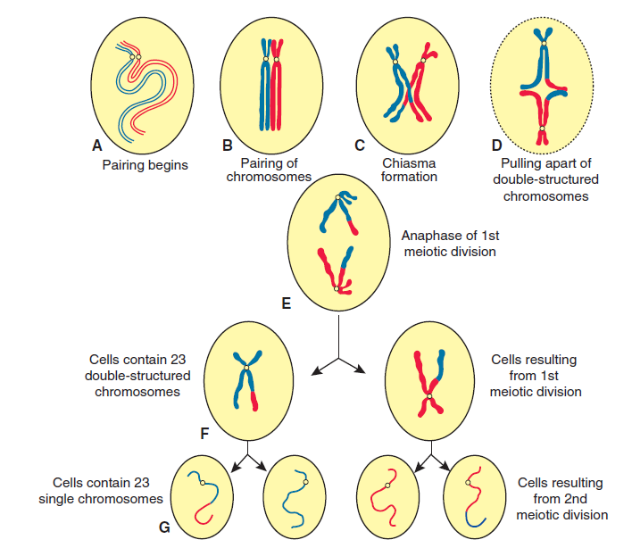
Meiosis II
Sister chromatids separate to form individual chromosomes.
Each haploid cell will then form 2 more haploid cells
Fig 2.4 p 12 Langman’s medical Embryology – Sadler T et al

Slide 34
G₀ phase
Not considered a part of interphase.
Only proliferating cells go through the cell cycle; G₀ considered a rest phase
Specialized cells will carry out their function and will not undergo cell division
Some cells can be stimulated to re-enter the cell cycle from G0
3 cell classifications
Labile – Never enter G₀; constantly replicate
Stable – May re-enter G₁ from G₀
Permanent - Remain in G₀; Stem cells needed for regeneration of tissue
Notes:
Labile – Epithelial cells (mucus membrane, hair, skin), Haematopoietic stem cells , Germ cells
Stable – Hepatocytes, Lymphocytes, Periosteum, PCT cells
Permanent- Cardiac muscle , RBC’s

Slide 35
Half and half on a baby
An overview of gametogenesis
z

Slide 36
Gametogenesis
Gametes are reproductive cells of an organism
Gametogenesis is the process by which these mature gametes are formed from primordial germ cells
Oogenesis
Spermatocytogenesis + Spermiogenesis
Notes:
Primordial germ cells for from the epiblast in the 2nd week of life and migrate to the wall of the yolk sac (4th )before moving to the gonads by approx. week 5 .

Slide 37
Oogenesis
z

Slide 38
Oogenesis
Once the primordial germ cells arrive in the gonad(Ovary) they differentiate into oogonia
3rd month of life:
Mitotic division results in the formation of clusters of cells surrounded by epithelial cells (follicular cells)
Some cells enter meiosis I and arrest at prophase (primary oocyte)
5th month of life:
MAX number of germ cells in the female. Approx. 7 million
7th month of life:
Majority of the germ cells have died. Remaining cells are almost all primary oocytes in prophase I
Most of them are primordial follicles
Notes:
Follicular cells originate from the ovarian epithelium.
No cell will progress past prophase at this point.
After the 5th month numerous oogonia and primary oocytes become atretic and die
Primordial follicles = primary oocyte + Surrounding follicular cells.

Slide 39
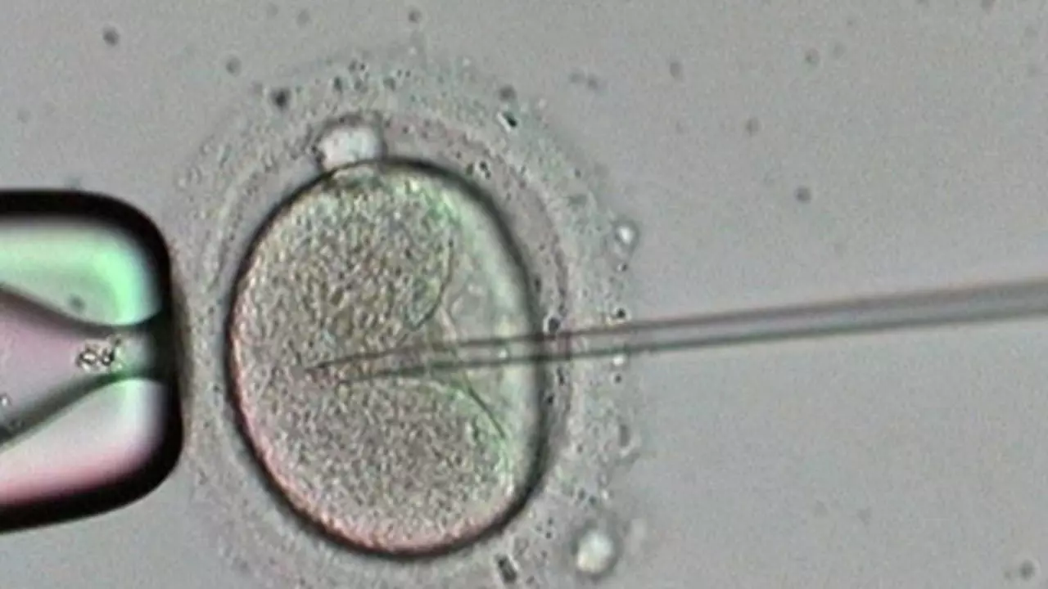
Oogenesis
At Birth:
Approx 700,000 germ cells remain
All primary oocytes should be in the diplotene stage
Meiosis I will not progress until puberty
Oocyte maturation inhibitor maintains the diplotene stage
At puberty :
Approx 40,000 oocytes remain
A pool of growing follicles s formed and replenished from the supply of primordial follicles.
Each month:
15-20 follicles are selected for maturation from the growing pool.
Some die and the others become:
Primary follicles → Antral follicles → Graafian (Mature) follicle
Notes:
Diplotene stage is a prolonged resting phase in prophase I
Primary oocytes are still vulnerable to damage in this stage as evidenced by increasing risk of chromosomal anomalies with increasing maternal age.
OMI secreted by follicular cells

Slide 40
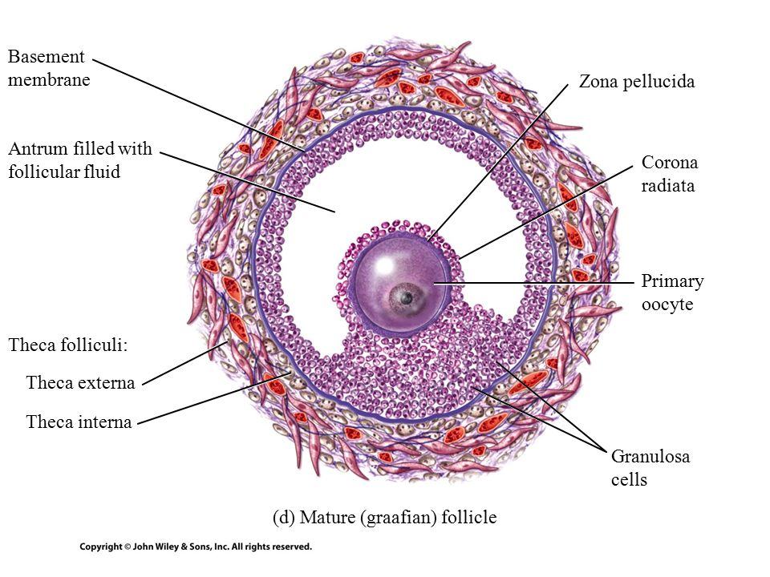
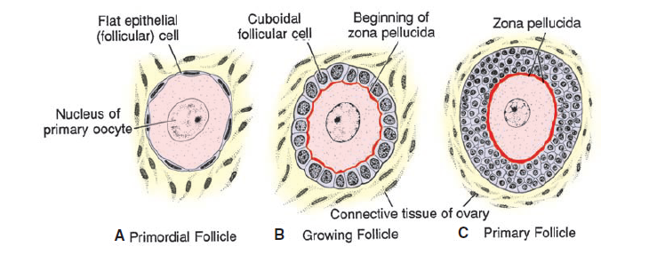
Oogenesis
Notes:
The follicular(now “Granulosa”) cells change from flat to cuboidal and form a stratified layer around the oocyte.
The surrounding basement membrane is call the theca folliculi
The Zona pellucida is a glycoprotein layer secreted by both the oocyte and the granulosa cells.
The theca folliculi organises as the follicle grows. It forms:
Interna : Layer of secretory cells
Externa : Fibrous capsule
As the cell develops , fluid filled vacuolar spaces develop between the granuolsa cells and coalesce to form the antum.
Antral follicule = Vesicular follicle
Cumulus oophorus formed by granulosa cells directly surrounding the oocyte

Slide 41
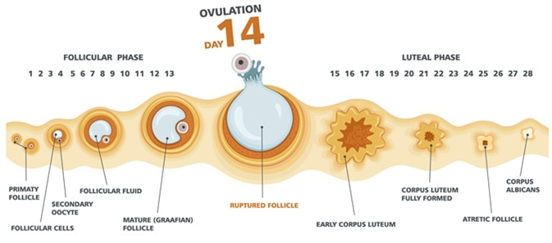
Oogenesis
With each menstrual cycle, numerous follicles but only one will reach full maturity*
When the follicle is mature it induces a surge of Leuteinizing Hormone (LH) which induces:
Preovulatory growth phase
Ovulation
Notes:
In normal circumstances

Slide 42
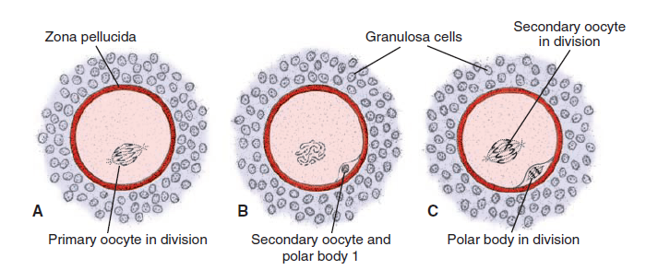
Oogenesis
Preovulatory growth phase:
Meiosis 1 is completed to form the Secondary Oocyte and the 1st polar body
Cell then arrests in Metaphase 2 until fertilization
If no fertilization occurs, the oocyte will degenerate 24h post ovulation.
Notes:
Both the oocyte and polar body are haploid
The polar body receives almost no cytoplasm.
Arrests in metaphase approx. 3 hours before ovulation

Slide 43
Spermatogenesis
z

Slide 44
Spermatogenesis
Process by which spermatogonia are transformed into spermatozoa.
Begins at puberty
At birth:
Germ cells are found in the sex cords surrounded by supporting cells (from the surrounding epithelium) which become Sustentacular (Sertoli) cells
Notes:
2 parts
Spermatocytogenesis
Spermiogenesis
PGC’s originate similarly to the females.

Slide 45
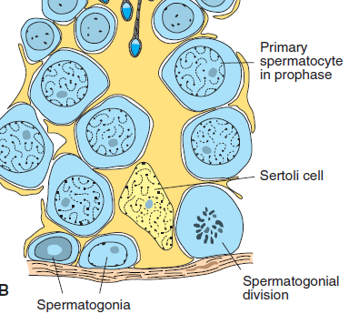
Spermatogenesis
Initiation
LH from the pituitary binds to Leydig cells
Leydig cells release testosterone
Testosterone is taken up by the Sertoli cells and spermatogenesis is promoted.
Puberty:
Before puberty the sex cords develop into the seminiferous tubules.
The PGC’s form spermatogonial stem cells which then give rise to type A spermatogonia.
These form type B spermatogonia after several mitotic divisions
These then go on to divide and form primary spermatocytes.
Notes:
FSH also important in development. (Causes Sertoli cells to secrete testicular fluid and synthesise androgen receptors)
They become tubes by developing a lumen.
Production of type A spermatogonia marks the start of spermatogenesis
Cross section of sex cord

Slide 46
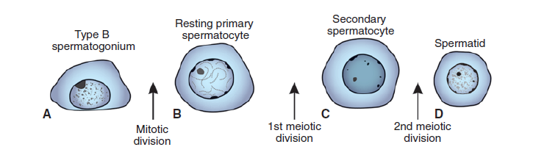
Spermatogenesis
Primary spermatocytes enter a prolonged prophase (~22 days)
Followed by completion of meiosis I to form Secondary Spermatocytes which enter meiosis II.
These then form spermatids.
Up to this point Cytokinesis is incomplete
Notes:
Spertmatogonia to spermatids are embedded in the Sertoli cells.

Slide 47
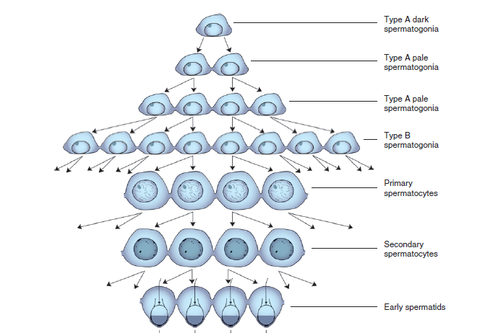

Slide 48
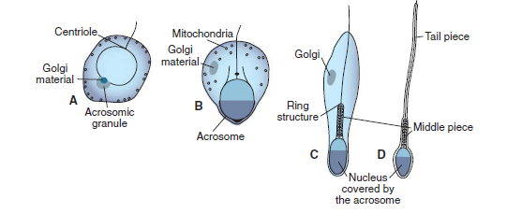
Spermatogenesis
Spermiogeneis
Development of mature,motile spermatozoa from spermatids
Steps
Acrosome formation
Nuclear condensation
Formation of the neck, middle piece and tail
Shedding of residual bodies
Notes:
Acrosome contains hydrolytic enzymes to aid egg penetraton; covers half the nucleus.
Once formed they enter the lumen of the seminiferous tubules and are pushed to the epididymis. (En route they attain full motility)

Slide 49
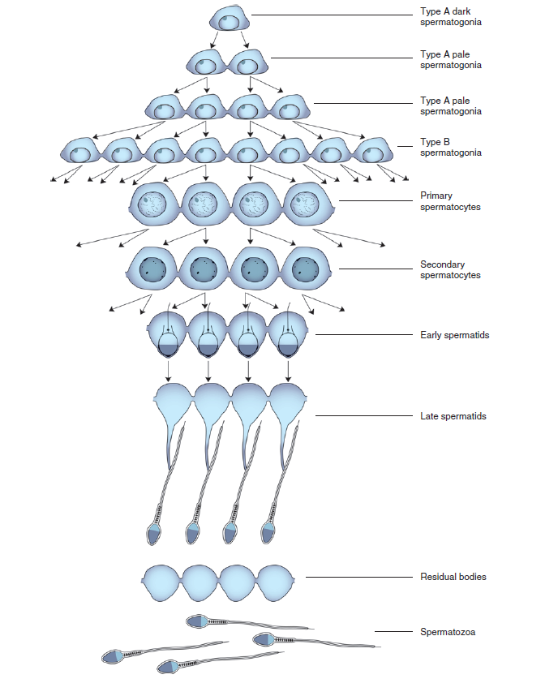
Spermatogenesis

Slide 50
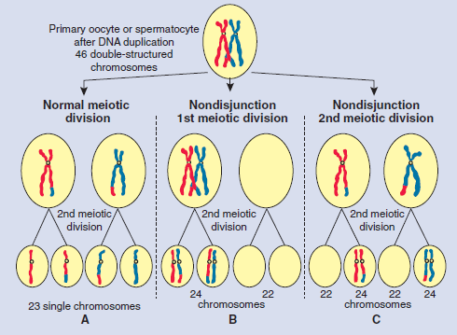
Clinical Correlates
Chromosomal anomalies account for 50% of spontaneous abortions and 10 % of major birth defects.
Numerical anomalies
Mosaicism (non disjunction in mitosis)
Euploidy
Aneuploidy
Sex chromosome
Turner syndrome – 45 XO
Kleinfelter – 47 XXY or 48 XXXY
Autosomes
Trisomy 21 (Down syndrome)
Trisomy 18 (Edward syndrome)
Trisomy 13 (patau syndrome)
Structural anomalies
Microdeletions
15q
(M)Angelmans , (P) Prader wili
Fragile sites
Fragile X syndrome
Notes:
Estimated that 50% of pregnancies end in spontaneous abortions
Turner syndrome is a monosomy, and the most common abnormality in abortuses.
Fragile x – CGG islands
Robertsonian Translocations(balanced vs unbalanced)

Slide 51
References
Langman's Medical Embryology. 12th ed. Philadelphia: Wolters Kluwer Health/Lippincott Williams & Wilkins, 2012
“The cell” https://next.amboss.com/us/article/Lo0wcS#Z0b2dbba84cd425084862e30873efee1a
“The cell cycle” https://next.amboss.com/us/article/Mo0McS#Z8df00e166ee4f3f06d0d108c2ab91db6

