Slide 1
BIT Review Session 3
By Dominic Tam

Slide 2
The Cubital Fossa

Slide 3
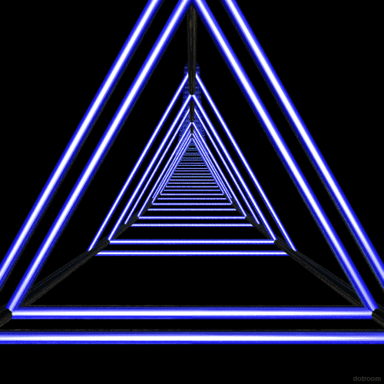
Cube?

Slide 4
The Cubital Fossa
“Cubitus” - Elbow
Triangular Space on anterior elbow

Slide 5
The Cubital Fossa
Laterally – medial border of Brachioradialis
Medially – lateral border of pronator teres
Superiorly – imaginary line between the medial & lateral epicondyles
Inferiorly – division of brachial artery into radial & ulnar arteries

Slide 6
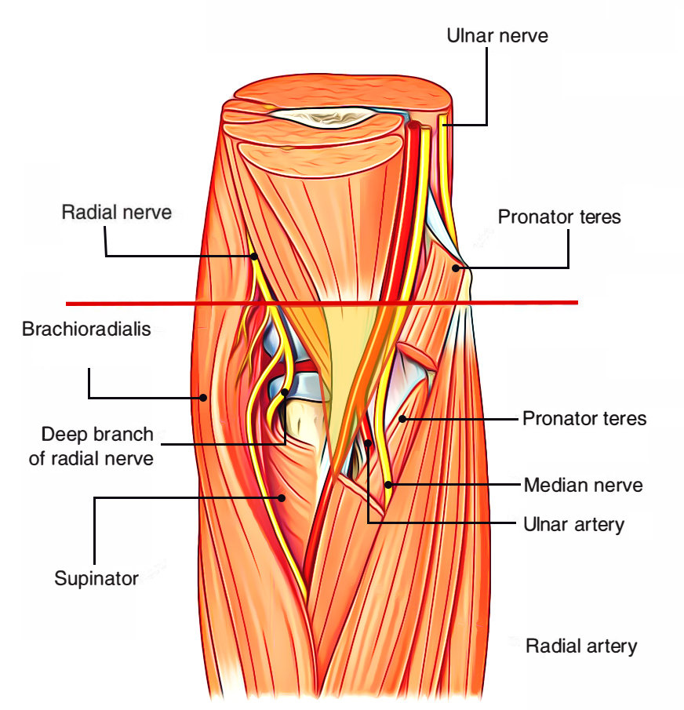
The Cubital Fossa
Floor
Brachialis
Supinator
Roof
Bicipital aponeurosis
Median cubital vein

Slide 7
The Cubital Fossa
Contents (lateral to medial)
Radial nerve
Biceps tendon
Brachial artery
Median nerve
Also are the epitrochlear lymph nodes

Slide 8
Question #1
Which structure does not pass through the cubital fossa?
Ulnar nerve
Radial Nerve
Median Nerve
Brachial Artery

Slide 9
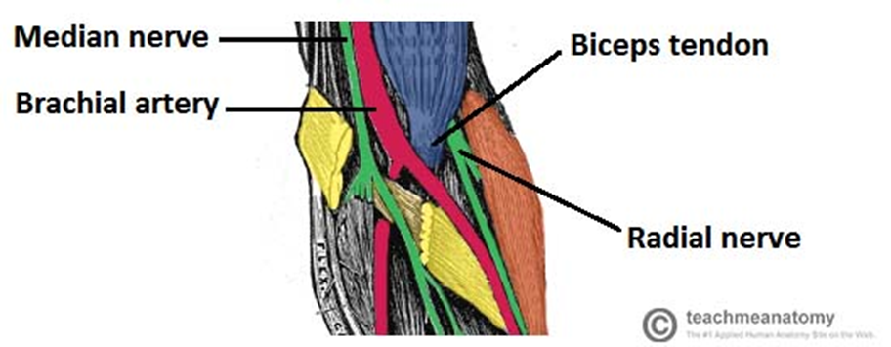
Question #1
Which structure does not pass through the cubital fossa?
Ulnar nerve
Radial Nerve
Median Nerve
Brachial Artery

Slide 10
Question #2
What forms the lateral border of the cubital fossa?
Medial border of brachioradialis
Lateral border of brachioradialis
Medial border of pronator teres
Lateral border of pronator teres

Slide 11
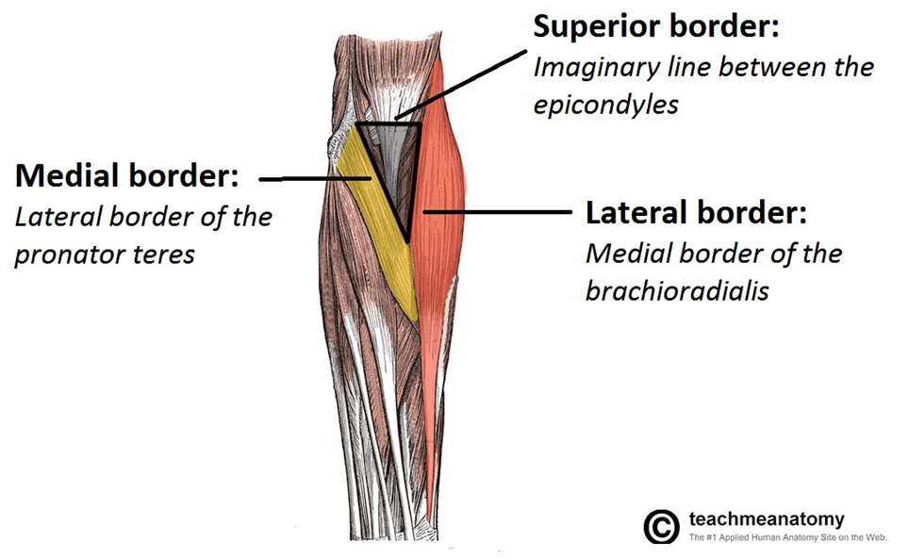
Question #2
What forms the lateral border of the cubital fossa?
Medial border of brachioradialis
Lateral border of brachioradialis
Medial border of pronator teres
Lateral border of pronator teres

Slide 12
Question #3
What structure(s) helps form the roof of the cubital fossa?
Median Cubital Vein
Tricepital Aponeurosis
Bicepital Aponeurosis
Supinator muscle

Slide 13
Question #3
What structure(s) helps form the roof of the cubital fossa?
Median Cubital Vein
Tricepital Aponeurosis
Bicepital Aponeurosis
Supinator muscle

Slide 14
Question #4
What structure is the most lateral relation of the median nerve in the cubital fossa?
Brachial Artery
Biceps tendon
Radial Nerve
Ulnar Nerve

Slide 15
Question #4
What structure is the most lateral relation of the median nerve in the cubital fossa?
Brachial Artery
Biceps tendon
Radial Nerve
Ulnar Nerve

Slide 16
Muscles of Forearm

Slide 17
Muscles of the Forearm
Made up of:
Flexors (anterior) compartment (median & ulnar nerves)
Extensor (posterior) compartment (radial nerve)
Move the forearm and the wrist

Slide 18
Superficial Flexors of the Forearm
Pronator teres
Flexor carpi radialis
Palmaris longus
Flexor carpi ulnaris
Flexor digitorum superficialis

Slide 19
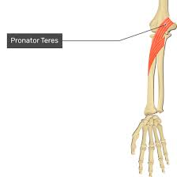
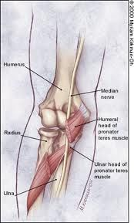
Pronator Teres
Origin | Insertion | Nerve Supply
Common origin (common tendon from medial epicondyle) Lower part of medial supracondylar ridge Deep Head Medial border of coronoid process of ulna & tubercle just distal to it | Middle of lateral surface of shaft of the radius | 1st muscular branch of median nerve (C6,7)
Median nerve lies between the two heads
Ulnar artery lies deep to deep head

Slide 20
Flexor Carpi Radialis
Origin | Insertion | Nerve Supply
Common origin | Base of 2nd & 3rd metacarpals | Median nerve (C6,7)

Slide 21
Flexor digitorum superficialis
Origin | Insertion | Nerve Supply
-Common origin -Medial ligament of elbow joint -Tubercle on medial border of coronoid process | Middle phalanges | Median nerve (C7,8)

Slide 22
Palmaris longus
Origin | Insertion | Nerve Supply
Common origin | Palmar aponeurosis | Median Nerve (C7,8)

Slide 23
Flexor Carpi Ulnaris
Origin | Insertion | Nerve Supply
Common origin Aponeurosis extending from medial border of olecranon Upper 2/3 of subcutaneous border of ulna | Pisiform Hamate and 5th metacarpal (via the pisohamate & pisometacarpal ligaments) | Ulnar nerve (C7,8)

Slide 24
Question #1
How many flexors in the anterior compartment of the forearm are there?
5
6
7
8

Slide 25
Question #1
How many flexors in the anterior compartment of the forearm are there?
5
6
7
8

Slide 26
Question #2
True or False?
The Biceps Brachii flexes the forearm

Slide 27
Question #2
True or False?
The Biceps Brachii flexes the forearm
True

Slide 28
Deep flexors of the forearm
Flexor digitorum profundus
Flexor pollicis longus
Pronator quadratus

Slide 29
Flexor Digitorum Profundus
Origin | Insertion | Nerve Supply
Medial surface of olecranon Upper ¾ of anterior & medial surfaces of ulna Ulna subcutaneous borders Interosseous membrane | Distal phalanges | Median nerve (anterior interosseous branch) & ulna nerve (C8,T1)

Slide 30
Flexor Pollicis Longus
Origin | Insertion | Nerve Supply
-Anterior surface of radius (below the anterior oblique line, but above the attachment of pronator quadratus) -Interosseous membrane | Base of distal phalanx of thumb | Anterior interosseous branch of median nerve (C7,8)

Slide 31
Pronator Quadratus
Origin | Insertion | Nerve Supply
(Ridge on the anteromedial aspect of) distal ulna | Anterior surface of lower ¼ of radius Triangular area above ulnar notch | Anterior interosseous branch of median nerve (C7,8)

Slide 32
Question
What muscle(s )of the forearm is/are highlighted here?
Pronator Quadratus
2) What other deep flexors of the forearm are missing?
FDP & FPL
3) What is the nerve supply of the muscle?
Anterior interosseous branch of median nerve (C7,8)
4) What is its action?
Pronation of wrist

Slide 33
Extensor superficial compartment
Brachioradialis
Extensor carpi radialis longus
Extensor carpi radialis brevis
Extensor digitorum
Extensor digiti minimi
Extensor carpi ulnaris
Anconeus

Slide 34
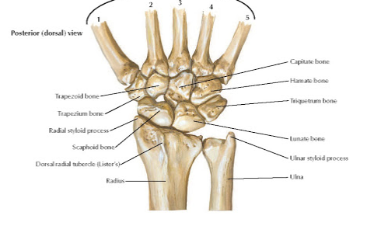
Brachioradialis
Origin | Insertion | Nerve Supply
Upper 2/3 of lateral supracondylar ridge | Base of radial styloid | Radial Nerve (C5,6)

Slide 35
Extensor Carpi Radialis Longus
Origin | Insertion | Nerve Supply
Lower 1/3 of lateral supracondylar ridge of humerus | Base of 2nd metacarpal | Radial Nerve (C6,7)

Slide 36
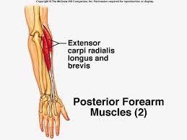
Extensor Carpi Radialis Brevis
Origin | Insertion | Nerve Supply
Common extensor origin (tendon from the lateral epicondyle) | Base of 3rd metacarpal | Posterior interossous nerve

Slide 37
Extensor Digitorum
Origin | Insertion | Nerve Supply
Common extensor origin | Dorsal base of middle and distal phalanges | Posterior interosseous nerve (C7,8)

Slide 38
Extensor Digiti Minimi
Origin | Insertion | Nerve Supply
Common extensor origin | Middle and distal phalanges of the little finger | Posterior interosseous nerve (C7,8)

Slide 39
Extensor Carpi Ulnaris
Origin | Insertion | Nerve Supply
Common extensor origin Aponeurotic sheet from SC border of ulna | Base of 5th metacarpal | Posterior interosseous nerve (C7,8)

Slide 40
Anconeus
Origin | Insertion | Nerve Supply
Posterior surface of lateral epicondyle | Lateral side of olecranon Adjacent shaft of ulna | Radial nerve (C7,8)

Slide 41
Identify the pinned structures
Brachioradialis
ECRB
ED
ECRL
ECU
ED minimi

Slide 42
Extensor deep compartment
Abductor pollicis longus
Extensor pollicis longus
Extensor pollicis brevis
Extensor indicis
Supinator

Slide 43
Abductor Pollicis Longus
Origin | Insertion | Nerve Supply
Posterior surface of radius and ulna Interosseous membrane between | Base of 1st metacarpal Trapezium | Posterior interosseous nerve (C7,8)

Slide 44
Extensor Pollicis Longus
Origin | Insertion | Nerve Supply
Just distal to origin of abductor pollicis longus | Base of distal phalanx of thumb | Posterior interosseous nerve (C7,8)

Slide 45
Extensor Pollicis Brevis
Origin | Insertion | Nerve Supply
Just below abductor pollicis longus origin on radius Adjacent interossoues membrane | Base of proximal phalanx of 1st digit | Posterior interossoues nerve (C7,8)

Slide 46
Extensor Indicis
Origin | Insertion | Nerve Supply
From the ulna, just distal to origin of EPL | Extensor expansion of index finger | Posterior interossoues nerve (C7,8)

Slide 47
Supinator
Origin | Insertion | Nerve Supply
Distal border of lateral epicondyle Lateral ligament of elbow joint Annular ligament of radius Supinator crest of the ulna, and the fossa just in front of it | Lateral surface of the radius | Posterior interossoues nerve (C6,7)

Slide 48
Identify the pinned structures and their nerve supply
Supinator
APL
EPB
EPL
EI

Slide 49
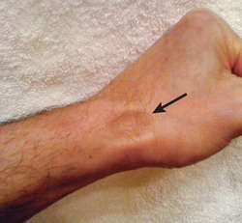
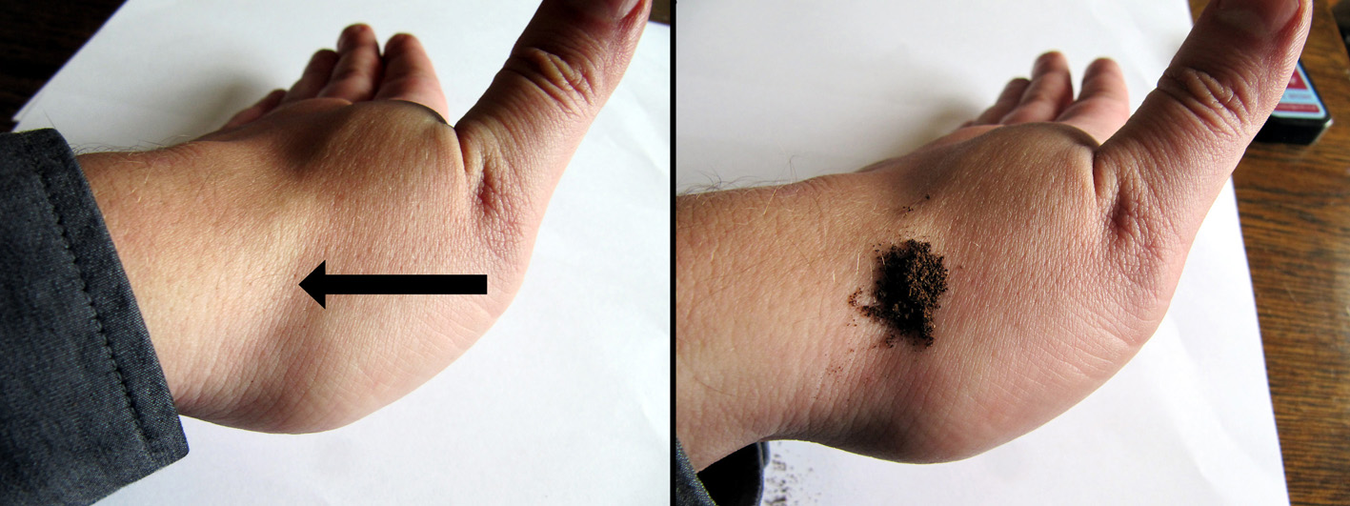
The anatomical snuffbox
A triangular groove on radial aspect of dorsal wrist

Slide 50
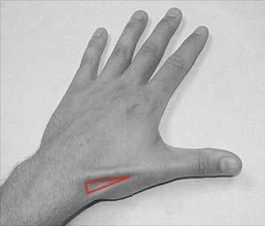
The anatomical snuffbox
Boundaries:
Lateral – APL, EPB
Medial – EPL
Proximal – styloid process of radius
Floor – carpal bones (scaphoid & triquetrum)
Roof - skin

Slide 51
The anatomical snuffbox
Contents:
Branch of radial artery
Branch of radial nerve
Proximal end of Cephalic vein
Scaphoid & Trapezium

Slide 52
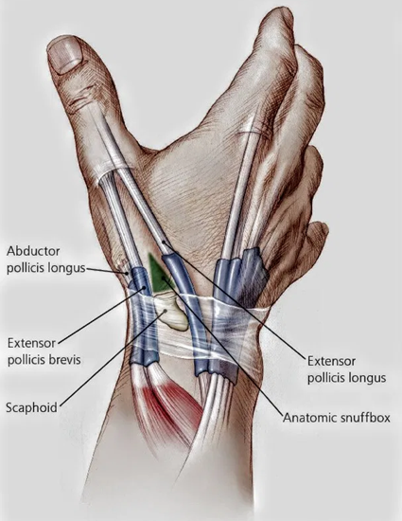
What is the medial boundary of the anatomical snuffbox?
APL
EPB
EPL
APB

Slide 53
What is the medial boundary of the anatomical snuffbox?
APL
EPB
EPL
APB

Slide 54
Muscles of hand

Slide 55
Thenar muscles of hand
Abductor pollicis brevis
Opponens pollicis
Flexor pollicis brevis
Adductor pollicis

Slide 56
Abductor Pollicis Brevis
Origin | Insertion | Nerve Supply
Flexor retinaculum Tubercles of scaphoid & trapezium | (radial side of) base of the proximal phalanx Tendon of extensor pollicis longus | Muscular (recurrent) branch of median nerve

Slide 57
Opponens Pollicis
Origin | Insertion | Nerve Supply
-flexor retinaculum - trapezium | Radial border of 1st metacarpal | Muscular (recurrent) branch of median nerve

Slide 58
Flexor Pollicis Brevis
Origin | Insertion | Nerve Supply
Superficial head Flexor retinaculum & trapezium Deep head - Trapezoid & capitate | Radial sesamoid of thumb (radial side of) base of proximal phalanx | - Muscular (recurrent) branch of median nerve - Deep branch of ulnar nerve

Slide 59
Adductor Pollicis
Origin | Insertion | Nerve Supply
- Capitate - Base of 2nd & 3rd metacarpals | Ulnar sesamoid bone (1st proximal phalanx) | Deep Branch of Ulnar nerve

Slide 60
Question
Which thenar muscle does not attach to the flexor retinaculum?
Abductor pollicis brevis
Opponens pollicis
Flexor pollicis brevis
Adductor pollicis

Slide 61
Question
Which thenar muscle does not attach to the flexor retinaculum?
Abductor pollicis brevis
Opponens pollicis
Flexor pollicis brevis
Adductor pollicis

Slide 62
Hypothenar muscles
Abductor digiti minimi
Flexor digiti minimi brevis
Opponens digiti minimi
Palmaris brevis

Slide 63
Abductor Digiti Minimi
Origin | Insertion | Nerve Supply
Pisiform (tendon of) flexor carpi ulnaris | (ulnar side of) base of proximal phalanx Extensor expansion | (Deep branch of) ulnar nerve

Slide 64
Flexor digiti minimi brevis
Origin | Insertion | Nerve Supply
Flexor retinaculum Hook of hamate | (ulnar side of) base of proximal phalanx | Deep branch of ulnar nerve (T1)

Slide 65
Opponens Digiti Minimi Brevis
Origin | Insertion | Nerve Supply
Flexor retinaculum Hook of hamate | (ulnar border of) 5th metacarpal | Deep branch of ulnar nerve (T1)

Slide 66
Palmaris Brevis
Origin | Insertion | Nerve Supply
Flexor retinaculum Palmar aponeurosis | Skin of hypothenar eminence | Ulnar nerve

Slide 67
The lumbricals (‘worms’)
Origin | Insertion | Nerve Supply
The 4 deep tendons | Extensor expansions on dorsum of proximal phalanges | 2 ulnar lumbricals by ulnar nerve 2 radial lumbricals by median nerve

Slide 68
The Palmar Interossei PAD-DAB
Origin | Insertion | Nerve Supply
Metacarpal bones 2,4,5 | Extensor Apparatus of 2,4,5 | Ulnar Nerve

Slide 69
The dorsal interossei
Origin | Insertion | Nerve Supply
Metacarpal bones 1-5 | Extensor apparatus of digits 2-5 | Ulnar Nerve

Slide 70
Identify the tagged structures
APB
Abductor digiti minimi
FPB
FDMB

Slide 71
Identify the tagged structures
Opponens Pollicis
Opponens Digiti Minimi
Flexor Pollicis Longus
Lumbrical
Flexor Digitorum Profundus

Slide 72
Identify the tagged structure
Adductor Pollicis

Slide 73
Important fascia and retinacula of hand
Flexor retinaculum
Extensor retinaculum
Palmar aponeurosis
Carpal tunnel
Ulnar canal

Slide 74
Flexor Retinaculum
aka the transverse carpal ligament
Medially:
Pisiform
Hook of hamate
Laterally:
Scaphoid
Trapezium
Superficial Structures:
Ulnar nerve, ulnar artery, palmar branch of ulnar nerve, palmaris longus tendon, palmar cutaneous branch of median nerve

Slide 75
Extensor Retinaculum
aka the dorsal carpal ligament
Medially:
Pisiform
Triquetrum
Laterally:
Distal radius
Superficial structures:
- Superficial branch of the radial nerve

Slide 76
Palmar Aponeurosis
Triangular thickening
Apex: palmaris longus tendon
Base: 4 slips that insert into the skin overlying the MCP joints
Significant in Dupuytren contracture

Slide 77
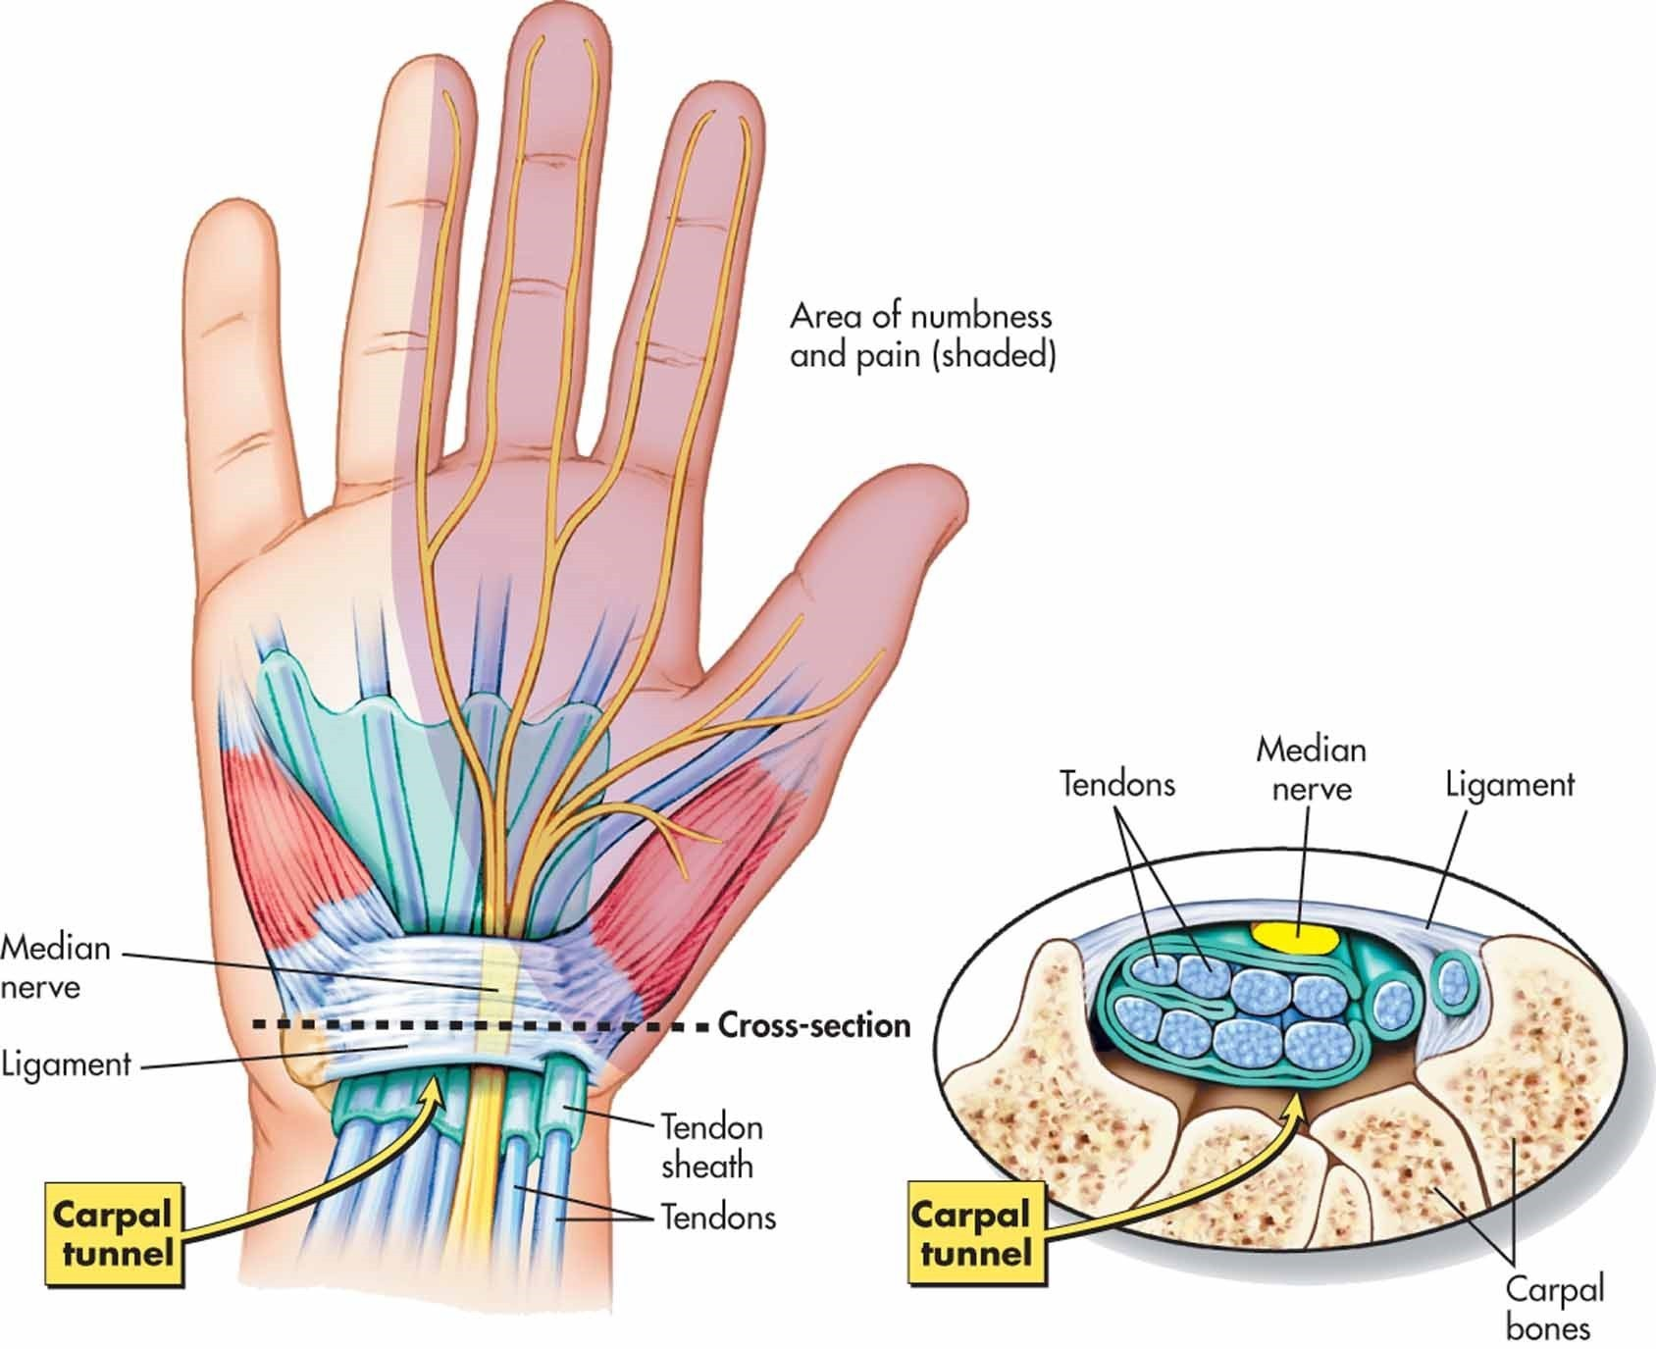
Carpal Tunnel
Contents:
Median nerve
Flexor pollicis longus tendon
4 tendons of flexor digitorum profundus
4 tendons of flexor digitorum superficialis
Clinical significance: Medial nerve compression

Slide 78
Ulnar Canal
Roof: palmar carpal ligament
Floor: flexor retinaculum & hypothenar muscles
Medial: pisiform
Laterally: hook of hamate
Contents:
Ulnar nerve
Ulnar artery
Clinical significance:
Ulnar nerve compression (Guyon Canal Syndrome)

Slide 79
Identify the structure
Flexor Retinaculum
Palmar Aponeurosis

Slide 80
Vasculature of the Upper Limb

Slide 81
Arteries

Slide 82
The Heart
Gives off the aorta:
Parts of the Aorta:
Ascending aorta
Arch of the Aorta
Descending (Thoracic) Aorta

Slide 83
Aortic Arch
The Aortic Arch gives off:
The brachiocephalic trunk (right side)
The left common Carotid
The left subclavian Artery
Theses supply the head & upper extremities

Slide 84
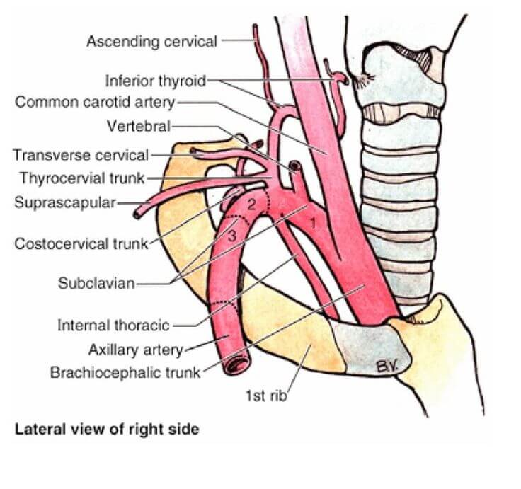
The Subclavian Artery
VIT C&D – named in relation to scalenus anterior (medial, posterior & lateral)
1st – Verterbral artery, Internal Thoracic Artery, Thyrocervical trunk
Thyrocervical trunk gives off the inferior thyroid, superficial cervical & suprascapular ateries
2nd – Costocervical trunk – superior intercostal & deep cervical artery
^{3rd – Dorsal Scapular Artery}
Notes:
Dorsal scapula artery supplies the levator scapulae, rhomboids and trapezius

Slide 85
Axillary Artery
S – Superior Thoracic Artery – From 1st Part
Supplies muscles of the thoracic wall
A – Acromio-thoracic artery – From 2nd Part
Gives off 4 Branches (Clavicular, Acromial, Pectoral, Deltoid)
L – Lateral thoracic artery – From 2nd Part
Gives off a lateral mammary in females
S - Subscapular artery – From 3rd Part
Further gives off the circumflex artery
A – Anterior circumflex humeral artery – From 3rd Part
P – Posterior circumflex humeral artery – From 3rd Part (LARGER!)
Both supply the shoulder joint
Notes:
Superior thoracic artery – supplies subclavius, (superior part of) serratus anterior, parts of pec major and minor
Thoracoacromial artery – pec major & minor, deltoid, clavipectoral fascia
Lateral Thoracic artery – breast, pec major & minor, subscapularis, serratus anterior
Subscapular artery – subscapularis, supraspinatus & infraspinatus, latissimus dorsi, serratus anterior

Slide 86
Brachial Artery
Begins at lower border of teres major
Gives off the profunda Brachii just inferiorly
Gives of radial collateral and middle collateral arteries
Brachial Artery gives off superior and inferior ulnar collaterals, then gives of radial and ulnar arteries (in the cubital fossa), below bicipital aponeurosis
Notes:
Profunda Brachii – triceps & nutrient artery to the humerus, given off just inferior to lower border of teres major
Brachial Artery – supplies muscles of the arm

Slide 87
Elbow Anastomosis

Slide 88
The Ulnar Artery
Begins inferiorly to the cubital fossa
Medial terminal branch of brachial artery
Supplies:
Elbow joint
Medial forearm muscles
Medial carpal bones
Medial three fingers
Median & ulnar nerves
Notes:
Branches:
Anterior and posterior ulnar recurrent arteries
Common interosseous artery – anterior and posterior interosseous arteries
Palmar and dorsal carpal branches
Terminal superficial and deep branches to the superficial and deep palmar arches

Slide 89
The radial Artery
Begins inferiorly to the cubital fossa
Is the lateral terminal branch of the brachial artery
Supplies:
Elbow
Lateral forearm muscles
Lateral carpal bones
Thumb & index finger
Radial nerve
Notes:
Branches:
Radial recurrecnt artery
Palmar carpal branch
Superficial and deep palmar arches

Slide 90
The Superficial Palmar Arch
Formed by:
Main – distal ulnar artery
And the superficial palmar branch of radial artery
Gives off three palmar metacarpal arteries

Slide 91
The Deep Palmar arch
Formed by:
Main – distal radial artery
And ulnar artery (deep palmar branch)
Gives off 3 palmar metacarpal arteries
Anastomoses with the superficial palamar arch via the common palmar digital arteries

Slide 92
Let’s trace the Arterial Supply of the Right Upper Limb
3 Parts of Aorta
Aortic Arch
Brachiocephalic Trunk
Right Subclavian
VIT CD
Profunda Brachii
Radial & Ulnar Arteries
Brachial Artery
SALSAP
Axillary Artery
Elbow Anastomosis
Superficial Palmar Arch
Deep Palmar Arch

Slide 93
Venous Drainage

Slide 94
The superficial veins
Cephalic vein
Basilic vein
Median antecubital vein

Slide 95
Cephalic vein
Originates of the radial side of the dorsal venous network at anatomical snuffbox
Lies on the lateral arm
Drain the palm, lateral forearm and arm
Drains into the axillary vein at the deltopectoral groove

Slide 96
Basilic Vein
Originates at the ulnar side of dorsal venous arch of the hand
Runs on the medial side
Joins the brachial vein at the outer border of teres major forming the axillary vein
Drains the palm, medial forearm and medial arm

Slide 97
Median antebrachial vein
Originates on the palmar venous network of the hand
Runs and drains into the median cubital vein
Drains the superficial structures of ventral mid-forearm and wrist

Slide 98
The deep veins
Each artery has an accompanying vein (venae commitantes)
Ie a radial and ulnar vein
These unite at the elbow to form the brachial vein
They communicate with the superficial veins via perforator veins

Slide 99
Brachial Vein
This vein accompanies the brachial artery
Becomes the axillary vein at the outer border of teres major

Slide 100
The axillary vein
Drains the upper limb, the axilla and lateral chest wall
Becomes the subclavian vein at the outer border of 1st rib

Slide 101
Subclavian Vein
Ultimately, will drain blood from the arms
Runs anteriorly to the anterior scalene
Ends at the venous angle forming the brachiocephalic vein, with the internal jugular

Slide 102
Brachiocephalic Vein
The right and left brachiocephalic vein becomes the superior vena cava

Slide 103
Question #1
What vein pierces the clavipectoral fascia?
Basilic Vein
Brachial Vein
Cephalic Vein
Axillary Vein

Slide 104
Question #1
What vein pierces the clavipectoral fascia?
Basilic Vein
Brachial Vein
Cephalic Vein
Axillary Vein

Slide 105
Question #2
Where does the Axillary Vein begin?
Outer border of teres major
Outer border of teres minor
Outer border of latissimus dorsi
Outer border of pectoralis major

Slide 106
Question #2
Where does the Axillary Vein begin?
Outer border of teres major
Outer border of teres minor
Outer border of latissimus dorsi
Outer border of pectoralis major

Slide 107
Clinical Correlations

Slide 108
Winging of the scapula
Laterally – dorsal scapular nerve damage
Medially – long thoracic nerve damage

Slide 109
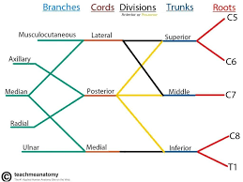
Erb’s Palsy aka Waiter’s Tip
Most common brachial plexopathy in newborns (~85%)
Upper Trunk plexopathy (C5/C6)
Shoulder adducted w/ arm internally rotated, extended & pronated w/ wrist flexed

Slide 110
KLUMPKE’S PALSY AKA CLAW HAND C8 AND T1
Extremely rare obstetric complication => Incidence of total obstetric brachial plexopathies: 0.6%

Slide 111
Question #1
A child was born with his shoulder adducted, arm internally rotated, extended, pronatated and flexed at the wrist? What condition does this child have, and where is the damage?
a) Klumpke’s Palsy, damage to lower trunk
b) Klumpke’s Palsy, damage to middle trunk
c) Erb’s Palsy, damage to upper trunk
d) Winged Scapula, damage to Long Thoracic Nerve

Slide 112
Question #1
A child was born with his shoulder adducted, arm internally rotated, extended, pronatated and flexed at the wrist? What condition does this child have, and where is the damage?
a) Klumpke’s Palsy, damage to lower trunk
b) Klumpke’s Palsy, damage to middle trunk
c) Erb’s Palsy, damage to upper trunk
d) Winged Scapula, damage to Long Thoracic Nerve

Slide 113
Important Median Nerve Entrapment Syndromes
Ligament of Struthers
Lacertus fibrosis (pronator syndromes)
Pronator heads (pronator syndrome)

Slide 114
Ligament of Struthers
This is a ligament off a spur above the elbow
Presentation:
- Pain above elbow
Numbness/Tingling in hand
Weak grasp, weak wrist flexion
Local tenderness
This requires surgical release

Slide 115
Biceps Aponeurosis – Lacertus Fibrosis
This is a thickening of the antebrachial fascia attaching the biceps to the ulnar fascia
The signs & symptoms are similar to ligament of Struthers

Slide 116
Pronator Syndrome
The median nerve becomes trapped between the 2 heads of the pronator teres
Pain in proximal forearm, often with exercise
Forearm is tender (+ve Tinel’s Sign)
Notes:
Tinel's sign is a way to detect irritated nerves. It is performed by lightly tapping (percussing) over the nerve to elicit a sensation of tingling or "pins and needles" in the distribution of the nerve.

Slide 117
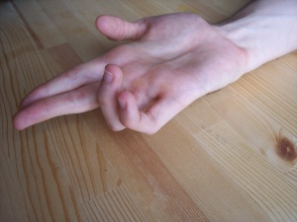
Median Claw
This occurs from a median nerve injury high along its course
There is paralysis of:
FDS, FPL,FPB, Radial ½ of FDP
The Ulnar ½ of FDP remains
Weakness of flexion of thumb, 2nd & 3rd fingers (supplied by the ulnar)
This occurs when patient tries to make a fist ie Active Benediction

Slide 118
Ulnar Claw
Occurs from an injury at the wrist
There is loss of function of the:
Interossei
Ulnar Lumbricals
There is unopposed action of:
Extensor Digitorum (MCP Hyperextended)
FDS &FDP (IP hyperflexed)
The 1st & 2nd lumbricals (Median N.) and most thenar muscles are spared
Patient has Benedict’s Sign at REST
Notes:
https://www.youtube.com/watch?v=0AAligXLJ1A

Slide 119
Wrist Drop
Results from damage to the Radial Nerve
Causes paralysis and weakness of the hand and finger extensors

Slide 120
Carpal Tunnel Syndrome
This is the most common neuropathic entrapment syndrome
Common in people who do manual work or repetitive flexion/extension of wrist
Symptoms:
Dropping items, can’t turn object
Proximal referred pain
Thenar wasting
Notes:
AMBOSS: Pressure increase within the carpal tunnel → compression of contained structures → impaired blood flow and altered microvascular structure of the median nerve → inflammatory reaction → edema and hypoxia → axonal degeneration

Slide 121
Question #2
Mr. Brown has worked as a tailor for 20 years. Recently, he presented to his GP with a complaint the he couldn’t thread his needles properly and is frustrating him.
What is the most likely diagnosis?
Carpal Tunnel Syndrome
What treatment would you recommend for him?
Surgical release of the transverse carpal ligament

Slide 122
Question #3
A farmer obtained a chop wound to his left proximal forearm. He presents to your office with his left hand (see picture). This sign occurs at rest.
What is this sign called?
Benedict’s Sign (At Rest)
b) What is it a result of?
Damage to Ulnar Nerve

