Slide 1
Sickle Cell Disease, Gastroenterology, and UTI
CRASH COURSE

Slide 2
Case
A previously well 6/12 old infant is brought to the health centre by his parents because he has been inconsolable for the last 2/7.
The examination of this child is unremarkable except for mild scleral icterus + swelling and tenderness to the right third metacarpal.

Slide 3
What is SCD?
Sickle cell disease is an inherited group of hematological disorders which result from mutations within the beta of hemaglobin.
Sickle cell anaemia is a specific variant which results from having two copies of the gene which codes for HbSS

Slide 4
Incidence
About 10% of the Jamaican population are carriers of some form of SCD.

Slide 5
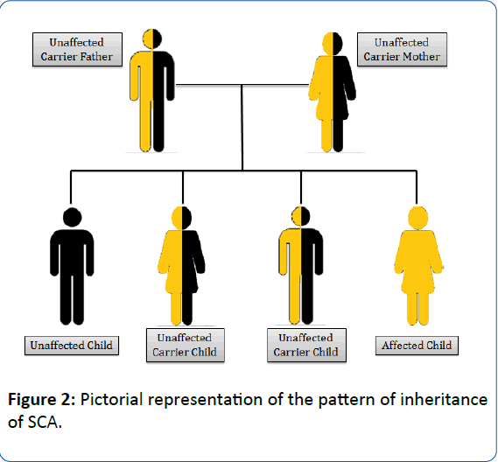
Aetiology
Autosomal Recessive

Slide 6
Pathophysiology

Slide 7
Genetics of SCD
Notes:
Chromosome 11

Slide 8
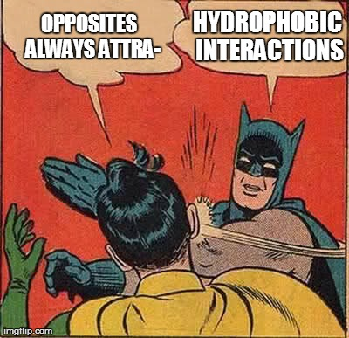
Pathophysiology
Glutamic acid is hydrophilic
Valine is hydrophobic
Result
Change in polarity of the protein

Slide 9
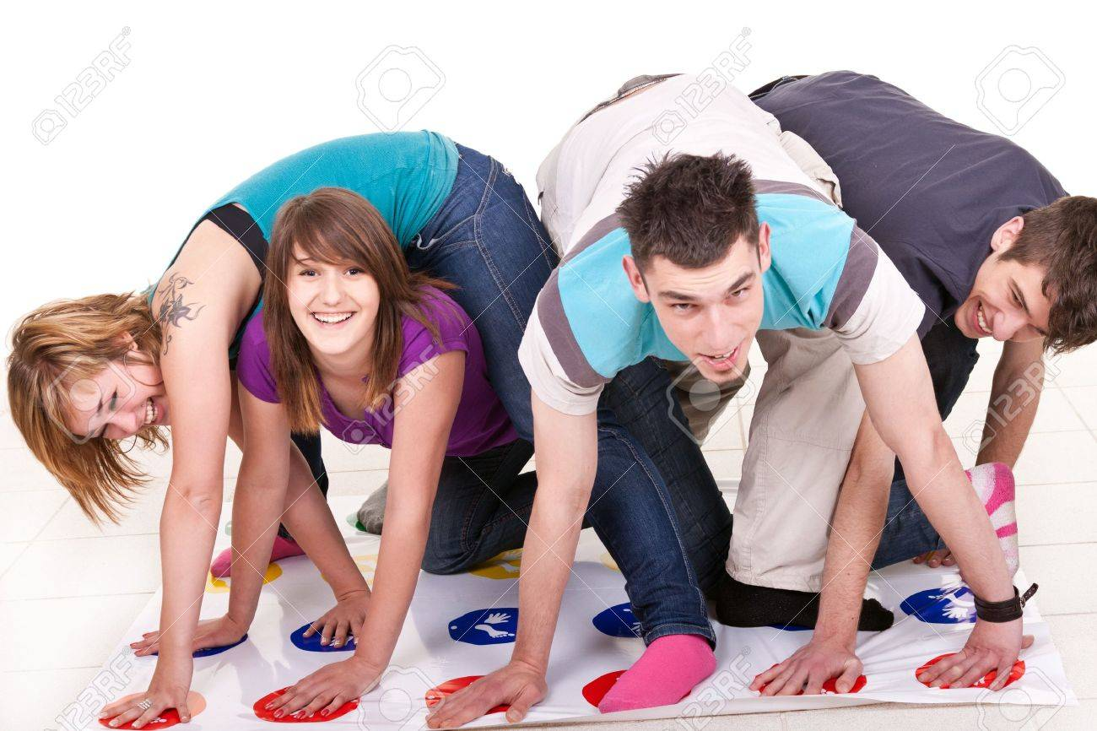
Pathophysiology
Change in polarity results in a misshapen protein
The misshapen protein is less soluble than HbA
Less soluble = more likely to precipitate

Slide 10
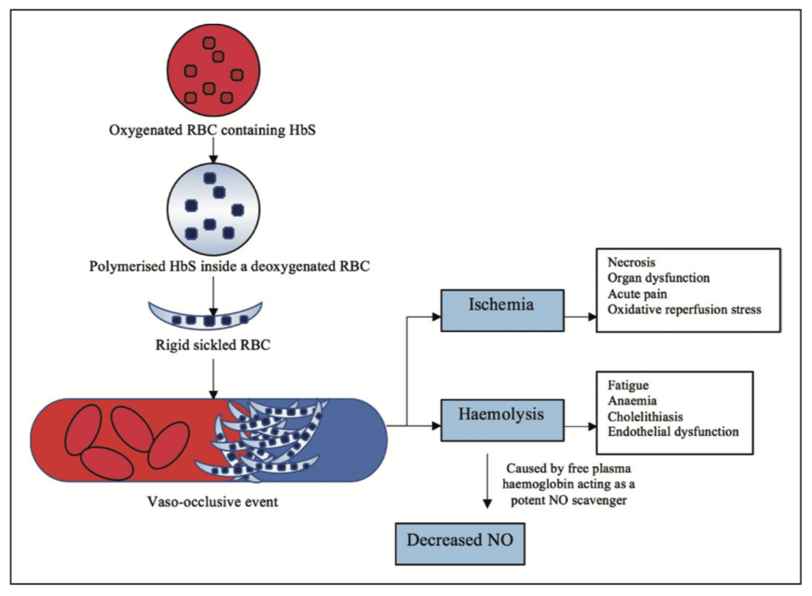
Pathophysiology

Slide 12
Head to Toe Sickle Cell Crash Course

Slide 13
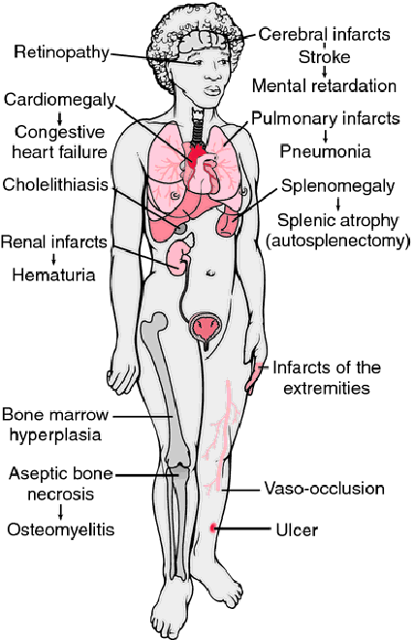

Slide 14
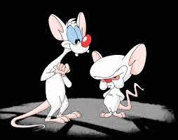
The CNS

Slide 15
Neurological conditions:
Acute neurological deficits
Headaches
Spinal cord infarcts
Posterior reversible leukoencephalopathy
Moyamoya syndrome

Slide 16
Acute Neurological Deficits
More common in the sickle cell population
Results in disability
Mental
Physical

Slide 17
Stroke
Affects 5-10% of homozygous SCD
50-90% will recur within 3 yrs without treatment
20% of SCD patients have silent infarcts

Slide 18
Stroke
Usually
In children, ischemic strokes are more common
In adults, haemorrhagic strokes are more common

Slide 19
Risk factors for stroke in SCD
Hx of TIA or previous stroke
High SBP
High WBC steady state
Low Hb steady state
Increased velocity on TCD

Slide 20
Transcranial doppler screening

Slide 21
Treatment of stroke
Determine if
>72hrs since onset of symptoms
<72hrs since onset of symptoms
There is progression

Slide 22
>72hrs + stable neurological status
Outpt management
Neuroimaging at presentation + 48-72hrs after presentation
Low dose ASA if plt > 500 or procoagulant
Physiotherapy
Decide on chronic transfusion vs hydroxyurea
Counsel on risk of recurrence

Slide 23
<72hrs or changing neurological status
Admit
A, B, Cs
CBC with retics
U&E + GXM
+/- cultures
Neuroimaging

Slide 24
<72hrs or changing neurologically
Transfusion
If Hb > 2g below steady state, simple then exchange
If < 2g/dl, exchange transfusion
>10g/dl or HCT 30% = increased risk of stroke
Manage seizures or ICP if present
+/- antibiotics

Slide 25
Headaches
Can be caused by
Stroke
Avascular necrosis

Slide 26
Altered mental status
Sinus venous thrombosis
Moyamoya syndrome

Slide 28
The Eyes in sickle cell
Acute
CRAO
Orbital infections
Vitreous hemorrahge
Retinal detachment
Chronic
sickle retinopathy

Slide 30
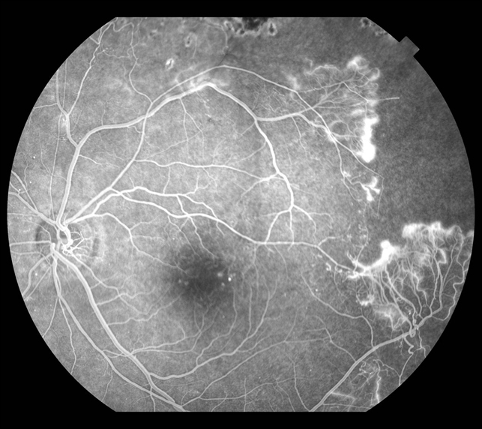

Slide 32
Cardiopulmonary

Slide 33
Symptoms of cardiopulmonary disease
Coughing
Chest pain
Palpitations
SoB
Oedema
Orthopnea or PND
Sputum production

Slide 34
Causes of cardiopulmonary disease
Cardiovascular
Sickle cardiomyopathy
Valvular heart disease
Myocardial infarction
Anaemia
Respiratory
Pulmonary HTN
ACS +/- pneumonia
Recurrent wheezing in SCD

Slide 35
Other mimics of CP disease
Osteomyelitis of ribs/ sternum
Painful crisis
Costochondritis
AVN of any bones of the thoracic cavity

Slide 36
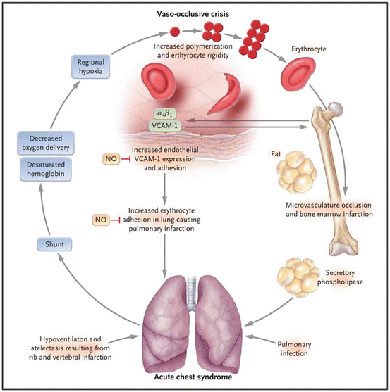
The Acute Chest Syndrome
New infiltrate of CXR

Slide 37
The ACS
ACS can rapidly evolve and result in death

Slide 38
Management of ACS

Slide 39
Principles of SCD management
A, B, C
Ensure adequate oxygenation and ventilation!
Hydrate! Hydrate! Hydrate!
Pain management!

Slide 40
Breathing and ventilation
Issues of ventilation and perfusion
Infarction (Q)
Splinting (V)
Consolidation (V)

Slide 41
Breathing and Ventilation
Pain management (will be covered later on)
Oxygen supplementation to maintain SpO2>94%
Incentive spirometry

Slide 42
Circulation
Hydration
1-1.5x maintenance
Helps to maintain perfusion
Helps to decrease sickling
Limits ischemic pain associated with sickling

Slide 43
Bronchodilators
Consider in patients who are wheezing or have asthma/ hyperactive airway disease

Slide 44
Transfusion
Anaemia can be a cause of SoB
Can be precipitated by ACS and other pathologies
May be simple or exchange
Exchange is the patient has severe ACS or rapidly progressing ACS despite appropriate management

Slide 45
Antibiotics
Empiric abx although not always infectious
Cephalosporins or augmentin + macrolide (atypical coverage)

Slide 46
Pulmonary HTN
Sickling in pulmonary capillaries = increase resistance = increased pressure

Slide 47
Cardiac
Sickle cardiomyopathy
Right or Left ventricular dysfunction
MI
Acquired hemochromatosis from chronic transfusion
Sudden cardiac death

Slide 48
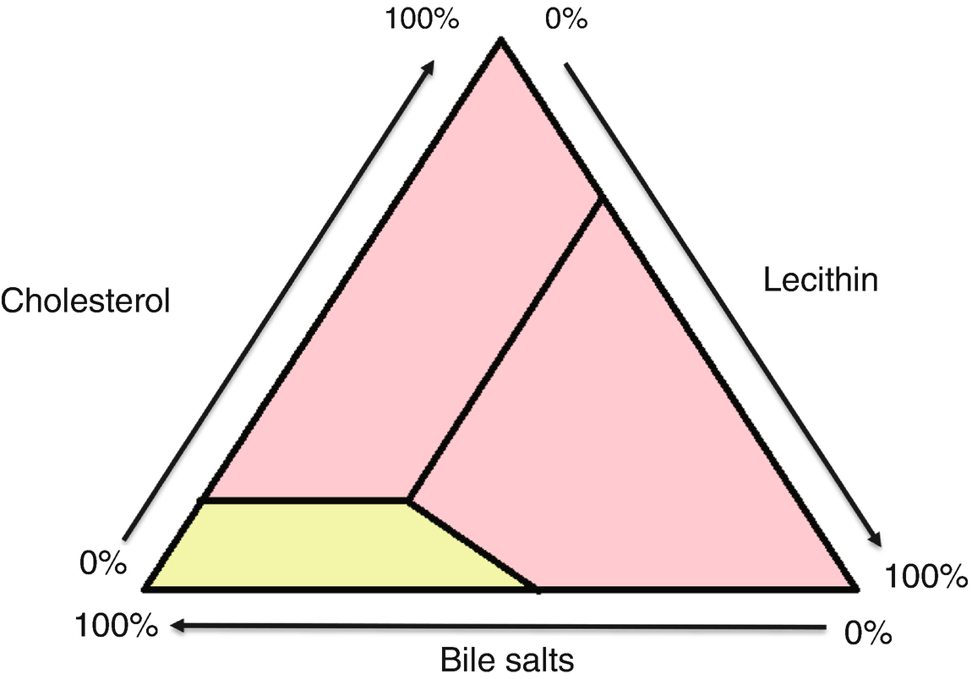
Cholelithiasis

Slide 49
Diseases related to cholelithiasis

Slide 50
Treatment
Treat specific pathology
Consider antibiotics if fever
Cholecystectomy when possible

Slide 51
Abdominal Pain
Abdominal painful crisis
Splenic sequestration
Hepatic sequestration

Slide 52
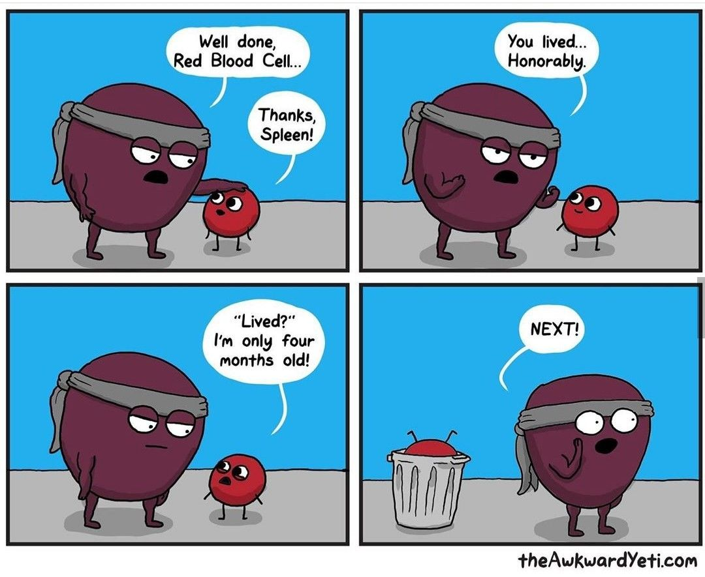
Splenic sequestration
Acute increase in spleen size
Fall from steady state >2g/dl

Slide 53
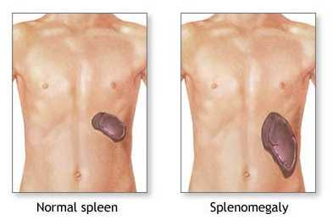
The spleen in sickle cell
Usually undergoes autosplenctomy in severe genotypes by 5-7 yrs

Slide 54
Indications for splenectomy
>/= 2 episodes of splenic sequestration
Failure to thrive with hypersplenism
Hb < 5g/dl
Plt < 50
Chronic pain + splenomegaly

Slide 55
Preparations for splenectomy
Complete immunisation at least 2 weeks prior
Penicillin prophylaxis for at least 3 years post splenectomy

Slide 56
Minimum immunisation

Slide 57
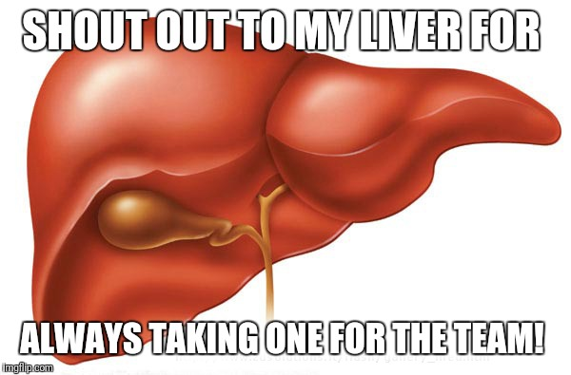
Hepatic Sequestration
Acute increase
>2g/dl fall from steady state

Slide 58
Treatment of Acute Abdominal Pain
Refer to principles of sickle cell management
ABCs
Pain control
Hydration

Slide 59
Genitourinary

Slide 60
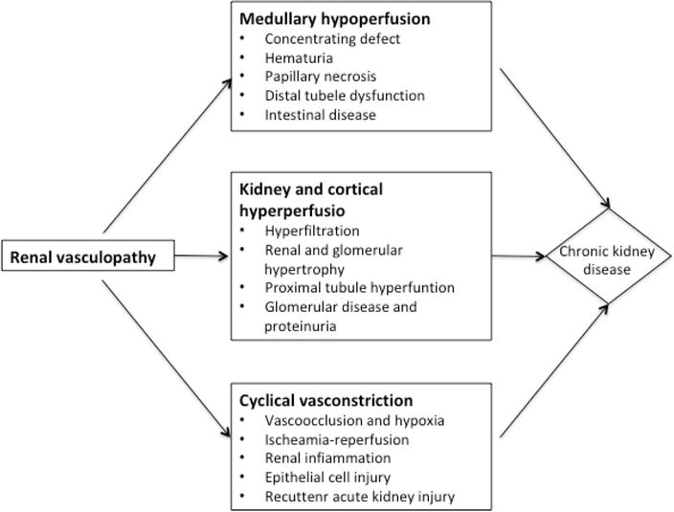
Kidneys

Slide 61
Female Reproductive health
Delayed menarche
Occurs around 15-16 yrs (2 years after patients without SCD)
No contraceptive is contraindicated
Progesterone only pills show to increase levels of HbF
Pregnancy in any SCD patient is a high risk pregnancy

Slide 62
Male Reproductive Health
Acute priapism
Damage may become irreversible after 4 hrs
Follow principles of SCD management
Can apply warm compress
Empty bladder
Gentle exercise

Slide 63
Male Reproductive Health
Pseudoepinephrine debateable
May require surgical ligation of the penile vessels

Slide 64
Male reproductive health
May have hypogonadism
Erectile dysfunction ore common amongst SCD patients
Abnormalities in
Sperm motility
Sperm morphology
Sperm count

Slide 65
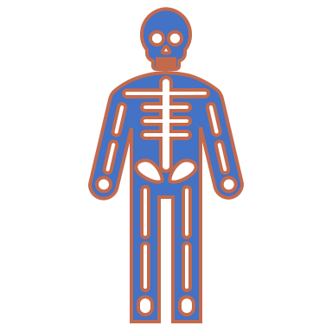
Musculoskeletal

Slide 66
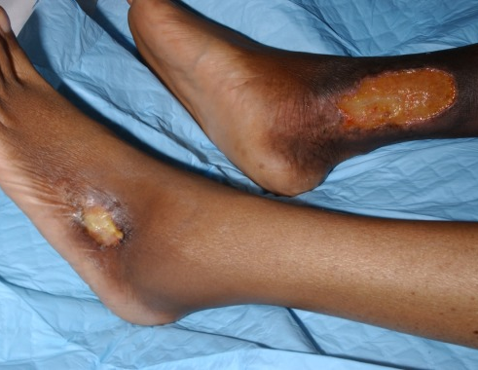
Leg Ulcers
Prevention
Wear protective shoes
Moisturise the skin
Dress cuts

Slide 67
Leg Ulcers
May require debridement (medical or surgical)
Daily dressings
Curiosin
Sufrexal

Slide 68
Avascular necrosis
Usually chronic pain
May present with limping or abnormal positioning of extremities
Common in the femoral head

Slide 69
Osteomyelitis
Usually due to hematogenous spread
Salmonella implicated more commonly in SCD patients
Red flag is point tenderness
Always examine the vertebrae, long bones, and sternum

Slide 70
Penicillin prophylaxis
From 4/12 – 4 years (post pneumovax)
After documented pneumococcal meningitis
3 years post splenectomy

Slide 71
Any questions?

Slide 72
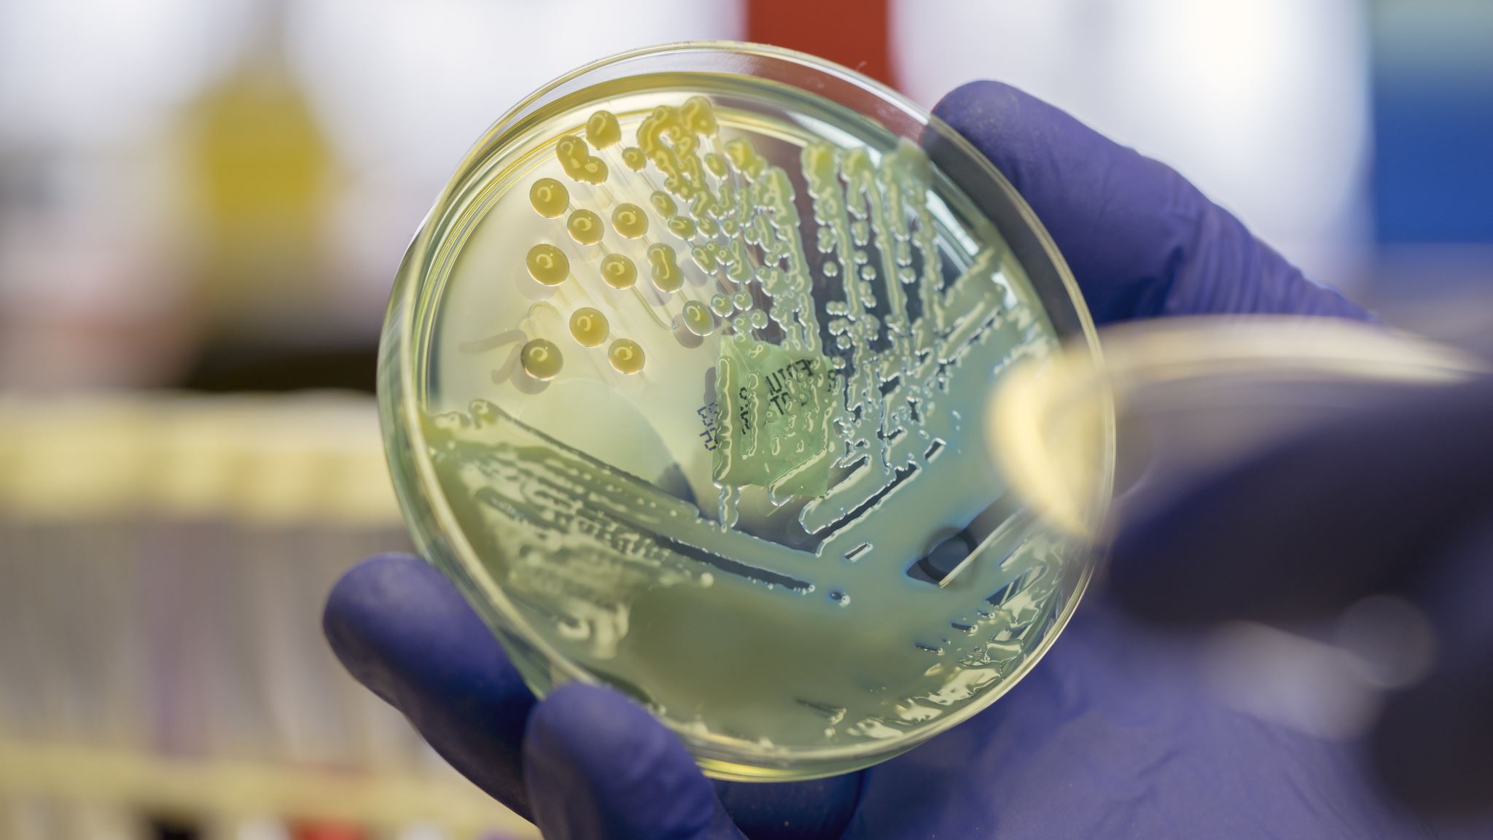
Urinary Tract Infection in paediatrics

Slide 73
UTI
Colonisation of the urinary tract by an organism. Usually bacterial

Slide 74
Aetiology
Usually bacterial
E coli (75%)
Klebsiella
Proteus
Pseudomonas
Can be fungal
candida

Slide 75
Risk factors for UTI
Anatomical abnormalities
Bladder dysfunction
Constipation
Recent antibiotic therapy

Slide 76
Presentation
Varies with age

Slide 77
Neonate
Irritability
Vomiting
Jaundice
Failure to thrive
Poor feeding
Fever

Slide 78
2/12 – 2 years
As above +
Malodorous urine
Abdominal pain

Slide 79
2-6 years
Dysuria
Polyuria
Enuresis
+ all of the above

Slide 80
> 6 years
Urinary incontinence
Back pain
Flank pain

Slide 81
Workup
CBC
U&E

Slide 82
Urine culture
Can either be SPA, CSU or MSU
Children 18/12- 2 yrs- SPA
Until control of urination – CSU
There after MSU/CSU
Repeat after treatment

Slide 83
Diagnosing UTI
Any growth on SPA
CSU
>50,000 CFU/ ml or
10000 -50,000 CFU/ml with pyuria

Slide 84
Imagining

Slide 85
Renal ultrasonography
All neonates with UTI
30-50% will have abnormalities
Normal US does not exclude reflux or scarring

Slide 86
MCUG
Debateable topic
Routinely performed on neonates in Jamaica
Some centres do not perform if US normal and the pathogen is e coli
Should have a no growth urine culture prior

Slide 87
Renal Scan
Routinely done in proteus infections
Patients with recurrent UTIS
>2 episodes of upper UTI
>3 episodes of cystitis
Atypical UTI
Abnormal U&Es, non-e coli,

Slide 88
Treatment
Neonates
Ampicillin + gentamycin
Benzylpenicillin sometimes used
Bactrim in older children
Cephalosporins

Slide 89
Treatment
Treat for 10-14 days
Can use culture directed therapy
48hr culture should be sterile
Prophylaxis using amoxicillin until renal imaging is done
Also used for any pt with known urinary abnormalities

Slide 90
Gastroenteritis

Slide 91
Definition
Inflammation of the upper and lower GIT

Slide 92
Incidence
More common in the rainy season
More common amongst school aged children
More common in areas without access to clean water
Crowding

Slide 93
Aetiology
Usually viral
Rotavirus most common in non-immunised children
Bacterial
Shigella, salmonella

Slide 94
Presentation
Usually more than 3 episodes of
Vomiting
Loose stool
Fever
Thirst
Hx of ill contacts

Slide 95
Presentation
History of improper water handling
Important to know how feeds are mixed
Dehydration

Slide 97
Investigations
CBC
U&E
+/- stool culture
Blood or mucous

Slide 98
Treatment
Usually supportive
Usually self-limiting
Hydration
Deficit
Maintenance
Ongoing losses

Slide 99
Vaccination
Rotavirus vaccine

Slide 100
Other common conditions
Surgical
Intussusception
Hirschprungs disease
Medical
Mesenteric adenitis

Slide 101
Causes of vomiting

Slide 102
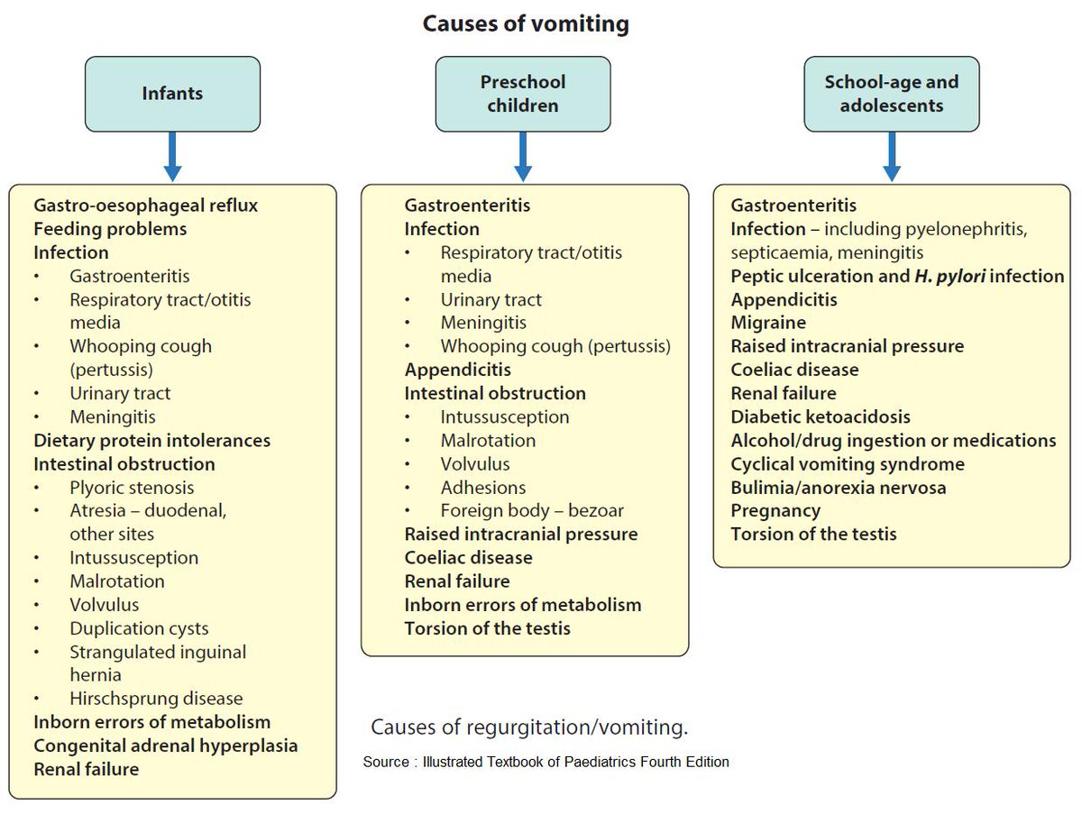

Slide 103
Causes of diarrhoea

Slide 104
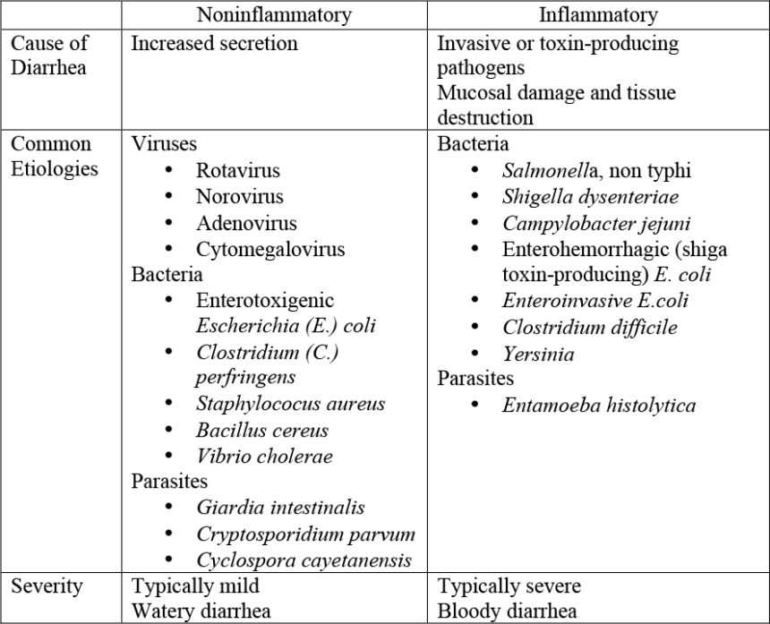

Slide 105
Causes of Jaundice

