Slide 1
CELL BIO
FOUNDATIONS 1
CELLULAR ESSENTİALS & AQUEOUS ENVİRONMENT OF THE CELL
DR. AKEEM THORPE

Slide 2
C
ontents
1
The Foundations of Biochemistry
4
Physical Essentials
2
Cellular Essentials
5
Water: The Fitness of the aqueous Environment
3
Chemical Essentials

Slide 3
01
BIOCHEMISTRY
THE FOUNDATIONS

Slide 4
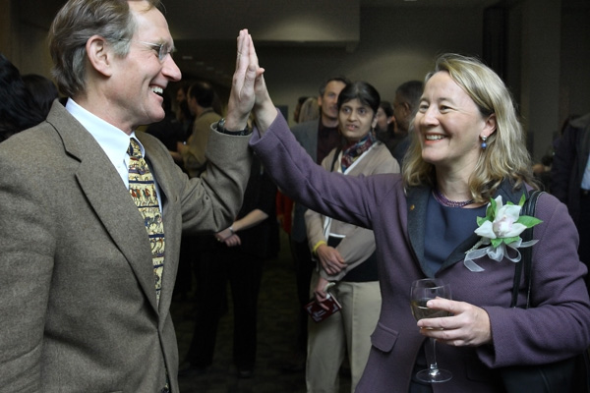
BIOCHEMISTRY
THE FOUNDATIONS
Biochemistry – The study of the chemistry of life processes
Biochemical unity underpins biological diversity
Interplay of biological macromolecules, and micromolecules
Key metabolic processes also are common to many organisms
This lecture series will explore the chemical reactions and the associated biological macromolecules and metabolites that are found in biological processes common to many organisms, with specific focus on those processes most relevant to human metabolism and disease.
Nobel Prize winners Peter Agre, M.D., and Carol Greider, Ph.D., who used, respectively, biochemical techniques to reveal key mechanisms of how water is transported into and out of cells, and how chromosomes are replicated faithfully.

Slide 5
BIOCHEMISTRY
THE FOUNDATIONS
The study of biochemistry shows how inanimate molecules interact to maintain and perpetuate life.
Living organisms possess attributes that distinguish them the nonliving.
A high degree of chemical complexity
Systems for extracting, transforming, and using energy from the environment
A capacity for precise self-replication and self-assembly
Mechanisms responding to their surroundings
Defined functional components and regulated interactions
A history of evolutionary change

Slide 6
BIOCHEMISTRY
THE FOUNDATIONS
In this introductory lesson, we visit the cellular, physical, chemical, and genetic backgrounds to biochemistry and the overarching principle of evolution.
We then turn our attention to water, with descriptions of the physical and chemical properties of the aqueous environment, to which all aspects of cell structure and function are adapted.

Slide 7
02
CELLULAR ESSENTIALS
GENERAL FOUNDATIONS

Slide 8
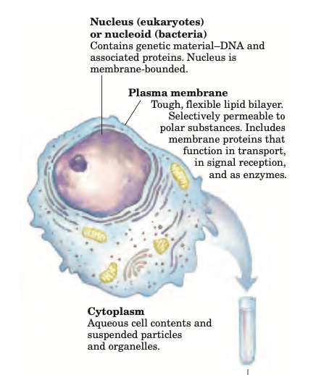
CELLULAR ESSENTIALS
GENERAL FOUNDATIONS
At the cellular level, the unity and diversity of organisms become apparent
Cells Are the STRUCTURAL and FUNCTIONAL Units of All Living Organisms
All cells share certain fundamental properties
Plasma membrane
Cytoplasm
Cytosol
Nucleus/Nucleoid

Slide 9
CELLULAR ESSENTIALS
GENERAL FOUNDATIONS
Cellular Dimensions Are Limited by Oxygen Diffusion
There Are Three Distinct Domains of Life
Eukaryotic Cells Have a Variety of Membranous Organelles, Which Can Be Isolated for Study
Cells Build Supramolecular Structures

Slide 10
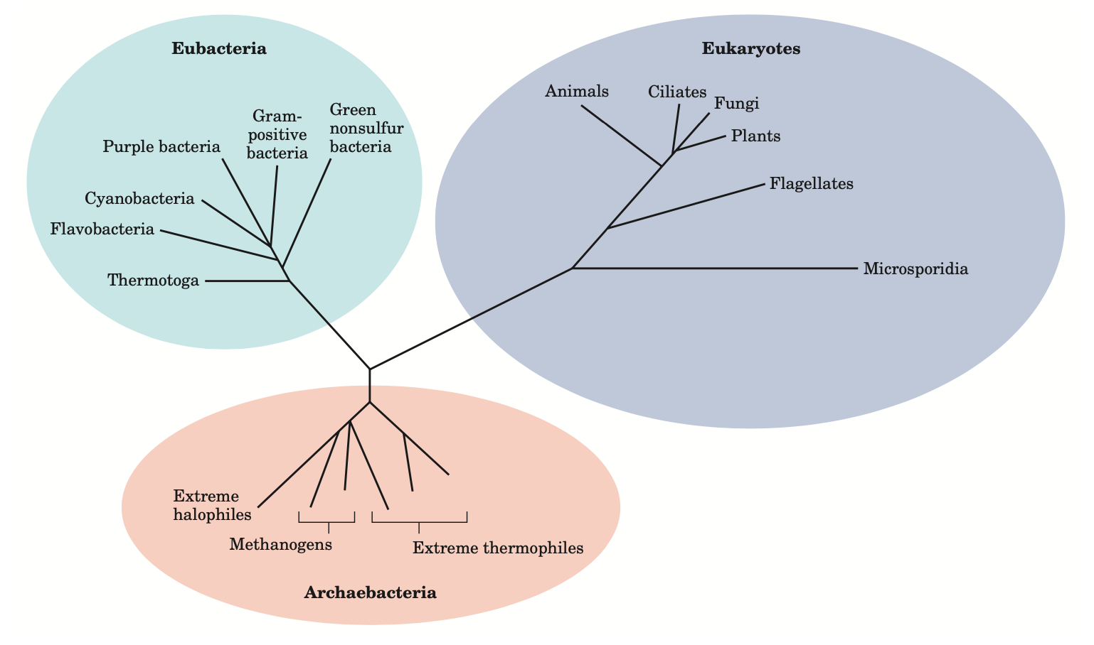
CELLULAR ESSENTIALS
GENERAL FOUNDATIONS
Phylogeny of the three domains of life.
Phylogenetic relationships are often illustrated by a “family tree” of this type. The fewer the branch points between any two organisms, the closer is their evolutionary relationship.

Slide 11
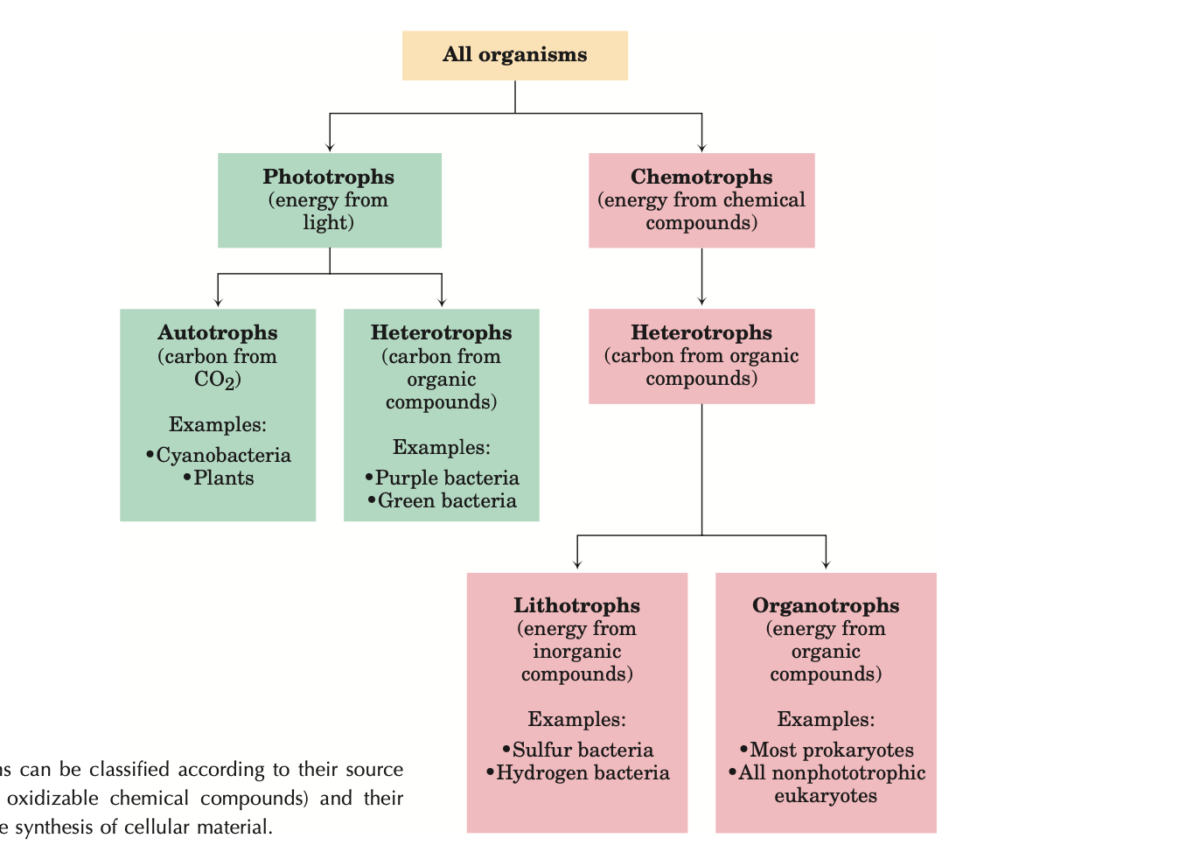
CELLULAR ESSENTIALS
GENERAL FOUNDATIONS
Organisms can be classified according to their source of energy (sunlight or oxidizable chemical compounds) and their source of carbon for the synthesis of cellular material.

Slide 12
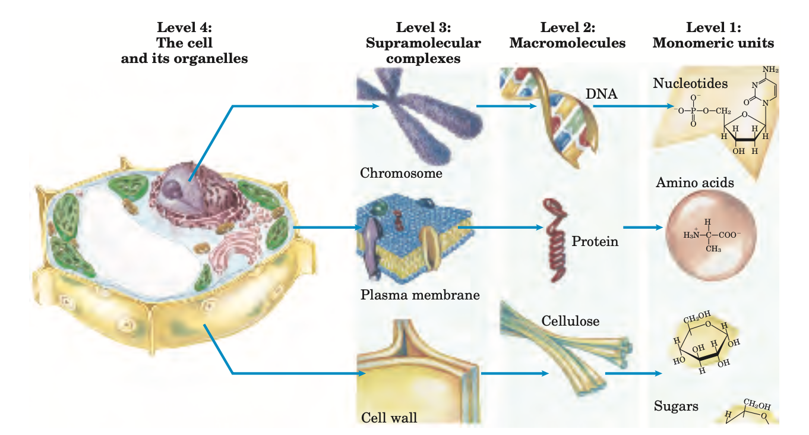
CELLULAR ESSENTIALS
GENERAL FOUNDATIONS
Structural hierarchy in the molecular organization of cells.
In this plant cell, the nucleus is an organelle containing several types of supramolecular complexes, including chromosomes.

Slide 13
03
CHEMICAL ESSENTIALS
GENERAL FOUNDATIONS

Slide 14
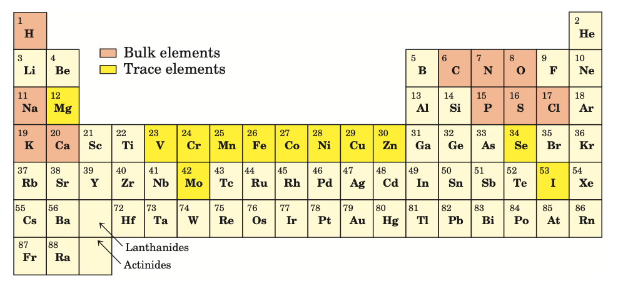
CHEMICAL ESSENTIALS
GENERAL FOUNDATIONS
Biochemistry aims to explain biological form and function in chemical terms.
Concepts from Chemistry Explain the Properties of Biological Molecules

Slide 15
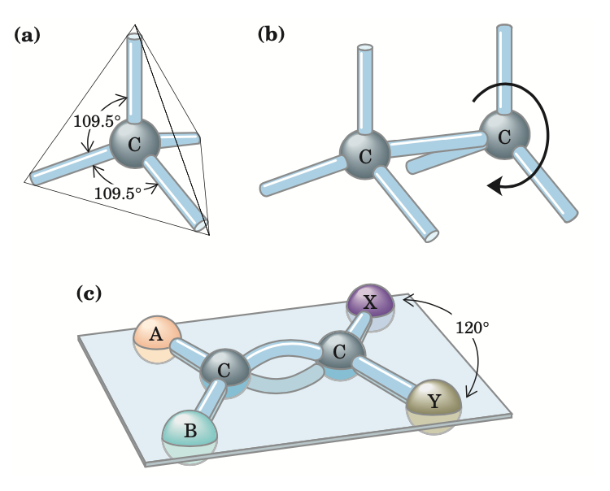
CHEMICAL ESSENTIALS
GENERAL FOUNDATIONS
BİOMOLECULES ARE COMPOUNDS OF CARBON WİTH A VARİETY OF FUNCTİONAL GROUPS
(a) Carbon atoms have a characteristic tetrahedral arrangement of their four single bonds. (b) Carbon–carbon single bonds have freedom of rotation, as shown for the compound ethane (CH3OCH3). (c) Double bonds are shorter and do not allow free rotation. The two doubly bonded carbons and the atoms designated A, B, X, and Y all lie in the same rigid plane.

Slide 16
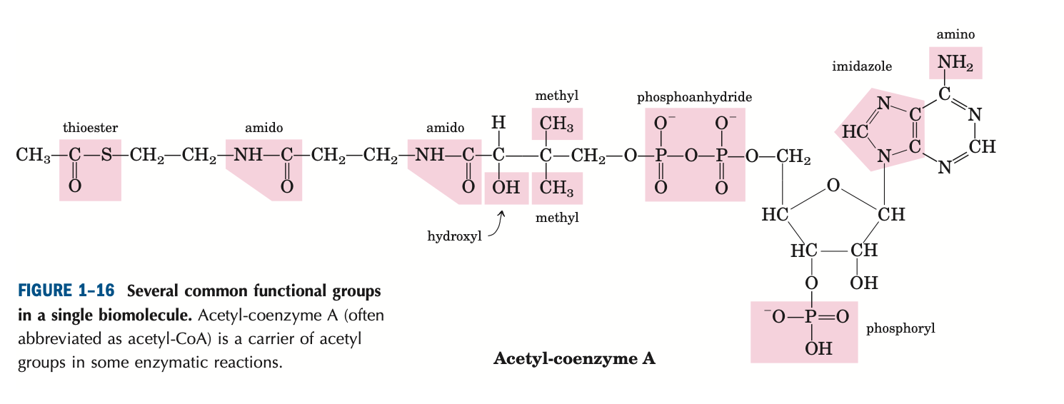
CHEMICAL ESSENTIALS
GENERAL FOUNDATIONS
Cells Contain a Universal Set of Small Molecules
Several common functional groups are found in single biomolecules.

Slide 17
CHEMICAL ESSENTIALS
GENERAL FOUNDATIONS
Macromolecules Are the Major Constituents of Cells
Proteins constitute the largest fraction of cells
Nucleic Acids
Polysaccharides
Lipids

Slide 18
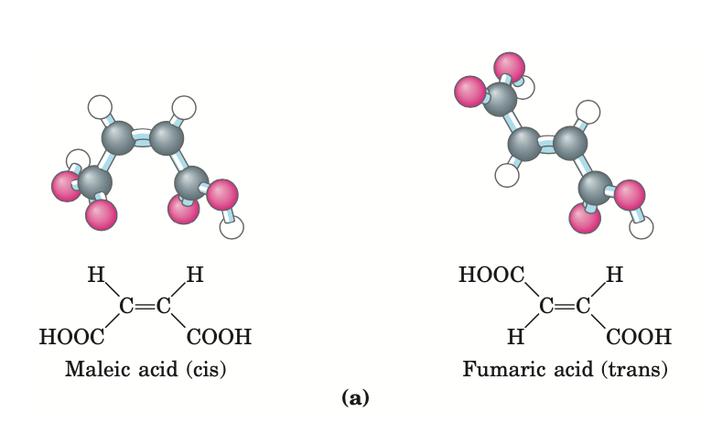
CHEMICAL ESSENTIALS
GENERAL FOUNDATIONS
Three-Dimensional Structure Is Described by Configuration and Conformation
The covalent bonds and functional groups of a biomolecule are central to its function, but so is the arrangement of the molecule’s constituent atoms in three-dimensional space - Stereochemistry.

Slide 19
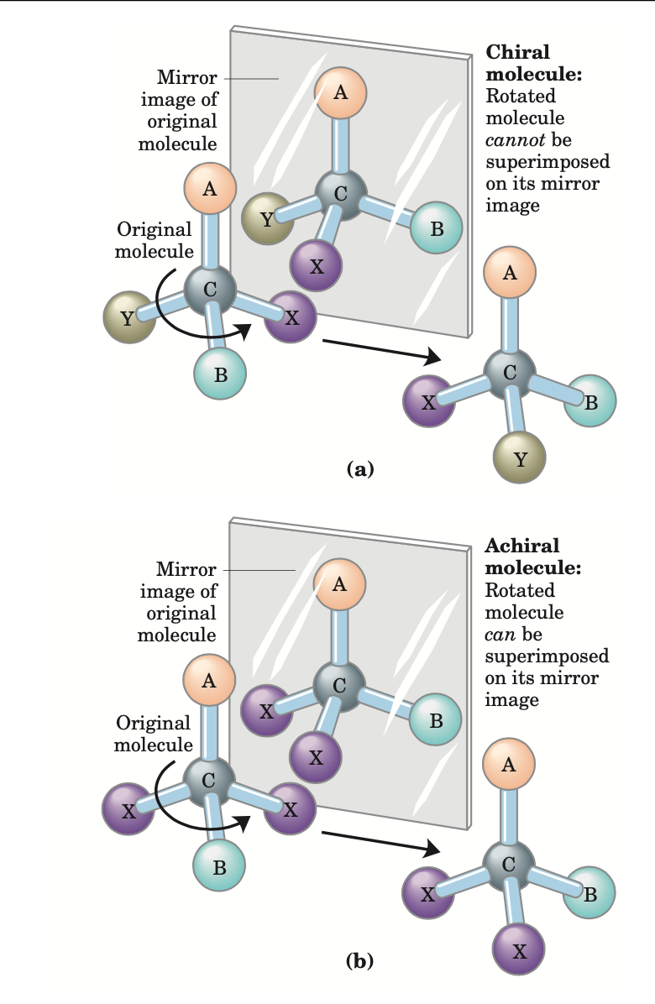
CHEMICAL ESSENTIALS
GENERAL FOUNDATIONS
A carbon atom with four different substituents is said to be asymmetric, and ASYMMETRİC CARBONS are called CHİRAL CENTERS.
(a) When a carbon atom has four different substituent groups (A, B, X, Y), they can be arranged in two ways that represent nonsuperimposable mirror images of each other (enantiomers). This asymmetric carbon atom is called a chiral atom or chiral center.
(b) When a tetrahedral carbon has only three dissimilar groups, only one configuration is possible and the molecule is symmetric, or achiral.

Slide 20
CHEMICAL ESSENTIALS
GENERAL FOUNDATIONS
Interactions between Biomolecules Are Stereospecific
IN LİVİNG ORGANİSMS, CHİRAL MOLECULES ARE USUALLY PRESENT İN ONLY ONE OF THEİR CHİRAL FORMS.
For example, the amino acids in proteins occur only as their L isomers
Glucose occurs only as its D isomer

Slide 21
04
PHYSICAL ESSENTIALS
GENERAL FOUNDATIONS

Slide 22
PHYSICAL ESSENTIALS
GENERAL FOUNDATIONS
Living cells and organisms must perform work to stay alive.
THE SYNTHETİC REACTİONS THAT OCCUR WİTHİN CELLS REQUİRE THE İNPUT OF ENERGY
Biochemistry also aims to understand the means by which energy is extracted, channeled, and consumed in living cells

Slide 23
PHYSICAL ESSENTIALS
GENERAL FOUNDATIONS
Living Organisms Exist in a Dynamic Steady State, Never at Equilibrium with Their Surroundings
The molecules and ions contained within a living organism differ in kind and in concentration from those in the organism’s surroundings.
When a cell can no longer generate energy, it dies and begins to decay toward equilibrium with its surroundings
Organisms Transform Energy and Matter from Their Surroundings

Slide 24
PHYSICAL ESSENTIALS
GENERAL FOUNDATIONS
A living organism is an open system; it exchanges both matter and energy with its surroundings
Cells are consummate transducers of energy, capable of interconverting chemical, electromagnetic, mechanical, and osmotic energy with great efficiency

Slide 25
PHYSICAL ESSENTIALS
GENERAL FOUNDATIONS
The Flow of Electrons Provides Energy for Organisms
Virtually all energy transductions in cells can be traced to this flow of electrons from one molecule to another, in a “downhill” flow from higher to lower electrochemical potential; as such, this is formally analogous to the flow of electrons in a battery-driven electric circuit.
All these reactions involving electron flow are redox reactions: one reactant is oxidized (loses electrons) as another is reduced (gains electrons).

Slide 26
PHYSICAL ESSENTIALS
GENERAL FOUNDATIONS
Creating and Maintaining Order Requires Work and Energy
The randomness or disorder of the components of a chemical system is expressed as entropy, S
Any change in randomness of the system is expressed as entropy change, ΔS
J. Willard Gibbs, who developed the theory of energy changes during chemical reactions, showed that the free energy content, G, of any closed system can be defined in terms of three quantities:
enthalpy, H, reflecting the number and kinds of bonds
entropy, S;
absolute temperature, T (in Kelvin).

Slide 27
PHYSICAL ESSENTIALS
GENERAL FOUNDATIONS
A PROCESS TENDS TO OCCUR SPONTANEOUSLY ONLY İF ΔG İS NEGATİVE.
Cell function depends largely on molecules, such as proteins and nucleic acids, for which the free energy of formation is POSİTİVE
To carry out these thermodynamically unfavorable, energy-requiring (ENDERGONIC) reactions, cells couple them to other reactions that liberate free energy (EXERGONIC).

Slide 28
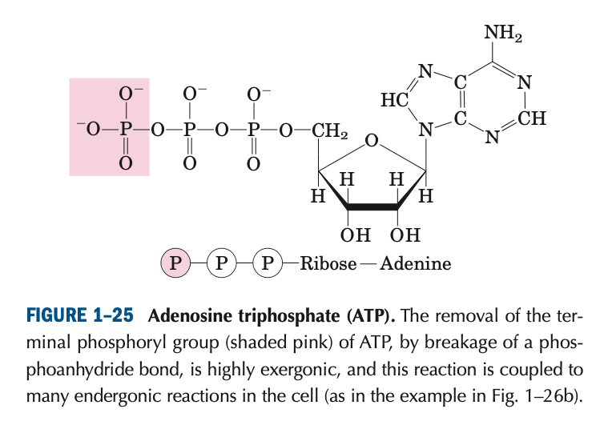
PHYSICAL ESSENTIALS
GENERAL FOUNDATIONS
The usual source of free energy in coupled biological reactions is the energy released by hydrolysis of phosphoanhydride bonds such as those in adenosine triphosphate (ATP)

Slide 29
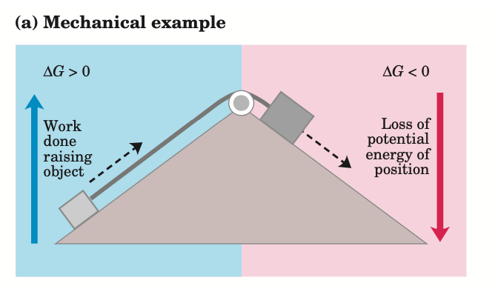
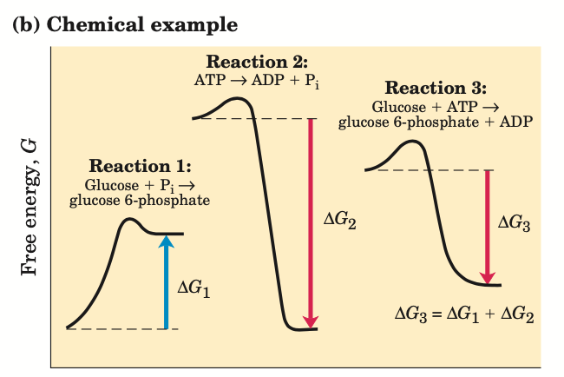
PHYSICAL ESSENTIALS
GENERAL FOUNDATIONS
Energy Coupling Links Reactions in Biology

Slide 30
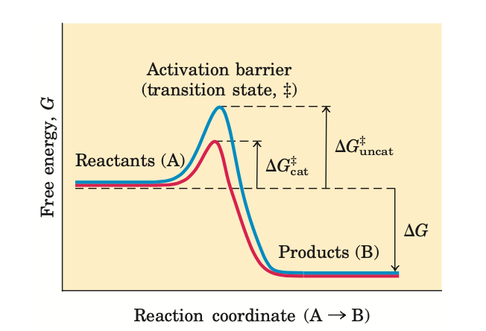
PHYSICAL ESSENTIALS
GENERAL FOUNDATIONS
Enzymes Promote Sequences of Chemical Reactions
An enzyme catalyzes a reaction by providing a more comfortable fit for the transition state

Slide 31
PHYSICAL ESSENTIALS
GENERAL FOUNDATIONS
The thousands of enzyme-catalyzed chemical reactions in cells are functionally organized into many sequences of consecutive reactions, called PATHWAYS, in which the product of one reaction becomes the reactant in the next.
We will explore several, vital metabolic pathways.

Slide 32
PHYSICAL ESSENTIALS
GENERAL FOUNDATIONS
Metabolism Is Regulated to Achieve Balance and Economy

Slide 33
05
WATER
The Fitness of the Aqueous Environment

Slide 34
WATER
The Fitness of the Aqueous Environment
Water is the most abundant substance in living systems, making up 70% or more of the weight of most organisms.
The attractive forces between water molecules and the slight tendency of water to ionize are of crucial importance to the structure and function of biomolecules.
Polar biomolecules dissolve readily in water because they can replace water-water interactions with more energetically favorable water-solute interactions. In contrast, nonpolar biomolecules interfere with water-water interactions but are unable to form water-solute interactions.
Hydrogen Bonding Gives Water Its Unusual Properties

Slide 35
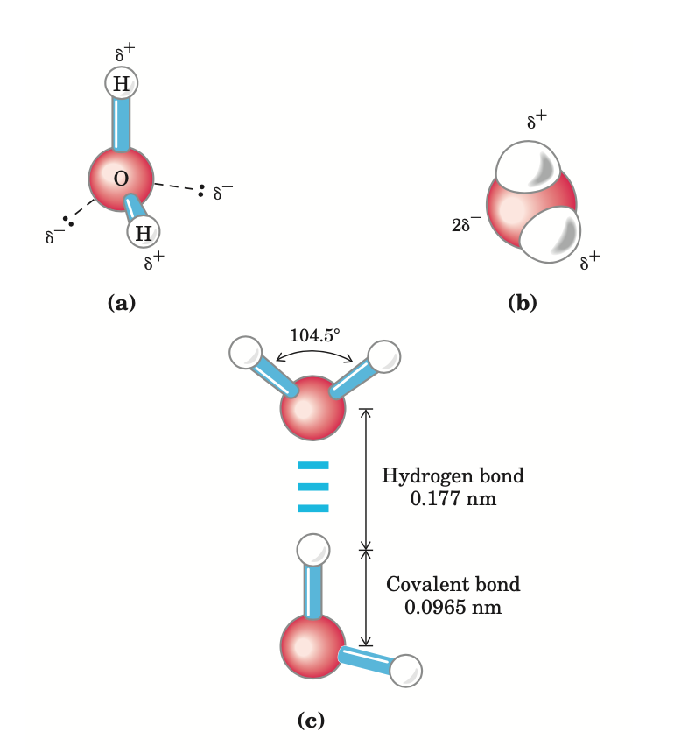
WATER
The Fitness of the Aqueous Environment
Structure of the water molecule. The dipolar nature of the H2O molecule is shown by:
(a) ball-and-stick and
(b) space-filling models. The dashed lines in (a) represent the nonbonding orbitals.
(c) Two H2O molecules joined by a hydrogen bond

Slide 36
WATER
The Fitness of the Aqueous Environment
Water Forms Hydrogen Bonds with Polar Solutes
Water Interacts Electrostatically with Charged Solutes
Water is a polar solvent. It readily dissolves most biomolecules, which are generally charged or polar compounds.
Compounds that dissolve easily in water are hydrophilic
In contrast, nonpolar solvents are hydrophobic; nonpolar molecules such as lipids and waxes.

Slide 37
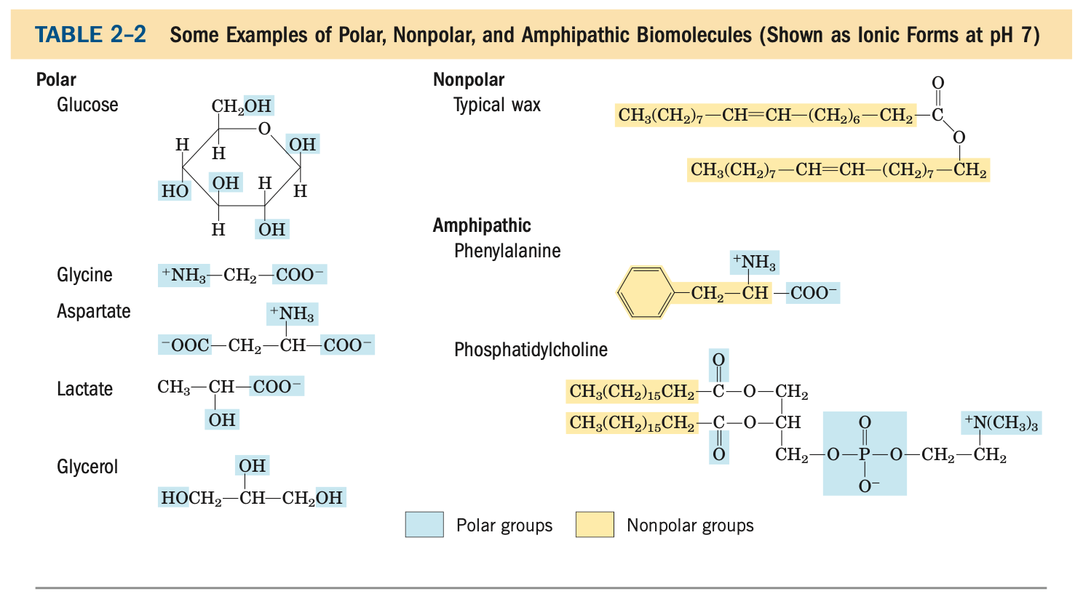
WATER
The Fitness of the Aqueous Environment

Slide 38
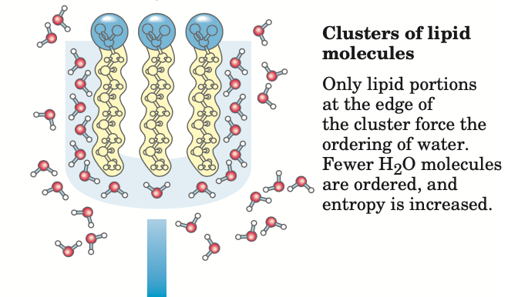
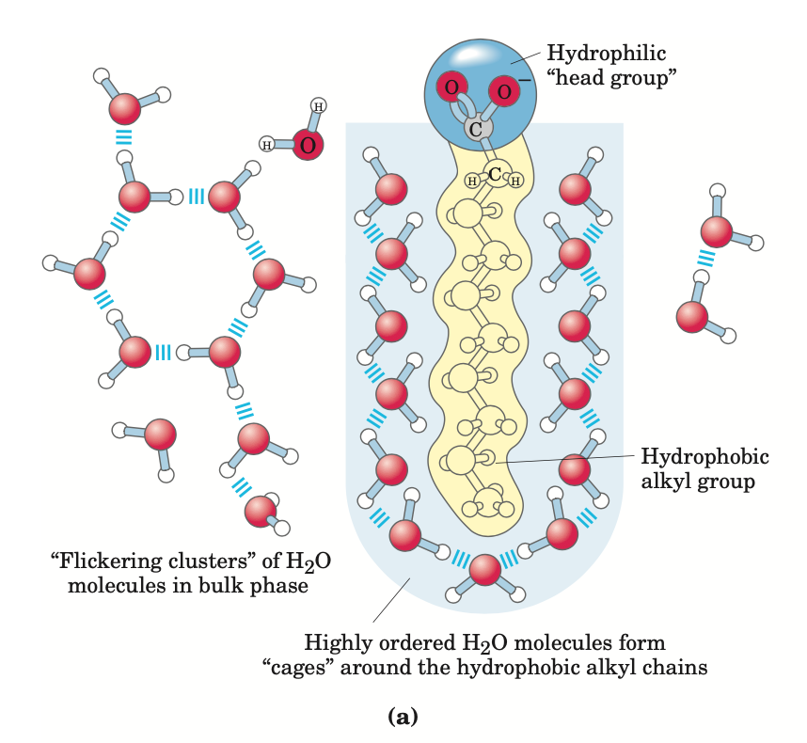
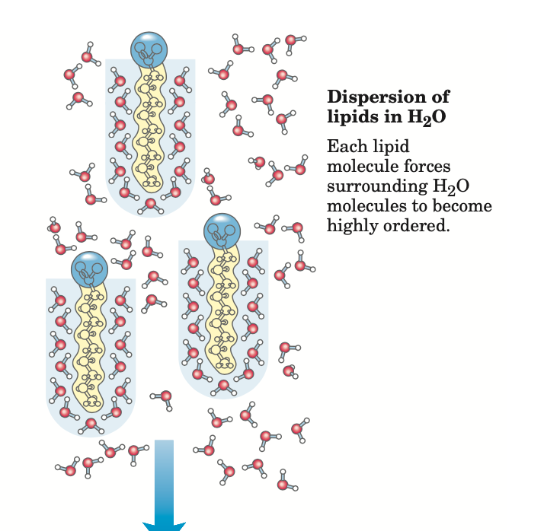
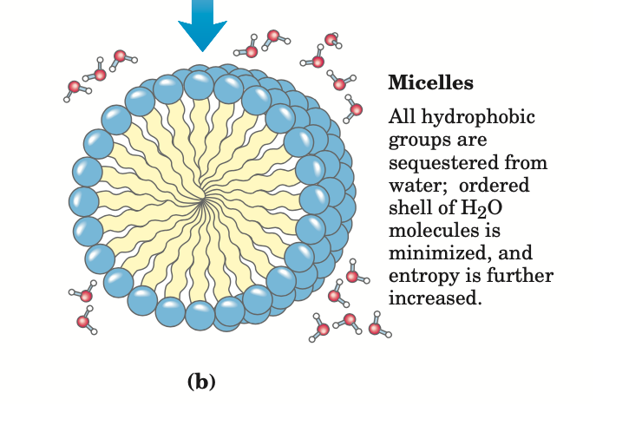
WATER
The Fitness of the Aqueous Environment
Amphipathic compounds contain regions that are polar (or charged) and regions that are nonpolar.

Slide 39
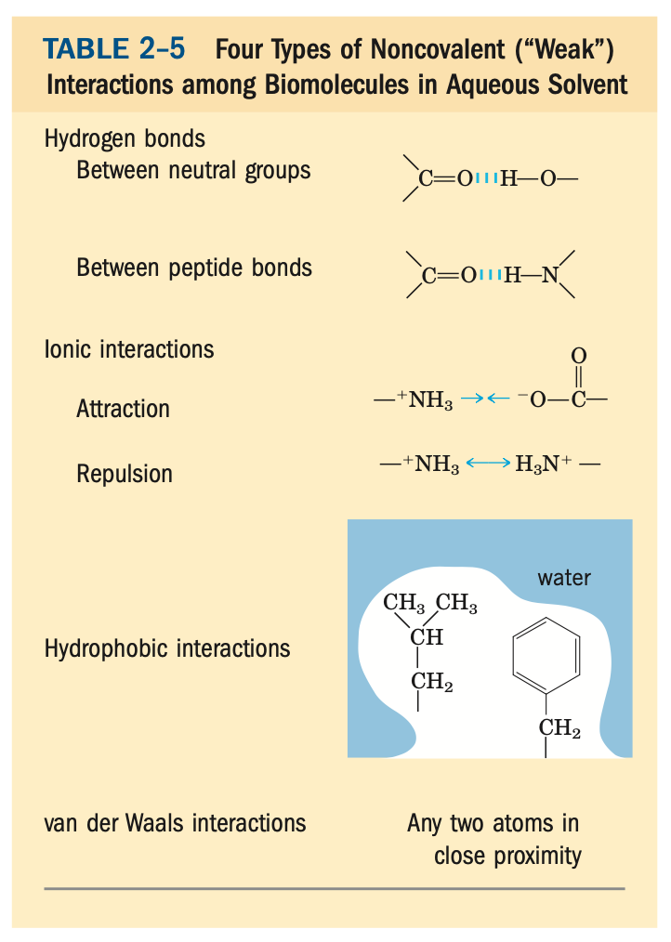
WATER
The Fitness of the Aqueous Environment
Van der Waals Interactions Are Weak Interatomic Attractions
Macromolecules such as proteins, DNA, and RNA contain so many sites of potential hydrogen bonding or ionic, van der Waals, or hydrophobic interactions that the cumulative effect of the many small binding forces can be enormous.

Slide 40
WATER
The Fitness of the Aqueous Environment
Water molecules tend to move from a region of higher water concentration to one of lower water con- centration.
When two different aqueous solutions are separated by a semipermeable membrane (one that allows the passage of water but not solute molecules), water molecules diffusing from the region of higher water concentration to that of lower water concentration produce osmotic pressure
Osmosis, water movement across a semipermeable membrane driven by differences in osmotic pressure.

Slide 41
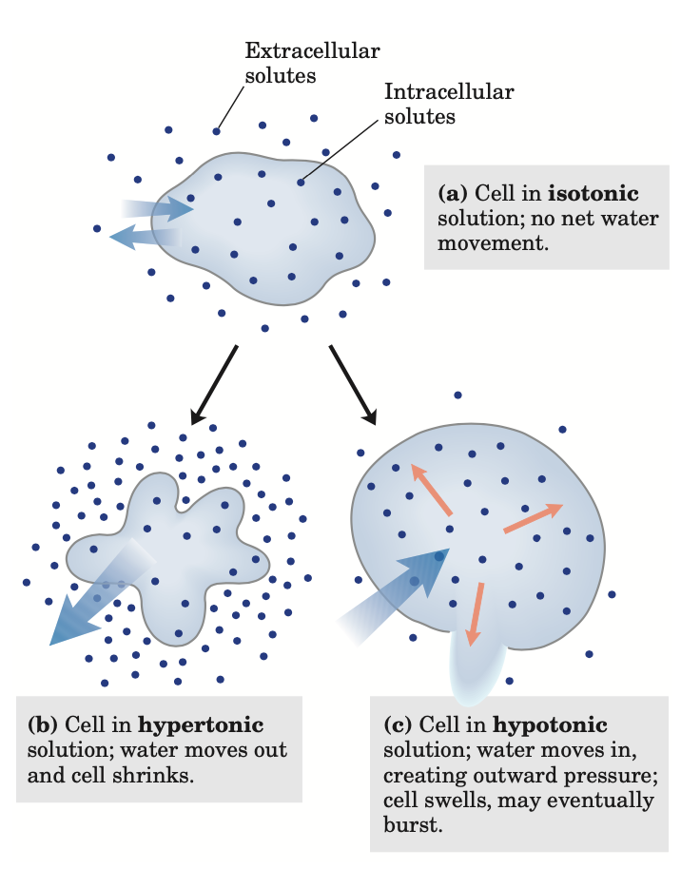
WATER
The Fitness of the Aqueous Environment
Solutions of equal osmolarity are said to be isotonic. Surrounded by an isotonic solution, a cell neither gains nor loses water
In a hypertonic solution, the cell shrinks as water flows out
In a hypotonic solution, with lower osmolarity than the cytosol, the cell swells as water enters

Slide 42
WATER
The Fitness of the Aqueous Environment
Other important considerations (To be adressed in specific settings of relevance)
Pure Water Is Slightly Ionized
Water as a Reactant - Water is not just the solvent in which the chemical reactions of living cells occur; it is very often a direct participant in those reactions.
The high specific heat of water
Most fundamental to all living organisms is the fact that many physical and biological properties of cell macromolecules, derive from their interactions with water molecules of the surrounding medium.

Slide 43
Thank You!
Don’t forget to send in all your questions to:
brainintraining2020@gmail.com
Look out for answers before our next class.
See you 27/02/2021 @ 6:00 PM for FOUNDATIONS 2 - Subcellular Organelles
Notes:
Special thanks to all the people who made
and released these awesome resources for free:
Presentation template by GoogleSlides.org

Slide 44
REFERENCES
BERG BİOCHEMİSTRY
5th edition. Jeremy M. Berg, John L. Tymoczko, and Lubert Stryer
LEHNİNGER PRİNCİPLES OF BİOCHEMİSTRY
4th edition. Nelson, David L., and Michael M. Cox

