Slide 1
CELL BIO
FOUNDATIONS 2
SUBCELLULAR ORGANELLES
DR. AKEEM THORPE

Slide 2
C
ontents
1
Introduction: We Are Cells
2
E. COLI: THE PROTOTYPICAL PROKARYOTE
3
EUKARYOTIC CELLS

Slide 3
01
WE ARE CELLS
UNIVERSAL PRINCIPLES OF LIVING CELLS

Slide 4
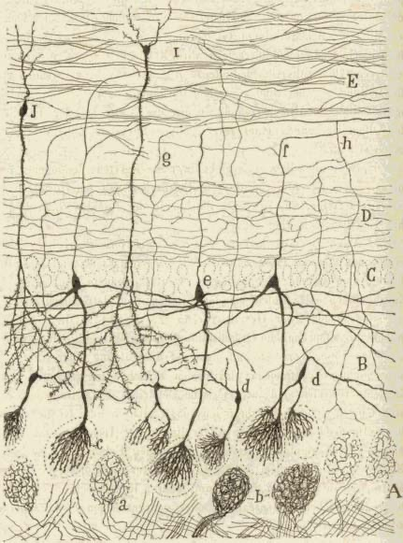
WE ARE CELLS
UNIVERSAL PRINCIPLES OF LIVING CELLS
We are all made of cells
The smallest organisms consist of single cells and are microscopic.
all cells of the simplest and most complex organisms share certain fundamental properties
The cell is the structural and functional unit of life
In this session, we will explore what cells are and how they work
Diagram of nerve cells from the cat brain, hand‐drawn by Santiago Ramón y Cajal. Ramón y Cajal was the first to recognize that the brain is made up of huge numbers of individual cells, rather than a continuous connected network as proposed by his competitor, Camillo Golgi.

Slide 5
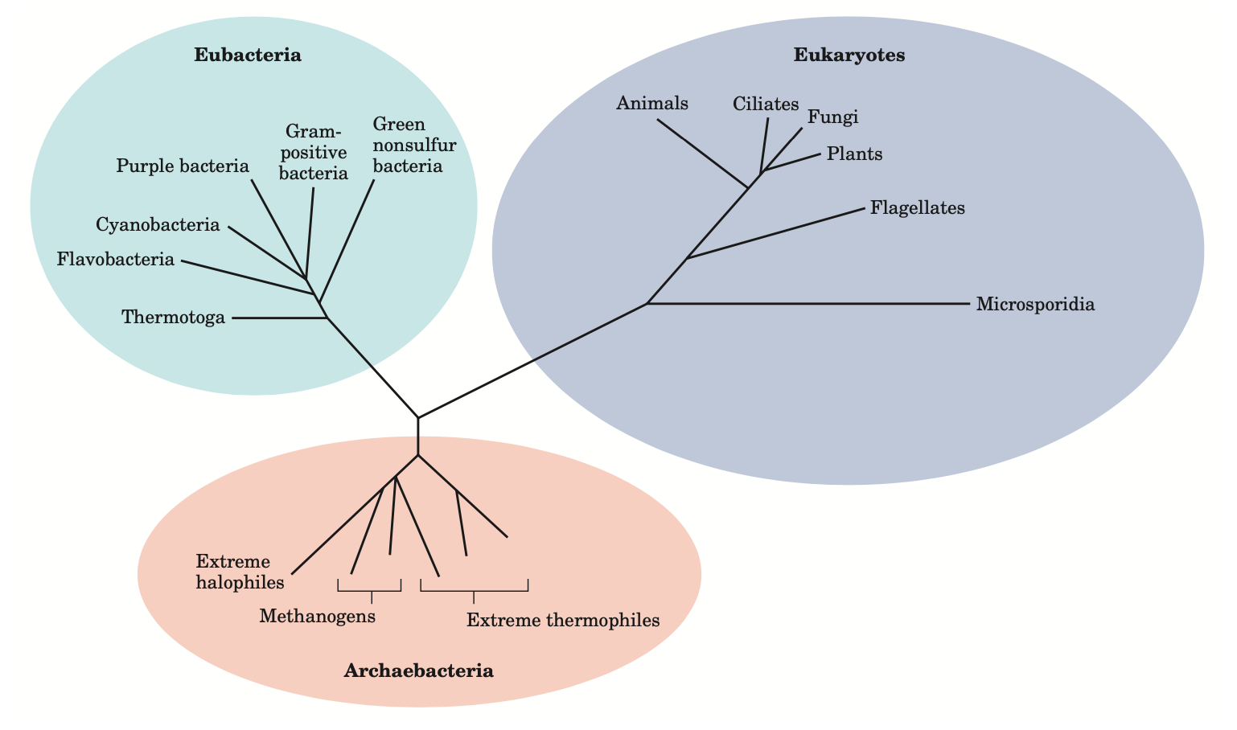
WE ARE CELLS
UNIVERSAL PRINCIPLES OF LIVING CELLS
Phylogeny of the three domains of life.
Phylogenetic relationships are often illustrated by a “family tree” of this type. The fewer the branch points between any two organisms, the closer is their evolutionary relationship.

Slide 6
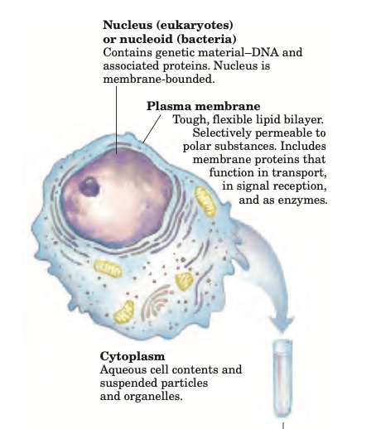
WE ARE CELLS
UNIVERSAL PRINCIPLES OF LIVING CELLS
Cells Are the STRUCTURAL and FUNCTIONAL Units of All Living Organisms
All cells share certain fundamental properties
Plasma membrane
Cytoplasm
Cytosol
Nucleus/Nucleoid

Slide 7
WE ARE CELLS
UNIVERSAL PRINCIPLES OF LIVING CELLS
Genetic information stored in the DNA is passed on to daughter cells
Linear chemical sequences stored in DNA code for RNAs and proteins
Macromolecular structures assemble from subunits
Membranes grow by expansion of preexisting membranes
Signal-receptor interactions target cellular constituents to their correct locations
Cellular constituents move by diffusion, pumps, and motors
Receptors and signaling mechanisms allow cells to adapt
Molecular feedback mechanisms control molecular composition, growth, and differentiation

Slide 8
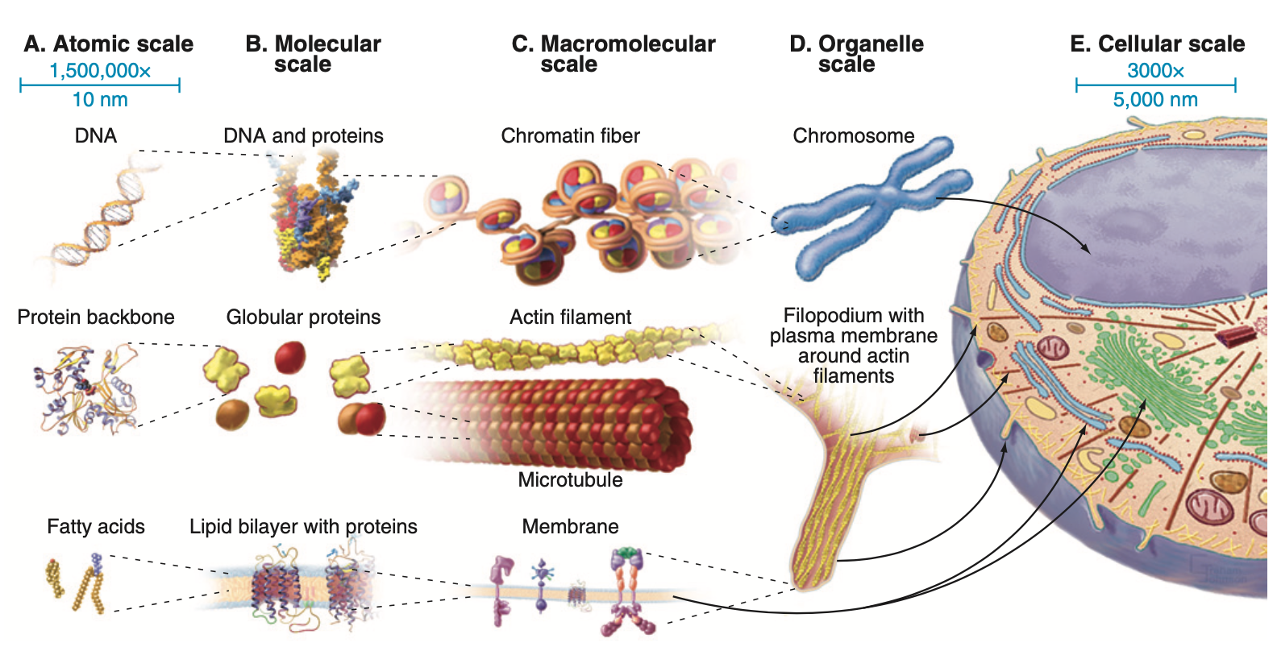
WE ARE CELLS
UNIVERSAL PRINCIPLES OF LIVING CELLS

Slide 9
WE ARE CELLS
UNIVERSAL PRINCIPLES OF LIVING CELLS
Several Features Distinguish Eukaryotic and Prokaryotic Cells
Bacteria and Archaea have chromosomes in the cytoplasm, cell membranes with similar families of pumps, carriers and channels, basic metabolic pathways, gene expression, motility powered by rotary flagella, and lack of membrane- bound organelles.
Eukaryotes comprise a multitude of unicellular organisms that differ from prokaryotes in having a compartmentalized cytoplasm with membrane-bounded organelles.

Slide 10
02
E. COLI
THE PROTOTYPICAL PROKARYOTE

Slide 11
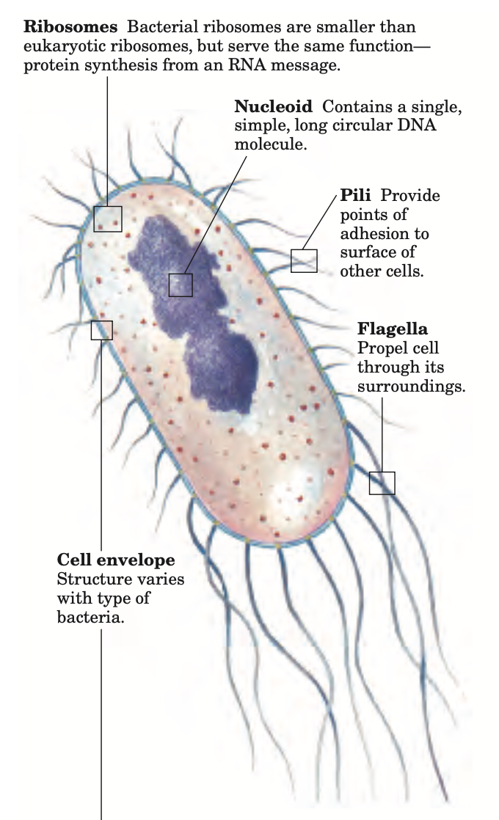
E. COLI
THE PROTOTYPICAL PROKARYOTE
Escherichia coli Is the Most-Studied Prokaryotic Cell
The E. coli cell is about 2 μm long and a little less than 1 μm in diameter. E. coli is a usually harmless inhabitant of the human intestinal tract.
It has a protective outer membrane and an inner plasma membrane.
Between the inner and outer membranes is a thin but strong layer of polymers called peptidoglycans

Slide 12
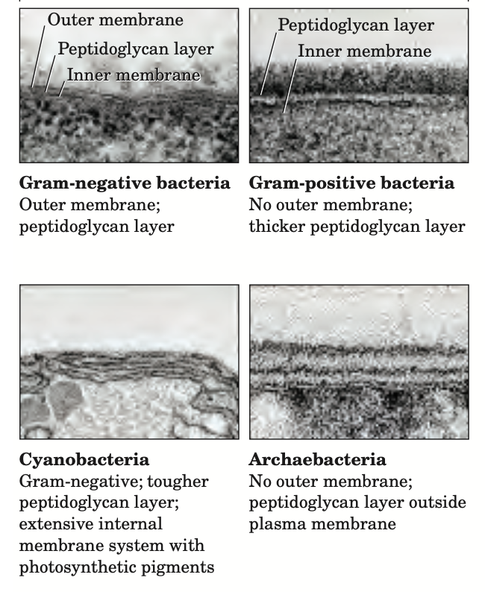
E. COLI
THE PROTOTYPICAL PROKARYOTE
Cell envelope Structure varies with type of bacteria.
Because of differences in the cell envelope structure, some eubacteria (gram- positive bacteria) retain Gram’s stain, and others (gram-negative bacteria) do not.
E. coli is gram-negative.

Slide 13
03
EUKARYOTIC CELLS
MEMBRANOUS ORGANELLES

Slide 14
EUKARYOTIC CELLS
MEMBRANOUS ORGANELLES
Typical eukaryotic cells are much larger than prokaryotic cells
The distinguishing characteristics of eukaryotes are the defined nucleus and a variety of membrane- bounded organelles with specific functions
Eukaryotic Cells Have a Variety of Membranous Organelles, Which Can Be Isolated for Study

Slide 15
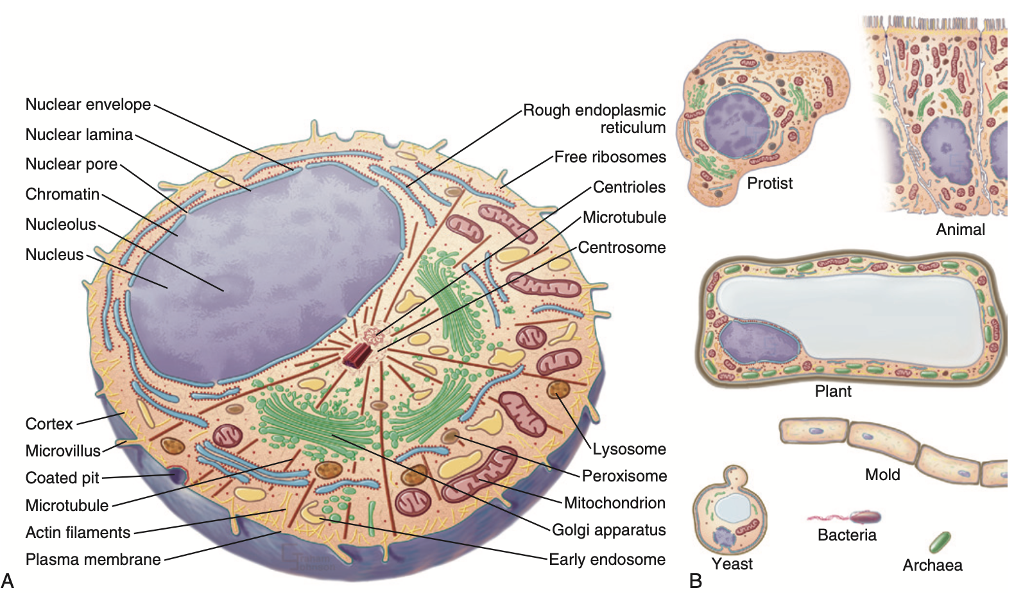
EUKARYOTIC CELLS
MEMBRANOUS ORGANELLES

Slide 16
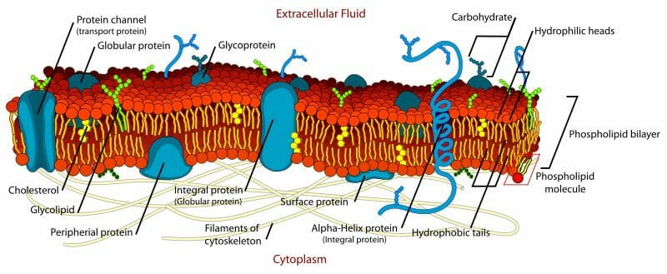
EUKARYOTIC CELLS
MEMBRANOUS ORGANELLES
THE PLASMA MEMBRANE is the interface of the cell with its environment

Slide 17
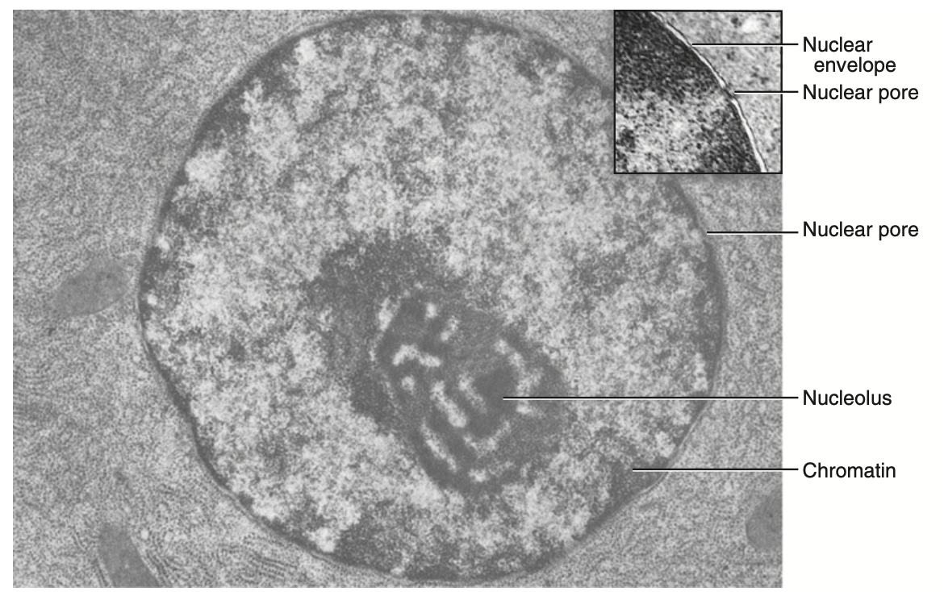
EUKARYOTIC CELLS
MEMBRANOUS ORGANELLES
The nuclear envelope is a double membrane that seprates the nucleus from the cytoplasm.
Genetic information is stored in extraordinarily long DNA molecules called chromosomes

Slide 18
EUKARYOTIC CELLS
MEMBRANOUS ORGANELLES
Lamins provide structural function in the cell nucleus.
Nuclear lamins interact with inner nuclear membrane proteins to form the nuclear lamina on the interior of the nuclear envelope.
Mutations in the LMNA gene are associated with several diseases, including:
Emery–Dreifuss muscular dystrophy
Familial partial lipodystrophy
Limb girdle muscular dystrophy
Dilated cardiomyopathy
Charcot–Marie–Tooth disease
Restrictive dermopathy
A truncated version of lamin A, commonly known as progerin, causes Hutchinson-Gilford-Progeria syndrome [premature ageing.

Slide 19
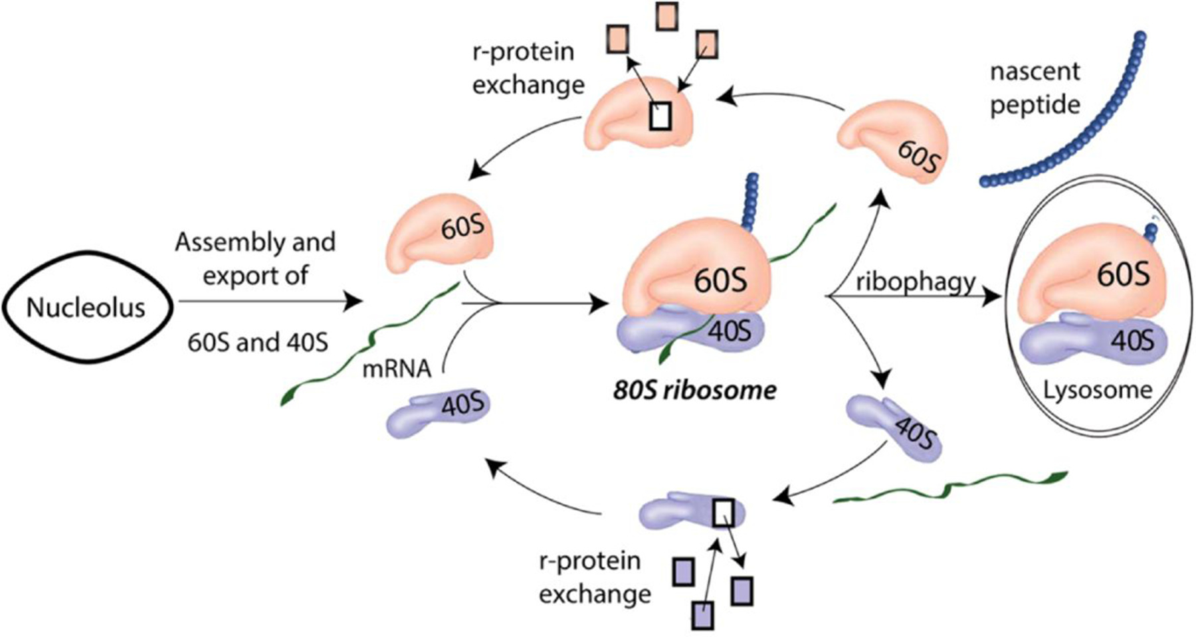
EUKARYOTIC CELLS
MEMBRANOUS ORGANELLES
Ribosomes catalyze the synthesis of proteins
Ribosomes are free in the cytoplasm

Slide 20
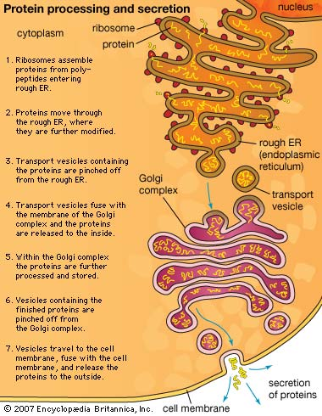
EUKARYOTIC CELLS
MEMBRANOUS ORGANELLES
Endoplasmic Reticulum
Synthesizes proteins destined for insertion into cellular membranes or for export from the cell.
Enzymes add sugar polymers to some proteins exposed in the lumen. Some proteins are retained in the ER, but most move on to other parts of the cell.
ER is very dynamic.

Slide 21
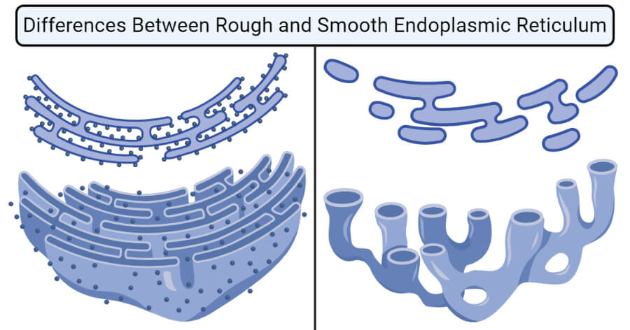
EUKARYOTIC CELLS
MEMBRANOUS ORGANELLES
https://smw.ch/journalfile/view/article/ezm_smw/en/smw.2002.09861/4314855adf9daac46956e2c3cdaa98f13f3f2968/smw.2002.09861.pdf/rsrc/jf#:~:text=ER%20storage%20diseases%20(ERSDs)%20are,ERSDs%20is%20very%20het%2D%20erogeneous.

Slide 22
EUKARYOTIC CELLS
MEMBRANOUS ORGANELLES
VARIOUS ER STORAGE DISEASES. May be due to:
1. Lack of protein due to ER retention
Cystic fibrosis and associated diseases
Protein C deficiency
Osteogenesis imperfecta
Albinism/tyrosinase deficiency
2. Toxic protein or protein aggregates
? Creutzfeldt-Jakob disease
3. Defective transport machinery
Combined coagulation factor V and VIII deficiency

Slide 23
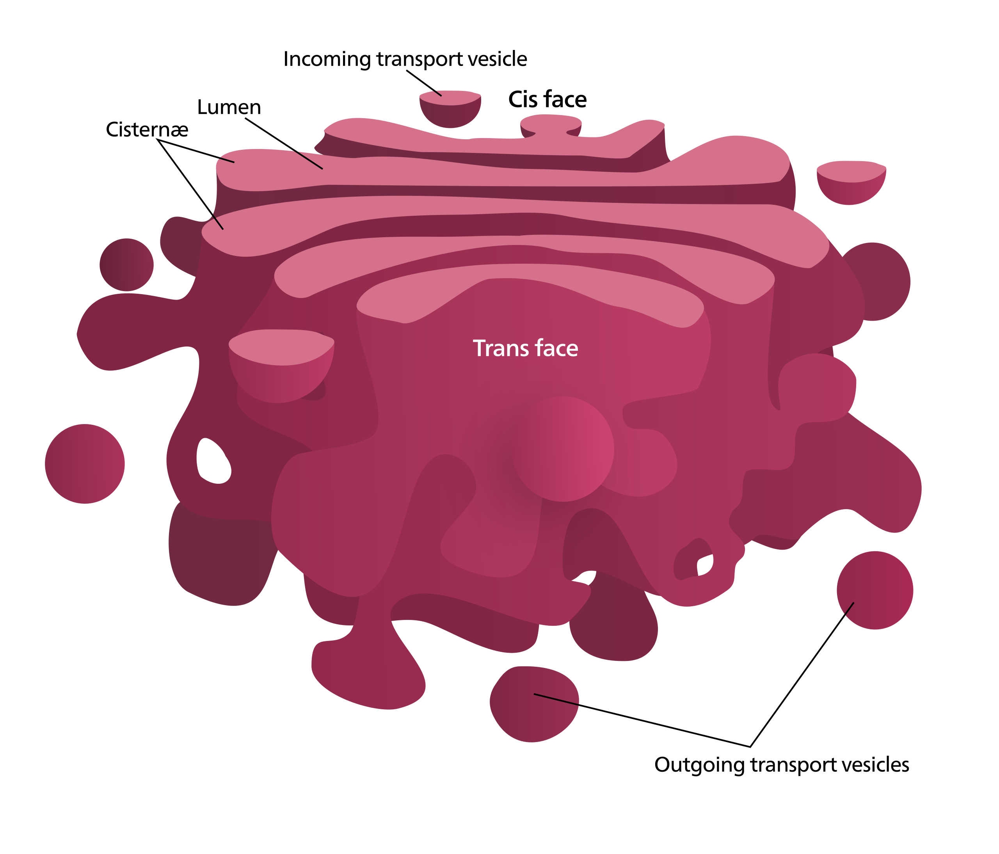
EUKARYOTIC CELLS
MEMBRANOUS ORGANELLES
The Golgi apparatus consists of a stack of flattened, membrane-bound sacks with many associated vesicles.
The Golgi apparatus processes the sugar side chains on transmembrane and secreted proteins
The Golgi apparatus is also involved in lipid transport and lysosome formation

Slide 24
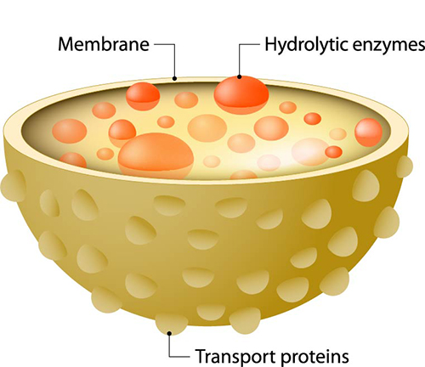
EUKARYOTIC CELLS
MEMBRANOUS ORGANELLES
An impermeable membrane separates degradative enzymes inside lysosomes from other cellular components
Cells ingest microorganisms and other materials in membrane vesicles derived from the plasma membrane.
The contents of these endosomes and phagosomes are delivered to lysosomes for degradation by lysosomal enzymes

Slide 25
EUKARYOTIC CELLS
MEMBRANOUS ORGANELLES

Slide 26
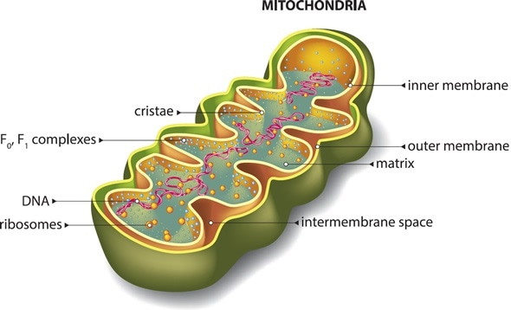
EUKARYOTIC CELLS
MEMBRANOUS ORGANELLES
Mitochondrial enzymes use most of the energy released from the breakdown of nutrients to synthesize ATP.
Mitochondria cluster near sites of ATP utilization, such as membranes engaged in active transport, nerve terminals, and the contractile apparatus of muscle cells.

Slide 27
EUKARYOTIC CELLS
MEMBRANOUS ORGANELLES
Leber's hereditary optic neuropathy (LHON)
Leigh syndrome
Neuropathy, ataxia, retinitis pigmentosa, and ptosis (NARP)
Myoneurogenic gastrointestinal encephalopathy (MNGIE)
MERRF syndrome
MELAS syndrome

Slide 28
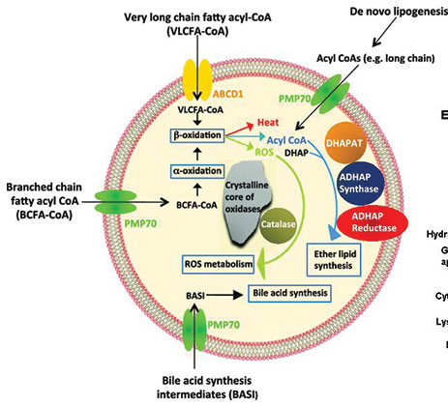
EUKARYOTIC CELLS
MEMBRANOUS ORGANELLES
Peroxisomes are small, membrane-enclosed cellular organelles containing oxidative enzymes that are involved in a variety of metabolic reactions, including several aspects of energy metabolism.
Purine degradation
Lipid biosynthesis
Fatty acid oxidation
Notes:
Peroxisomes are small, membrane-enclosed cellular organelles containing oxidative enzymes that are involved in a variety of metabolic reactions, including several aspects of energy metabolism.
They are considered as an important type of microbody found in both plants and animal cells.
They were identified as organelles by Belgian cytologist Christian de Duve in 1967 after already been described.
First peroxisomes to be discovered were isolated from leaf homogenate of spinach.
They are most abundantly found in detoxifying organs such as the liver and kidney cells. However, they can be induced to proliferate in response to metabolic needs.
They are membrane-bound spherical bodies of 0.2 to 1.5 μm in diameter found in all eukaryotic organisms including both plants and animal cells.
They are found floating freely in the cytoplasm in close association of ER, mitochondria or chloroplast within the cell.
They are among the simplest of eukaryotic organelles.
They exist either in the form of a network of interconnected tubules called peroxisome reticulum or as individual microperoxisomes.
They are variable in size and shape according to the cell and usually circular in cross-section.
They range from 0.2 -1.5 μm in diameter.
It consists of a single limiting membrane of lipid and protein molecules enclosing the granular matrix.
The matrix consists of fibrils or a crystalloid structure containing enzymes.
Functions of Peroxisomes
Hydrogen Peroxide Metabolism:
Enzymes present in the peroxisomes both lead to the production and elimination of H₂0₂ which is a reactive oxygen species.
Fatty acid oxidation:
Oxidation of fatty acids, in animal cells, occurs in both peroxisomes and mitochondria, but in yeasts and plants, only limited to peroxisomes.
Oxidation is accompanied by the production of H₂0₂ which is decomposed by catalase enzyme. This provides a major source of metabolic energy.
Lipid biosynthesis
Synthesis of cholesterol and dolichol occurs in both ER and peroxisomes. Bile acid synthesis takes place from cholesterol in the liver.
Peroxisomes contain enzymes to synthesize plasmalogens, a family of phospholipids which are important membrane components of tissues of the heart and brain.
Germination of seeds
Peroxisomes in seeds responsible for the conversion of stored fatty acids to carbohydrates, critical to providing energy and raw materials for the growth of germinating plants.
Photorespiration
Peroxisomes in leaves particularly in the green ones carry out the photorespiration process along with chloroplasts.
Degradation of purines
Carry out the catabolism of purines, polyamines and amino acids especially by uric acid oxidase
Bioluminescence
Luciferase enzyme found in the peroxisomes of fireflies help in bioluminescence and thus aid the flies in finding a mate or its meal.

Slide 29
EUKARYOTIC CELLS
MEMBRANOUS ORGANELLES
Approximately 60 known enzymes are present in the matrix of peroxisomes.
The main groups of enzymes include:
Urate oxidase
D-amino acid oxidase
Catalase
Notes:
Approximately 60 known enzymes are present in the matrix of peroxisomes.
They are responsible to carry out oxidation reactions leading to the production of hydrogen peroxide.
The main groups of enzymes include:
Urate oxidase
D-amino acid oxidase [in humans is a candidate susceptibility gene and together with G72 may play a role in the glutamatergic mechanisms of schizophrenia. DAAO also plays a role in both biotechnological and medical advancements. Risperidone and sodium benzoate are inhibitors of DAAO.]
Catalase

Slide 30
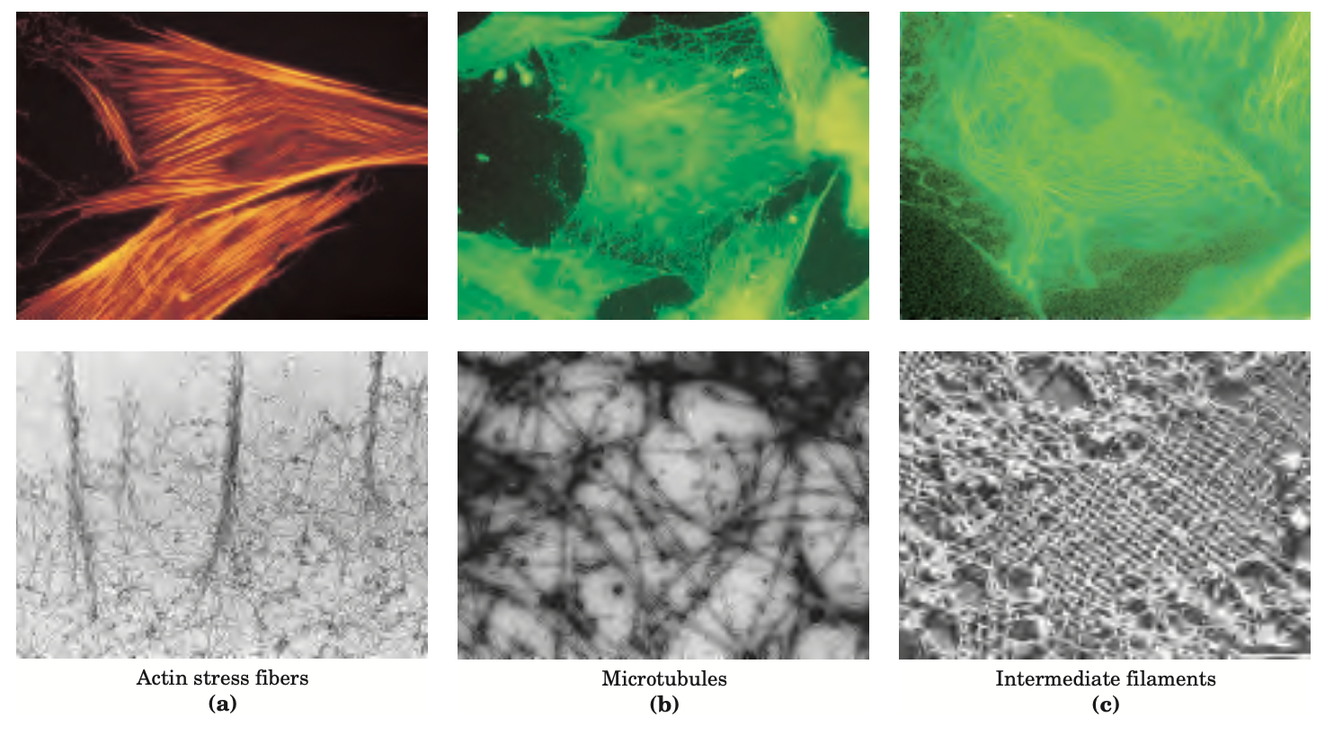
EUKARYOTIC CELLS
MEMBRANOUS ORGANELLES
The Cytoplasm Is Organized by the Cytoskeleton and Is Highly Dynamic

Slide 31
EUKARYOTIC CELLS
MEMBRANOUS ORGANELLES
COMPARTMENTALIZATION OF CELLULAR FUNCTIONS
Notes:
Compartmentation of functions within
an organelle allows mutually exclusive
or opposite metabolic pathways to
occur simultaneously within a cell.

Slide 32
EUKARYOTIC CELLS
MEMBRANOUS ORGANELLES
Compartmentalization is vital
Compartments help to separate even chemically quite heterogeneous environments and so to optimize the course of chemical reactions.
The cell must also protects itself against the activity of lytic enzymes. For example, sealing the cellular digestion in lysosomes prevents an unwanted auto-digestion of other organelles within cell.
Notes:
Importance of compartmentalization
All reactions occurring in cells take place in certain space – compartment, which is separated from other compartments by means of semipermeable membranes. They help to separate even chemically quite heterogeneous environments and so to optimise the course of chemical reactions.
Enzymes catalysing individual reactions often have different temperature and pH optimums and if there was only one cellular compartment a portion of enzymes would probably not function or them-catalysed reactions would not be sufficiently efficient. By dividing the cellular space, optimal conditions for individual enzymatically catalysed reactions are created.
At the same time, cell also protects itself against the activity of lytic enzymes. For example, sealing the cellular digestion in lysosomes prevents an unwanted auto-digestion of other organelles within cell. A common processes that accompany the disruption of some of the compartments (like spilling the content of lysosomes or mitochondria) are necrosis or activation of apoptosis (the process of programmed cell death).
Compartmentalization affects the regulation of metabolic pathways as well, making them more accurate and targeted and less interfering with each other. It is sometimes possible to regulate the course of the reaction at the point of entry of particular substrate into the compartment (transport across the membrane, often mediated by transport mechanisms).
Despite its advantages, compartmentalization at the same time puts greater demand on the energy consumption. It arises from a frequent need to use ATP-dependent transporters, transporting substances across membranes against the concentration gradient and thus creating different environments in different compartments.

Slide 33
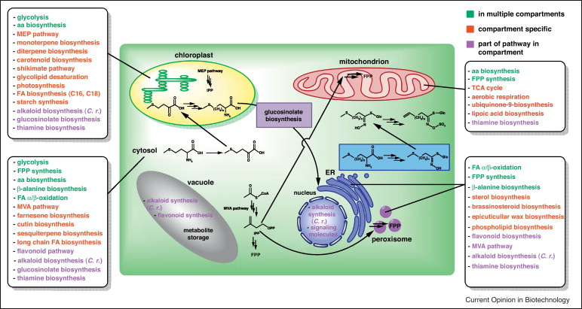
EUKARYOTIC CELLS
MEMBRANOUS ORGANELLES

Slide 34
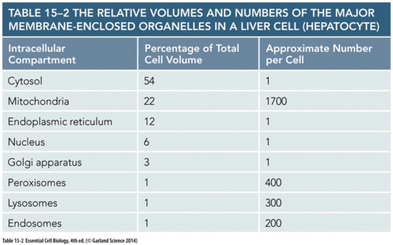
EUKARYOTIC CELLS
MEMBRANOUS ORGANELLES
Notes:
Different cells have different proportions of organelles

Slide 35
Thank You!
Don’t forget to send in all your questions to:
brainintraining2020@gmail.com
Look out for answers before our next class.
See you next class where we conclude with FOUNDATIONS 3 - Cell Transport Mechanisms & Oedema Formation
Notes:
Special thanks to all the people who made
and released these awesome resources for free:
Presentation template by GoogleSlides.org

Slide 36
REFERENCES
BERG BİOCHEMİSTRY
5th edition. Jeremy M. Berg, John L. Tymoczko, and Lubert Stryer
LEHNİNGER PRİNCİPLES OF BİOCHEMİSTRY
4th edition. Nelson, David L., and Michael M. Cox

