Slide 1
Blood Vessel and Cardiac Pathology
By: Dr. Anton Small

Slide 2
A 56 year old man comes into A&E with a complaint of crushing central chest pain that started 1 hours ago. He states that he has never experienced anything like this before. The pain started while he was washing his car, rated a 10/10 and radiates to his left shoulder and neck. He has a history of hypertension, however does not take his medication regularly, and has a 20 pack year smoking history. On examination you see an overweight male in painful distress and dyspneic. His vitals are BP 148/100, pulse 102, SpO2 99% on room air and RR of 24.The remainder of his physical exam is unremarkable. He is started on aspirin, GTN, clopidogrel, beta blockers and heparin. ECG done shows no T-wave or ST-segment abnormalities. Troponin levels taken off at presentation are 50 and repeat in 4 hours is 99. (Range <10 low risk, 10-99 moderate risk, >99 high risk).

Slide 3
What was the initial lesion that led to the pathogenesis of this patient's condition?
What are the modifiable risk factors for this condition?
Three days after admission the patient develops new chest pain. Physical exam reveals muffled heart sounds, with no increased JVD and a scratching like sound on auscultation of the heart. What is the likely diagnosis?
On day 3, the patient develops new onset of chest pain, SOB and palpitations. What blood test can be done to determine if the patient is having another occurrence of the disease?
On day 7 the patient develops an arrhythmia and dies. What will the likely gross and microscopic changes of the heart be?

Slide 4
Endothelial injury/dysfunction.
Hypertension, diabetes, dyslipidemia, smoking
Fibrinous pericarditis
CK-MB
In the infarcted section: gross- yellow pallor, micro- invasion with macrophages

Slide 5
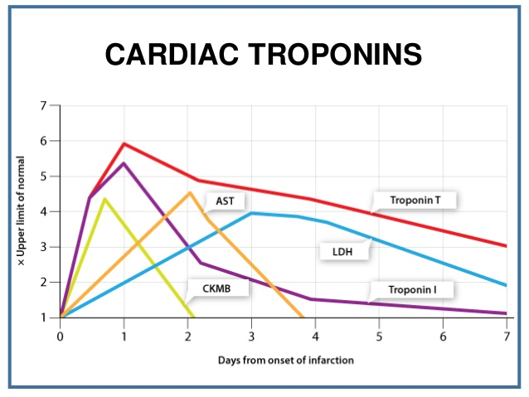

Slide 6
A 65 year old female comes to A&E with sudden onset of painless loss of vision to the right eye. She has a 1 year history of headaches, mainly to the right side, as well as a cramping jaw pain that occurs with chewing and relieved when she stops chewing. Her past medical history is only significant for polymyalgia rheumatica
What test would confirm the diagnosis?
What would this test show?

Slide 7
Temporal Artery biopsy
Granulomatous infiltration of the vessel wall, usually with multinucleated giant cells

Slide 8
A 4 year old girl comes to A&E with a 9 day history of fever measured between 38-39ºC by the mother each day. Over the past few days she has developed a rash that started on the truck and spread to the limbs, as well as dryness and cracking to the lips and tongue, and mother finds the tongue looks like a strawberry. On examination you note erythema to the mouth as well as cracking to the lips, bilateral conjunctivitis as well as cervical lymphadenopathy.
What is the likely diagnosis?
How would you manage this condition?
What is a feared adverse reaction to treatmeant?

Slide 9
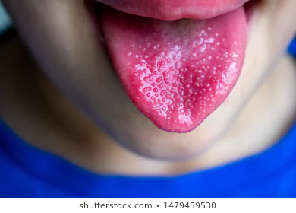
Kawasaki Disease
Asians>Blacks>Caucasians
Peak age 3 months to 5 years
Diagnosis: FEver >5 days and any 4 of the following
Bilateral Conjunctivitis
Erythema of the hands and soles
Polymorphic rash
Cervical lymphadenopathy
Oral mucosal changes (strawberry tongue, fissured lips, injected pharynx
Coronary artery involvement can lead to lead to myocardial infarction or aneurysm with rupture
Managed with IVIG and aspirin
Reye’s Syndrome – acute non-inflammatory encephalopathy and fatty liver degeneration

Slide 10
A 45 year old male comes to A&E with the complaint of severe headache and reports of twisting to the face. He reports the headache is a bilateral throbbing headache, that started yesterday evening and persisted into today. His wife noticed his face looks asymmetrical this morning and told him to go to the emergency. He has no past medical history but has a 20 pack year smoking history. His vitals are BP 194/120, pulse 84, RR 20 and SpO2 is 99% on room air. On examination you see an obese male in nil distress, physical exam is unremarkable with no neurological deficits noted.
What is the likely diagnosis?
What are some of the secondary causes of hypertension?

Slide 11
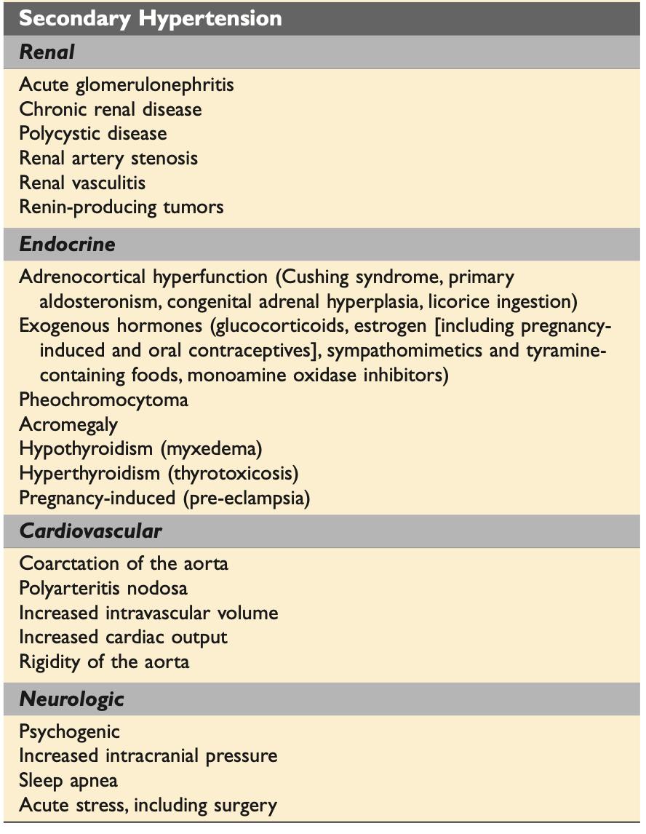
Hypertensive emergency presenting with Transient Ischemic Attack
Notes:
Hyaline arteriolosclerosis

Slide 12
A 65 year old male presents for a routine medical check up. He has been in good health apart from hypertension managed on enalapril as well as a 30 pack year smoking history however he quit smoking 10 years now. On physical you note a middle line mass, that is pulsatile as well as expansile. Shortly after examination he complains of numbness and tingling to his right leg. On examination, he right dosalis paedis pulse is weaker than the left.
What is the likely diagnosis?
What complication has he likely developed after his initial examination?

Slide 13
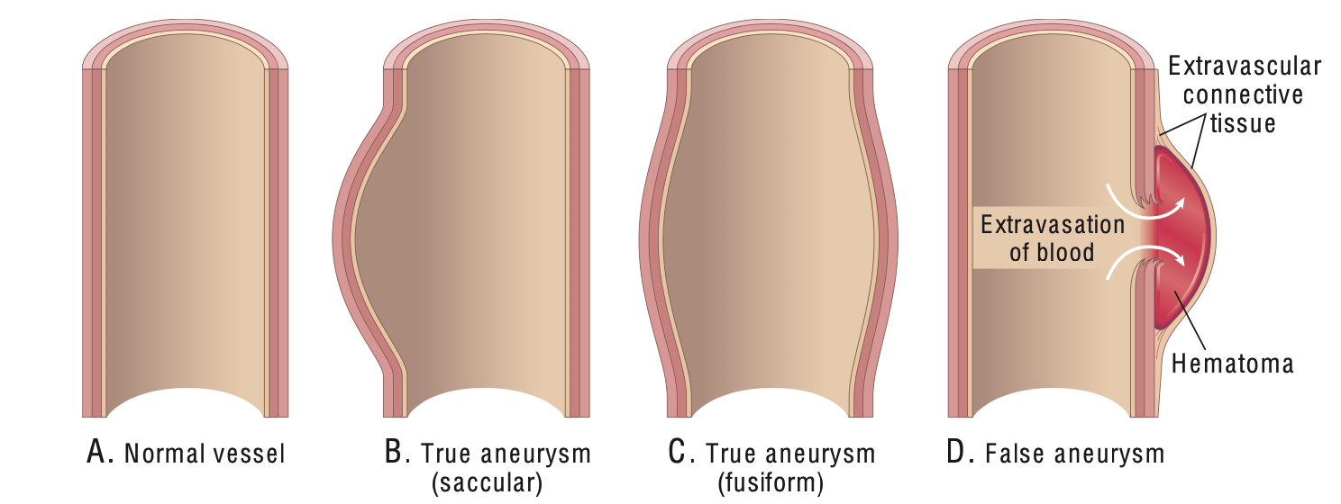
Aneurysm
Abnormal dilation of a blood vessel of the heart
Acute limb ischemia

Slide 14
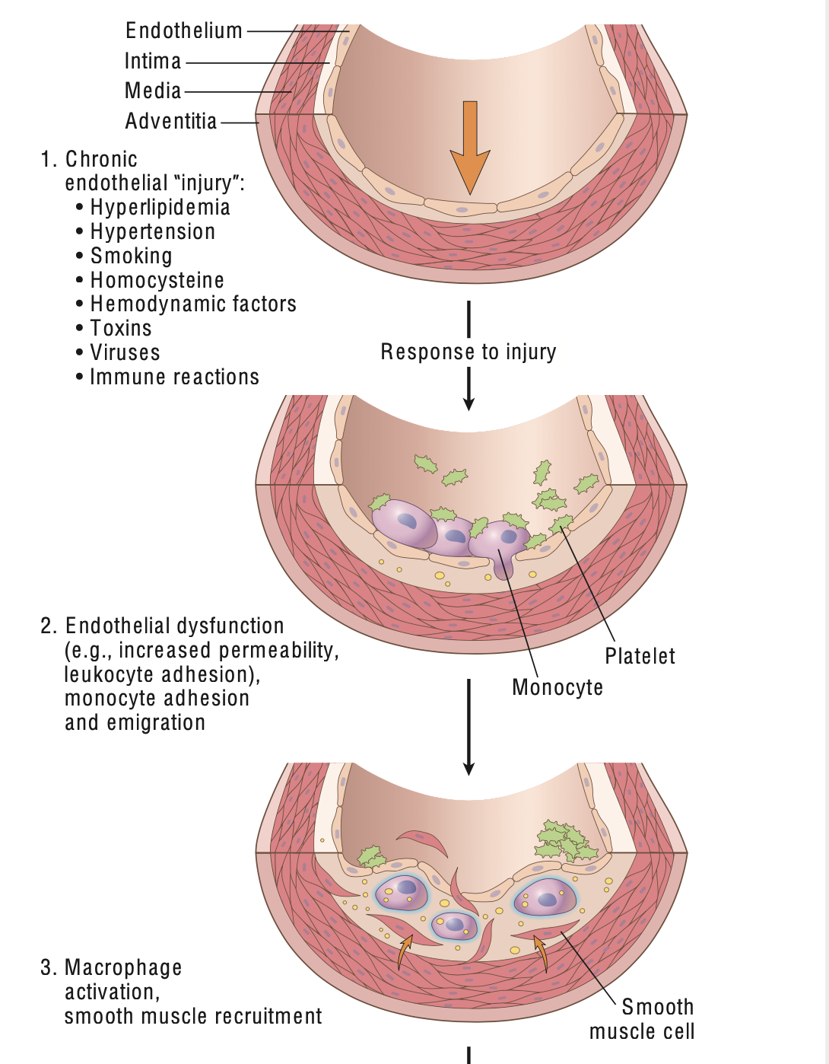
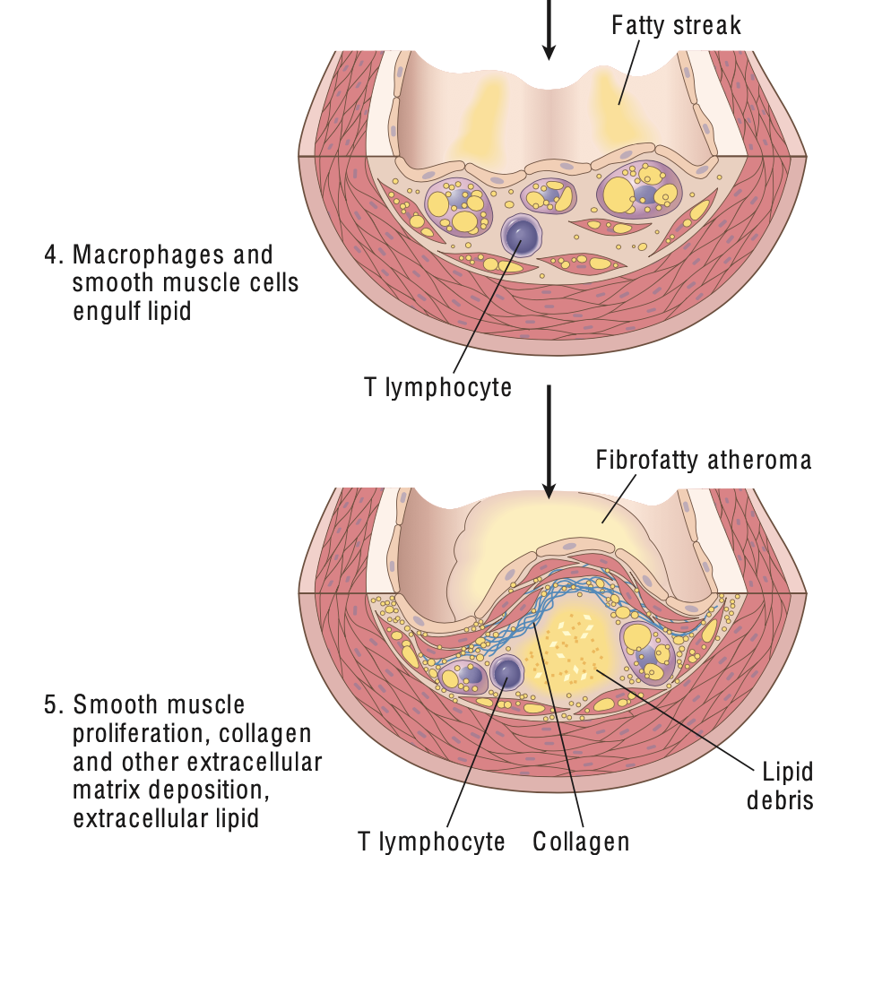

Slide 15
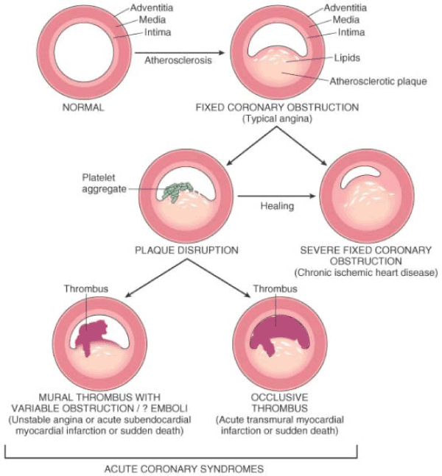
Pathogenesis
Coronary atheromatous plaque undergoes fissuring, rupture or hemorrhage
Subendothelial collagen and necrotic plaque contents cause platelet adhesion
Platelets release granules which lead to platelet aggregation
Mediators from platelets cause vasospasm
Tissue factors trigger the coagulation cascade worsening the thrombus

Slide 16
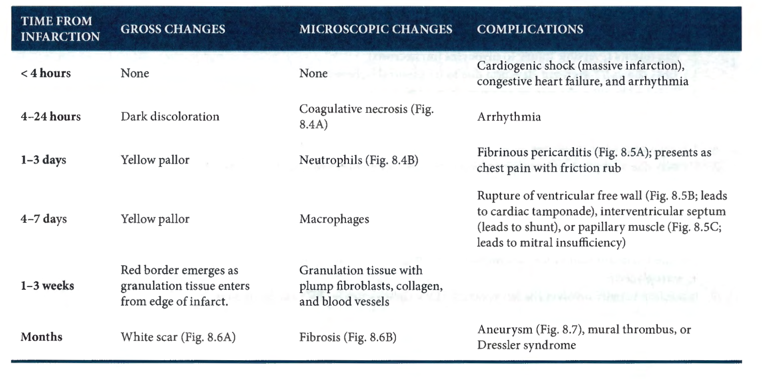

Slide 17
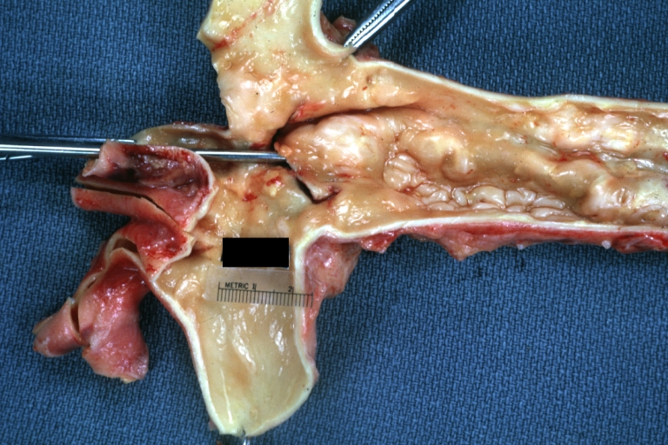
Notes:
A 65 year old male is brought in for sudden onset of severe chest pain radiating to the back. During examination, the patient becomes unresponsive and attempts to resuscitate are unsuccessful. At autopsy the following is seen.
What is the diagnosis?
Aortic Dissection

Slide 18
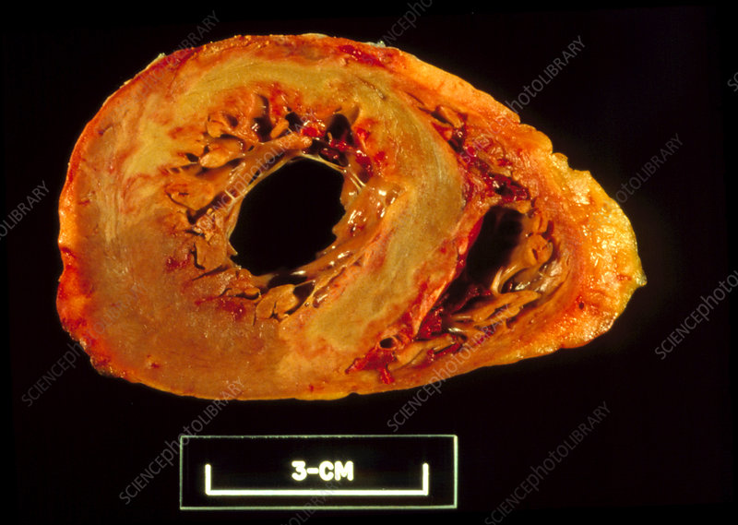
Notes:
A 56 year old female is brought into A&E for sudden onset of a central, crushing chest pain, radiating to her neck and left arm. She is diagnosed with an STEMI. On her way to the cardiac intervention suit, she becomes unresponsive and attempts to resuscitate her ar unsuccessful.
What is the likely cause of death in this patient?
Arrhythmia
What biochemical marker is most sensitive for diagnosing this condition?
Troponin
Had this patient survived the MI, what condition is he at great risk of developing?
Congestive heart failure

Slide 19
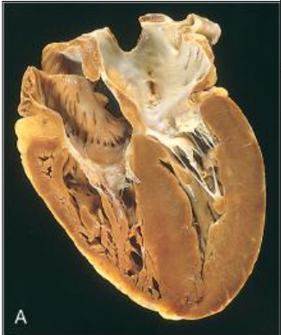
Notes:
A 65 year old male is brought for autopsy after being found unresponsive at home. He has no past medical history on record. On examination of the heart,no abnormalities are noted to the valves, the right atrial thickness is 4mm and the left ventricle is 21 cm.
What underlying condition did this patient likely have?
Uncontrolled hypertension

Slide 20
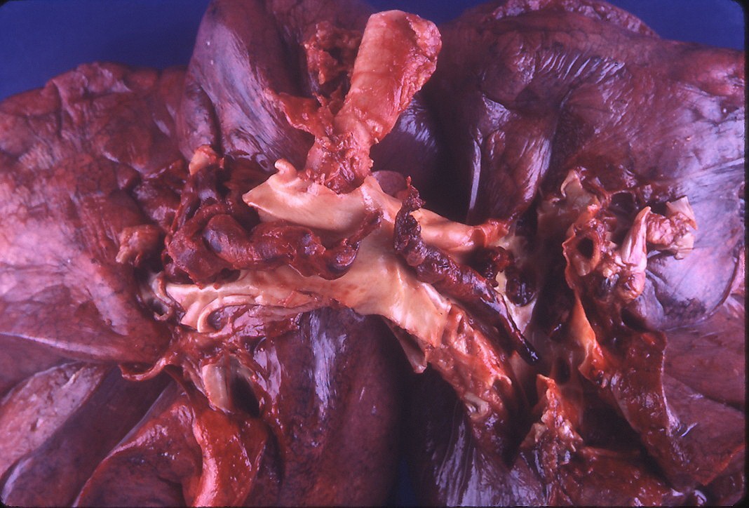
Notes:
A 85 year old female was being treated with palliative care for metastatic breast cancer. She suddenly develops shortness of breath and dies. At autopsy the following is found.
What is the cause of death?
Pulmonary embolism
How can this be differentiated from a postmortem artifact?
Lines of Zahn
What are risk factors for this disease?
Virchow’s triad- Stasis, endothelial injury, hypercoagulable state

Slide 21
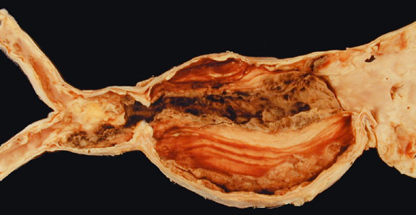
Notes:
A 60 year old male is brought in for sudden onset of severe abdominal pain. On presentation he is in severe shock. Resuscitation is attempted however the patient eventually dies. At autopsy the following is found along with a large volume of clotted blood in the abdomen.
What is the likely cause of death?
Ruptured AAA

Slide 22
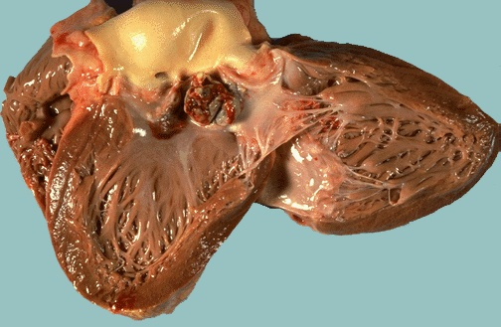
Notes:
A 50 year old female admitted for fever and confusion. Blood cultures done return positive for Strep viridans and she is started on antibiotic therapy. Three days after admission, she develops of uncontrolled seizures and eventually dies. At autopsy the following is found.
What is the diagnosis?
INfective endocarditis
What was the likely cause of this patients seizures?
Septic emboli to the brain

Slide 23
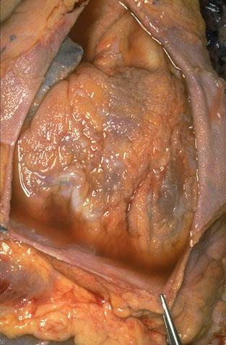
Notes:
A 30 year old male presents with SOB and central chest pain. The chest pain is worse with leaning back, and significantly relieved by leaning forward. His Trop at presentation is significantly elevated and the repeat 4 hours later, is as elevated as the first. The patient eventually develops an arrhythmia and dies. The following is found at autopsy.
What is the diagnosis?
Fibrinoid pericarditis
What is the most common cause of this condition?
Viral infection (Coxsackievirus)

