Slide 1
Gastroenterology Pathology
By: Dr Anton Small

Slide 2
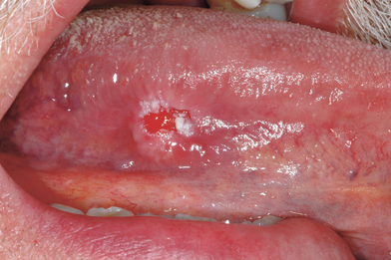
A 70 year old male comes to the clinic with a report of a red rough patches to the lateral side of the tongue. He tried scraping them away with dental floss but they bleed and seem adherent to the tongue. He was recently diagnosed with COPD, but otherwise has been in good health.
What is your next step in management?

Slide 3
The biopsy comes back being malignant, what malignancy is it most likely?
What are the risk factors for this malignancy?
Microscopically what is characteristic of this malignancy?

Slide 4
Squamous cell carcinoma
Smoking and drinking
Keratin pearls (abnormal keratinization)

Slide 5
A 60 year old male presents to clinic with the complaint of having difficulties swallowing solids but not liquids. He has a history of GERD and was diagnosed with Barrett’s Oesophagus 6 months ago. A barium swallow down shows symmetric circumferential narrowing of the distal oesophagus.
What are your differentials?
Which one is most likely?
How would you confirm your diagnosis?

Slide 6
Stricture, achalasia, malignancy, hiatal hernia
Stricture
Endoscopy with biopsy
If it was a malignancy what type of malignancy would it be?

Slide 7
Adenocarcinoma

Slide 8
A 3 hour old infant starts experiencing choking, vomiting and coughing shortly after initiating breastfeeding. She was born at 40 weeks with the only complication of polyhydramnios. APGARs were 9 and 9. On examination the infant has nasal flaring and intercostal recessions. Nurse reports difficulty in passing an nasogastric tube.
What is the likely diagnosis?

Slide 9
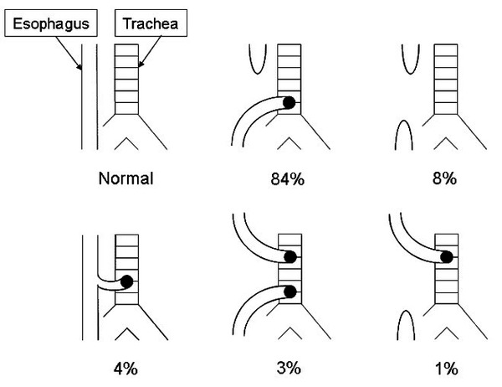
Tracheoesophageal fistula

Slide 10
A 24 month female is brought to the clinic due to abdominal pain. The pain is severe and intermittent, and the child brings her legs to her chest during the episodes. The mother reports she has an episode of gastroenteritis 2 weeks ago. On examination, there is mild abdominal tenderness with a cylindrical mass palpated to the right side of the abdomen.
What is the likely diagnosis?
What is the likely trigger for this condition?
Are any vaccines contraindicated in this patient?
If this condition was to get more severe, how might the patient present?

Slide 11
Intussusception
Hypertrophied Peyer's Patches (Lymphoid tissue)
Rotavirus vaccine is contraindicated
Currant jelly stool (blood mixed with mucus) due to bowel wall ischemia

Slide 12
A 2 day old baby is ready for discharge however the nurse and mother reports the baby is yet to pass meconium. The pregnancy and delivery was uneventful. On examination you see a well looking neonate, vitals within normal limits physical exam is unremarkable apart from mild abdominal distention. A digital rectal exam is performed and on removal of the finger meconium is seen spraying from the anus.
What is the likely diagnosis?
How would you confirm your diagnosis and what would the result show?
Are there any special histological techniques that might be used in this patient?

Slide 13
Hirschsprung disease (Associated with Down syndrome)
Rectal suction biopsy - aganglionosis and neural hypertrophy
Frozen section

Slide 14
An 18 year old college freshmen is brought to the emergency room after multiple episodes of vomiting. His friends reports they were drinking to celebrate the end of term examinations, then he started having 3-4 episodes of forced vomiting follow by two episodes of vomiting blood.
What is the likely diagnosis?
During resuscitation the patient complains of severe chest pain, he spikes a fever, chest x-ray shows a widened mediastinum, what is the likely diagnosis?

Slide 15
Mallory-Weiss tear (longitudinal laceration at the GE Junction)
Boerhaave Syndrome - complete rupture of oesophagus (highly fatal)

Slide 16
A 40 year old male comes to the emergency room with sudden onset of abdominal pain, nausea and two episodes on vomiting. His past medical history is insignificant apart from epigastric pain for the last few months, that improves with meals, which he has been take antacids for with mild relief. On examination, he has a fever with epigastric and right upper quadrant tenderness with guarding but no rebound.
What will an abdominal x-ray likely show?
What is the likely underlying cause of this patient’s condtion?

Slide 17
Pneumoperitoneum (air under the diaphragm) - likely a perforated viscus
Likely H. pylori induced duodenal ulcer leading to perforation
If anterior wall of the duodenum is perforated you get the above presentation
If posterior wall is perforated you get upper/lower GI bleed due to erosion into the gastroduodenal artery

Slide 18
A 50 year old man comes in with a swelling to the right side of the neck that he notices gets bigger after drinking water. He sometimes has a feeling of food getting stuck in his throat on swallowing and his wife reports his breathe has been getting worse despite an increase in oral hygiene.
What is the likely diagnosis?
What is the underlying pathology?

Slide 19
Zenker’s Diverticulum (Not a true diverticulum)
Acquired muscular defect in the pharyngeal mucosa

Slide 20
A 76 year old woman presents with a 2 day history of left lower quadrant pain and fever. The patient has an uneventful past medical history apart from recurrent episodes of constipation for the last 20 years. Examination reveals tenderness to the left lower quadrant with rebound but no guarding. CT scan of the abdomen reveals a collection near the sigmoid colon.
What is the likely diagnosis?
What are the complications of this condition?

Slide 21
Acute diverticulitis
Lower GI bleed (hematochezia), bowel obstruction, fistula formation

Slide 22
A 55 year old caucasian male with recently diagnosed heart failure, presents with a complain of tan like complection despite avoidance of the sun. Physical exam is unremarkable apart from non-tender hepatomegaly.
What condition does this patient likely have?
How test would you order to confirm the diagnosis?

Slide 23
Haemochromatosis
Iron studies - elevated ferritin, decreased TIBC, elevated serum iron, elevated % saturation

Slide 24
A 65 year old male comes in with complaints of epigastric pain, mostly at night when he sleeps. He sometime wakes up at night with a cough and a bitter taste in the back of his mouth. He has experiences this problem for the last few years, however has been managing on antacids. He reports no weight loss, melena, dysphagia or vomiting. An upper GI endoscopy is done with biopsy of the lower oesophagus. The result comes back showing stratified columnar epithelium with goblet cells, and no evidence of malignancy. What condition is this patient at risk of developing?

Slide 25
Adenocarcinoma of the esophagus

Slide 26
A 21 year old male comes to the clinic with a complaint of crampy abdominal pain associated with diarrhea. The pain is worse to the right lower quadrant but its intermittent, and the diarrhea is sometimes associated with blood. The patient reports a 5kg weight loss in the last 3 months. Colonoscopy is done and a lesions to noted in the transverse colon with a cobblestone appearance.
What is the likely diagnosis?
What other complications can this patient develop?

Slide 27
Crohn’s Disease
Fistulas, malabsorption and nutritional deficiencies, colon cancer

Slide 28
A 70 year old female presents to the emergency room due to abdominal pain, vomiting and failure to pass stool. She complains that she hasn’t been able to pass stool for 5 days now and the pain and vomiting starts 3 days ago. She is taken for emergency surgery and a section of the sigmoid colon is removed.
What are the risk factors for this condition?

Slide 29
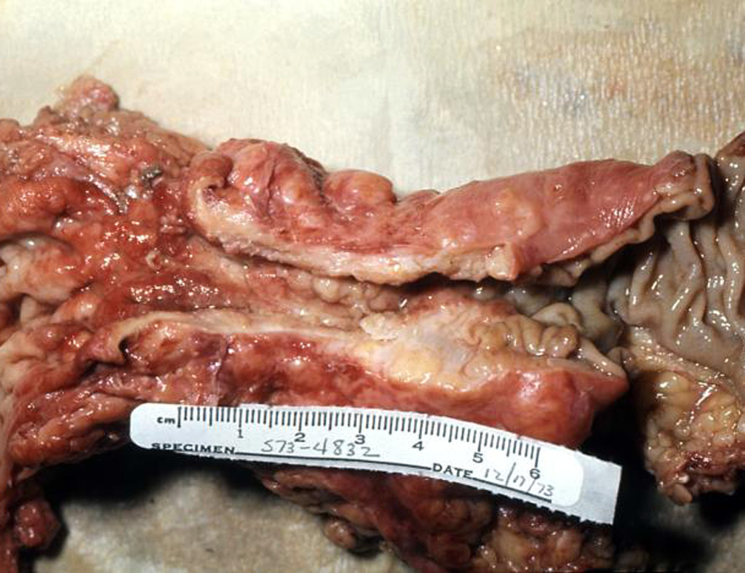

Slide 30
Left sided colon cancer
Genetic - FAP, Peutz-Jehgers, HNPCC, family history of colon cancer
Non-genetic- low fibre diets, diet high in red meat, DM, acromegaly, age, smoking and alcohol (Maybe)

Slide 31
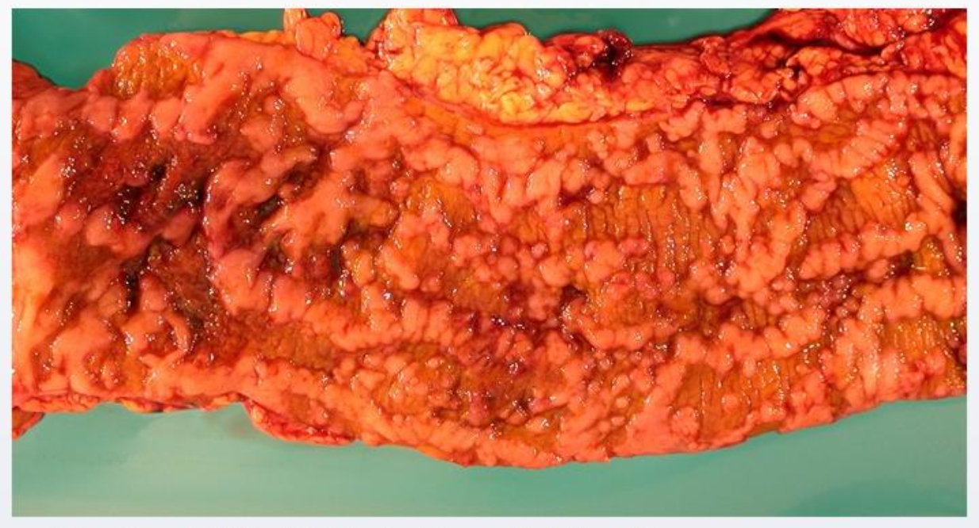
A 25 year old male comes to the clinic for daily episodes of crampy abdominal pain and diarrhea. He has been experiencing these symptoms for a few months now and they have been getting progressively worse. He subsequently undergoes partial colectomy.

Slide 32
What is the likely diagnosis?
What histopathologic findings do you expect to see in this patients?
What other parts of the body might this condition occur?

Slide 33
Crohn’s Disease
Lymphoid aggregates with granulomas
Mouth to anus

Slide 34
A 65 year old female comes to the clinic with a complain of nausea and vomiting most days the week. She reports after eating she feels full and nauseated for hours, and when she does vomit, reports the vomitus to be partially digested food. She has a history of type diabetes and is non-compliant with medication. Last year she had a below knee amputation for an infected ulcer.
What is the likely diagnosis?
What is the pathogenesis behind the disease?

Slide 35
Diabetic gastroparesis
Autonomic neuropathy secondary to microvascular disease in diabetics

Slide 36
A 65 year old comes to the clinic with reports of nausea and weight loss. He first noticed these symptoms 5 months ago, and has been taking a antacid with mild relief. He cannot quantify how much weight he has lost, however states he can no longer wear his pants without belts. Upper GI endoscopy is done and a biopsy is taken of the stomach. The biopsy report states diffuse infiltrate growth within the stomach wall.
What is the likely diagnosis?
What type of cells of characteristic of this diagnosis?

Slide 37
Linitis plastica - “leather bottle stomach”
Signet ring cells

Slide 38
A 45 year old man with a massive upper GI bleed. The bleeding is controlled with IV octreotide administration. The patient has a history of Hep C infection and chronic alcohol abuse. On examination, the patient has gynecomastia, distended abdomen, distended veins around the umbilicus and testicular atrophy.
What is the underlying cause of the upper GI bleed?
What is the mechanism behind the gynecomastia?
What other symptoms might the patient development due to this mechanism?

Slide 39
Cirrhosis of the liver
Due to elevated estrogen and decreased testosterone levels -
Spider angiomata, palmar erythema, testicular atrophy

Slide 40
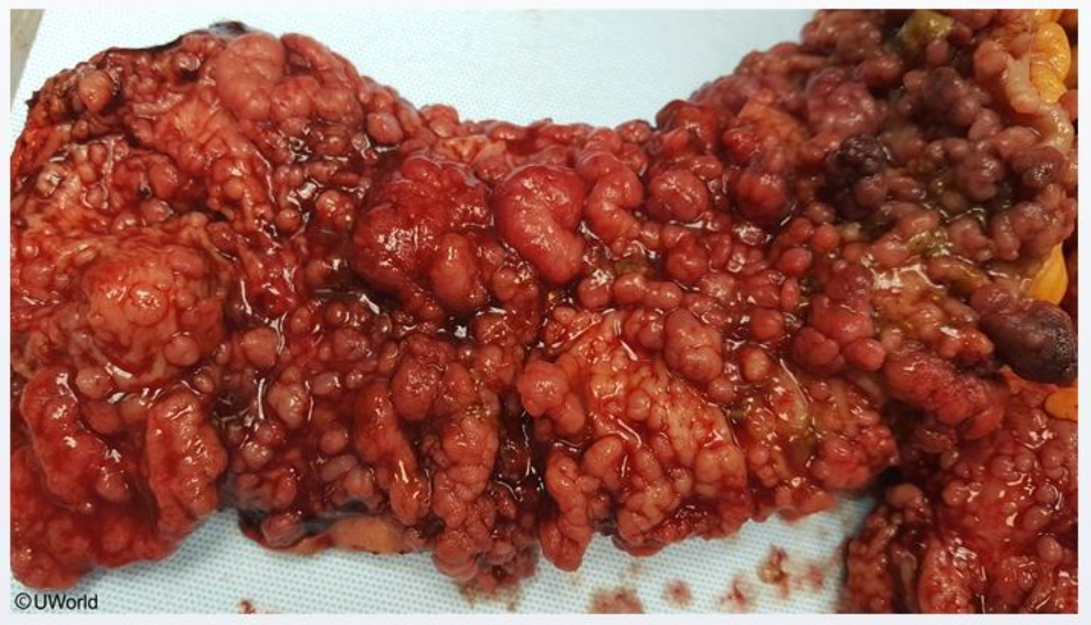
A 25 year old female comes to the clinic for her colonoscopy results after a prolonged periods of abdominal pain and diarrhea. He sister has similar symptoms that which required her to do a total colectomy. She is worried that she may need surgery as well. A section of her sister’s colon is shown below?

Slide 41
What is the likely diagnosis?
What is this patient’s lifetime risk of developing malignancy?
What is the gene mutation associated with this condition?

Slide 42
Familial adenomatous polyposis syndrome (FAP)
100%
Mutation of APC gene (tumor suppressor gene)

Slide 43
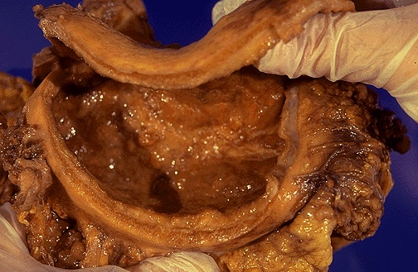
Notes:
An 80 year old male presents with vague abdominal pain, early satiety and weight loss. Multiple biopsies of the stomach wall are taken and it reveals diffuse infiltration of the stomach wall. The patients is scheduled for total gastrectomy.
What is the diagnosis?
Linitis plastica
What histological feature is classifc of this condition>
Signet ring cells
This patient is found to have metastatic spread to the ovaries, what is this condition called?
Krukenberg tumors

Slide 44
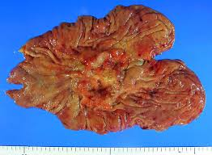
Notes:
A 50 year old male presents with a history of epigastric pain and nausea. Endoscopy reveals an ulcer to the gastric antrum. The patient is treated for 2 weeks with a combination of amoxicillin, clarithromycin and pantoprazole. Four weeks later, his symptoms continue to persist. He is scheduled for repeat endoscopy with biopsy.
What is the likely diagnosis?
Gastric cancer
What are risk factors for this condition?
H. pylori infection, nitrosamines, blood group A

Slide 45
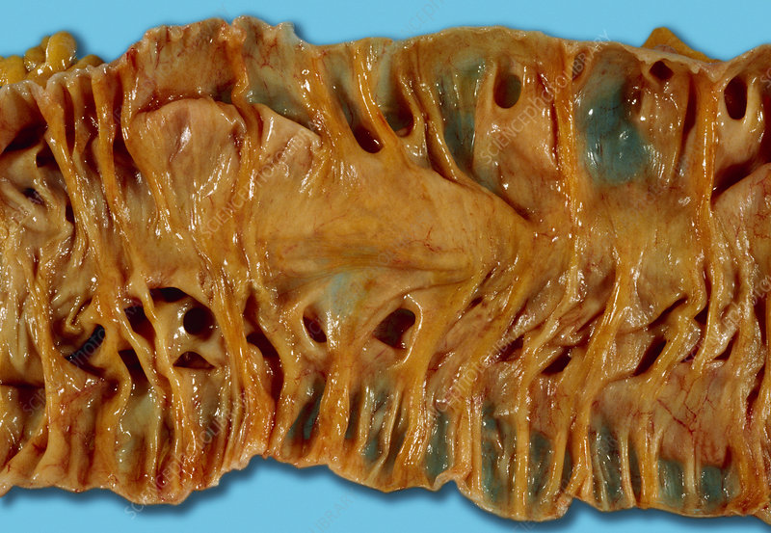
Notes:
A 50 year old male presents to A&E with fever and RLQ pain. On examination he has guarding and rebound to the RLQ. He is scheduled for emergency laparotomy.
What is the diagnosis seen above?
Diverticular disease
What are the complication of this condition?
Perforation, fistula, abscess, LGIB

Slide 46
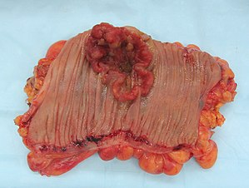
Notes:
A 70 year old male is undergoing his first colonoscopy. A mass is seen and the patient is ascending colon and is biopsied.
What complaints might this patient have prior to colonoscopy?
Fatigue (anemia), weight loss
What tumor marker can be useful in this patients and how is it used?
CEA, following resection, CEA levels are repeated to evaluate for “cure” and re-occurance

Slide 47
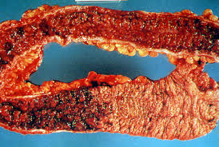
Notes:
A 30 year old male is being evaluated for recurrent bouts of lower abdominal pain and bloody diarrhea. He is scheduled for colonoscopy and the following is found.
What is the diagnosis?
Ulcerative colitis
What would you expect to see on biopsy of the affected area?
Crypt abscess with neutrophils

