Slide 1
Respiratory Pathology
By: Dr Anton Small

Slide 2
A 35 year old man comes to the clinic with a report of fever and cough for 2 weeks. He is currently homeless after being incarcerated for for 10 years, and does part time work as a porter in a retirement home. He also has a history of IV drug abuse, which he resumed after being released from prison. He also reports a 5kg weight loss in the last 2 months, as well as sweating at night.
What is the likely diagnosis?
How would you confirm the diagnosis?
How would you treat this patient?

Slide 3
Mycobacterium Tuberculosis
Chest x-ray - apical infiltrates, cavitation, pleural effusion, pneumothorax, hilar lymph nodes
Sputum culture - culture (acid fast smear)
RIPE: Rifampin, isoniazid, ethambutol and pyrazinamide (2 months) then isoniazid and rifampin 4 months
What about PPD test?

Slide 4
Purified protein derivative (PPD) or Tuberculin skin test (TST) or Mantoux test
Injection given measure after 48-72 hrs
Positive if:
>5mm in an immunocompromised person
>10mm in high risk person
>15mm in a low risk person

Slide 5
A 80 year old female presents to the emergency room with decreased responsiveness and fever, what appears to be labored breathing by the caregiver. The patient has right sided hemiparesis following a stroke and has been bedridden since, as well as is fed via a nasogastric tube. Her temp is 39oC and on physical exam she has decreased air entry to wheeze to the right lung base.
What is the likely diagnosis?
What is the underlying mechanism?
What bacteria is likely to be associated with this condition?

Slide 6
Aspiration pneumonia
Impair swallowing/gag reflex
Mixed flora - aerobes and anaerobes

Slide 7
A 25 year old woman comes to A&E with a complaint of fever, vomiting and lower back pain for 3 days. Her symptoms starts with dysuria and frequency and progressed to fever and lower back pain. On examination her temp is 39.5oC, pulse is 120, bp 90/60 and he has exquisite pain on tapping of the right flank. She was resuscitated, admitted and started on antibiotics. A few hours after admission she develops hypoxia and respiratory distress. She is admitted to ICU and started on mechanical ventilation, however passed shortly after.

Slide 8
What was the likely diagnosis on presentation?
What was the likely cause of her admission to ICU?
What would you expect to see on cross-section of her lungs?

Slide 9
Pyelonephritis with septic shock
Acute respiratory distress syndrome (ARDS)
Hyaline membranes

Slide 10
A 76 year old retired shipyard worker comes to the clinic with a complaint of SOB and cough with occasional blood tinged sputum. These symptoms have been going on for 6 months now, however he decided to come in because one of her former co-workers died after developing similar symptoms. He is life long smoker of 1 pack a day, with no chronic illnesses. On examination he has decreased air entry on the right lower zones, with crackles, and a dull percussion note. Chest x-ray shows a opacification in the right lower lobe with a small pleural effusion.
What is the most likely diagnosis?
What is his most significant risk factor?

Slide 11
Bronchogenic lung cancer
Mesothelioma is a possibility (Shipyard workers and asbestos exposure)
Asbestos exposure and smoking (relative risk of 92 for cancer)

Slide 12
A 60 year old women with a history of osteoporosis comes to A&E following a fall on her right hip. X-rays show a right neck of femur fracture. She undergoes surgical correction the following day. On the 3rd day following surgery she develops sudden onset of respiratory distress and dies.
What is the likely cause of the patient’s sudden respiratory failure?
At autopsy, how would differentiate this cause of death from a postmortem artifact?

Slide 13
Deep vein thrombosis leading to pulmonary embolism
Lines of Zahn

Slide 14
A 23 year old male comes into A&E with bilateral femur fractures after being involved in a motor vehicle accident. After resuscitation and stabilization, he is placed on traction pending surgery. A few hours later, he develops SOB, confusion and chest pain. His lungs are clear to auscultation, but is noted to have a petechial rash on the upper chest. The nurse alerts you to a small globules seen in the urine bag.
What is the likely diagnosis?

Slide 15
Fat embolism syndrome

Slide 16
A 23 year old IV drug abuser comes in with sudden onset of SOB and chest pain. Despite intervention the patient passed. At autopsy, multiple wedge shaped hemorrhagic infarcts are seen in the lung.
Where would the pathologist look next to confirm the diagnosis?
What is the likely etiologic agent of this condition?

Slide 17
Look in the heart at the tricuspid valves
Staph aureus

Slide 18
A 25 year old non-smoker presents with worsening SOB. He is an avid tennis player, however the SOB prevented him from playing in the last year. He doesn’t smoke and doesn’t have any environmental or occupational exposure. His FEV1 and FEV/FVC ratio is less than expected and doesn’t improve with ventolin administration.
What is the likely diagnosis?
What underlying condition does this patient likely have?
If a cross-section of the affected organ was done, what would you expect to see under the microscope?

Slide 19
Emphysema
Alpha 1 antitrypsin deficiency
Panacinar emphysema

Slide 20
A 65 year old woman comes to the emergency room for fever, cough and worsening SOB. During evaluation her her respiratory status worsens and she is intubated and mechanically ventilated. Bronchoalveolar lavage is done and sent for culture and sensitivity. Cultures return showing “lancet” shaped gram positive diplococcus. After two days in ICU she dies.
How would you expect this patient’s lungs to look grossly?
What other inflammatory stages can be seen in this condition?
What is the likely organism that causes this condition?

Slide 21
Red hepatization
Consolidation (0-2 days) - Red Hepatization (2-4 days) - Grey Hepatization (4-7) - Resolution (>7 days)
Strep pneumo

Slide 22
A 79 year old male comes to clinic with a complaint of chronic cough and weight loss for 1 year associated with headache and lethargy for 1 week. Chest x-ray shows a mass in the right upper lobe, that was not seen on previous x-rays. A biopsy is done and a diagnosis of lung cancer is made. During workup the following results are obtained
Na - 122 (135-145) BUN- 2.2 (2.5-6.7) Plasma Osmolarity - 250 (275-295)
K - 4.5 (3.3-5) Creat - 22 (9-126) Urine Osmolarity - 310 (100-900)
Cl - 101 (95-105)
HCO3 - 24 (20-26)

Slide 23
What is the likely cause for this patient's hyponatremia?
What type of malignancy does this patient have?
What are other paraneoplastic syndromes associated with malignancy?

Slide 24
Syndrome of inappropriate antidiuretic hormone
Small cell lung cancer
Cushing Syndrome (Ectopic ACTH), Eaton-Lambert Syndrome, Cerebellar ataxia

Slide 25
A 25 year old woman comes to the clinic with a report of SOB and a dry cough for 2 months. The SOB of breath has gotten worse and she is now unable to climb stairs without stopping. She also has pain to the joints of her hands and knees. The pain is worse in the morning and gets better throughout the day. The pain is felt in all joints of the hand except the DIP. Fine crackles are heard on auscultation of the lungs.
What is the likely cause of the SOB?
How is this condition classically seen on x-ray?

Slide 26
Interstitial pulmonary fibrosis
Honeycomb lung

Slide 27
A 35 year old female presents with persistent dry cough. A chest x-ray is done and he is revealed to have bilateral hilar lymphadenopathy. Biopsy of one of the lymph nodes show non-caseating granulomas.
What is the likely diagnosis?
What enzyme would you expect to the elevated in this patient?

Slide 28
Sarcoidosis
Angiotensin converting enzyme

Slide 29
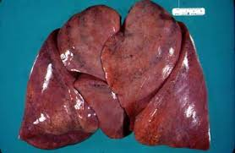
Notes:
A patient is brought for autopsy with a history of worsening SOB and lower limb swelling. The patient has had a cough productive of pink frothy sputum, for which he has been taking a OTC cough syrup for with no relief. On examination of the lungs, right lung weights 800g(400-500) and left lung 750g (300-350), no abnormalities are seen grossly.
What disease did this patient likely have?
Congestive heart failure
Histologically, what can be seen that is pathognomonic of this condition?
Heart failure cells, hemosiderin laden macrophages

Slide 30
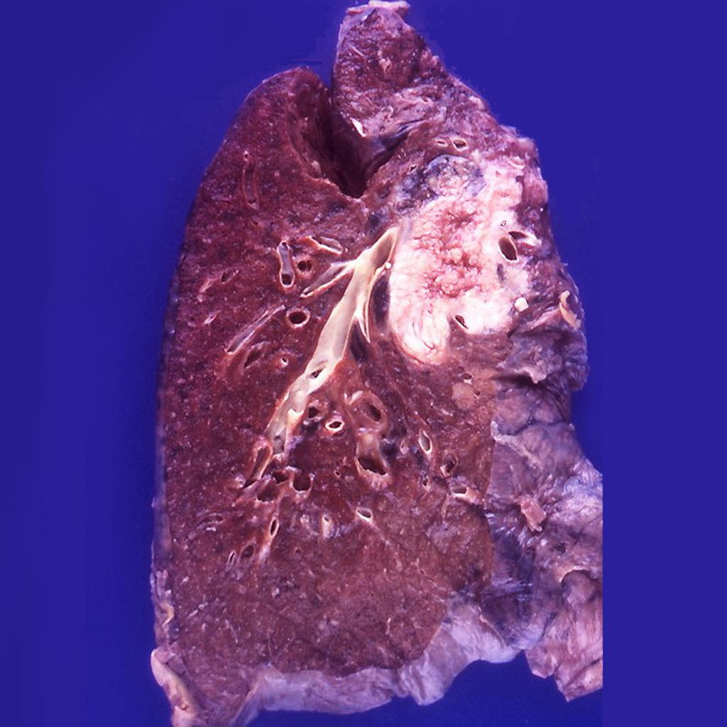
Notes:
A 60 year old male presents for SOB, cough and weight loss. He is sent for a chest x-ray which reveals a mass in the right upper lobe, not seen on previous x rays.
What is the likely diagnosis?
Lung cancer

