Slide 1
CNS Pathology
By: Dr Small

Slide 2
An 11 month old baby is brought into clinic by his mother who noted a mass in the abdomen during a bath. Weight check review the infant has lost weight since the last visit. The mass is right sided and immobile. Urine is positive for elevated catecholamine breakdown products.
What is the likely diagnosis?
What type of cells did this mass arise from?

Slide 3
Neuroblastoma
Neural crest cells

Slide 4
A 48 year old female is brought for autopsy after dying in a motor vehicle accident. Her only significant medical history is for complete hearing loss to her right ear and partial hearing loss in the left ear. A note is also made of a family history of hearing difficulty. On examination of the brain bilateral tumors are found in the cerebellopontine angle.
What tumor is this likely?
What underlying condition does this patient have?
What is the genetic association of this disease?

Slide 5
Acoustic neuromas
Neurofibromatosis type 2
NF2 gene on chromosome 22

Slide 6
A 45 year old man is brought in for autopsy after being killed in a standoff with police. This was the 3rd time the neighbours reported he was making violent threats towards them, and when the police arrived he got violent and killed. His wife reports that over the last few years, he began getting clumsy, forgetful and aggressive. At autopsy, there is atrophy of the caudate nucleus and histologically there is loss of neurons in the caudate and putamen.
What is the likely diagnosis?
Is anyone else at risk for developing this disease?

Slide 7
Huntington’s Disease
Children - autosomal dominant with 100% penetrance

Slide 8
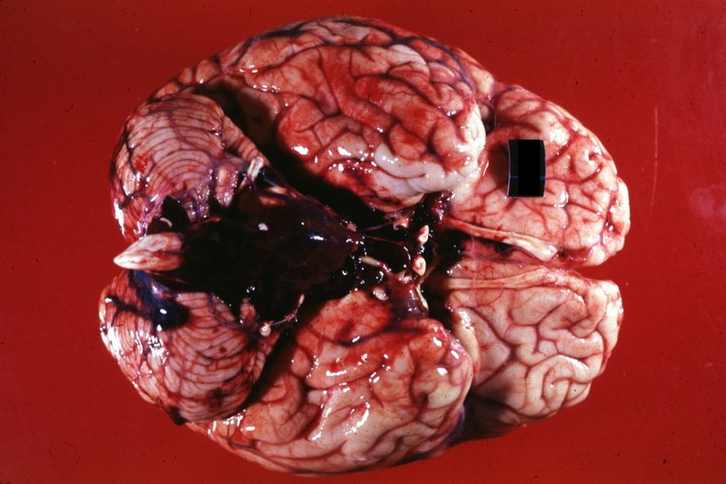
A 35 year old female comes into A&E complaining of the worst headache of her life. It was sudden in onset and associated with N/V as well as photophobia. While on her way to CT scan she develops a seizure and dies. The picture below is seen at autopsy.

Slide 9
What is the diagnosis?
What is the likely cause of this condition?
What are the risk factors for this condition?

Slide 10
Subarachnoid haemorrhage
Saccular (Berry) aneurysm
SHAME - Smoking(Cocaine), Hypertension, ADPKD, Marfans, Ehlers Danlos

Slide 11
A 79 year old female is brought A&E with for confusion and decreased responsiveness for 2 days. Her sodium is 115. Correction is started with hypertonic saline. Three days later the patient is unable move all limbs, even with application of a painful stimulus.
What is the likely diagnosis?
What is the underlying mechanism?

Slide 12
Central pontine myelinolysis
Osmotic demyelination secondary to rapid sodium correction.

Slide 13
A 5 year old boy is brought to the clinic for well child visit. On examination you see a male child with a cranium that appears too big for his body. He is loss of bulk in the lower limbs bilaterally, as well as loss of tone and absent reflexes. On his back he has a cystic protrusion to the lower back, just above the sacrum.
What is the cause of this patient’s limb weakness?
How could this be prevented?
What condition could account of this patient’s enlarged head and presentation?

Slide 14
Myelomeningocele
Folate supplementation
Arnold-Chiari Malformation type 2

Slide 15
A 20 year old college student is brought in for fever and confusion. On examination he is a positive kernig and brudzinski reflex. A lumbar puncture is done and the gram stain comes back as gram negative diplococci. The patient later develops severe hypotension and dies.
What is the likely organism found on gram stain?
Besides the brain, what other organ is important to examine in this patient?
What advice would you have the pathologist in this case?

Slide 16
Neisseria meningitidis
Adrenal glands (Waterhouse-Friderichsen syndrome)
Adequate PPE and post-exposure prophylaxis for those in contact without PPE

Slide 17
A mother brings her 1 year old child to the clinic with a complaint of swelling to the right eye. There is absent red reflex as well as leukocoria in the right eye. A CT scan is done and it shows a tumor in the right orbital socket. The child is scheduled for enucleation of the right eye.
What is the likely diagnosis?
What gene mutation is likely to be seen in this tumor?

Slide 18
Retinoblastoma
RB1

Slide 19
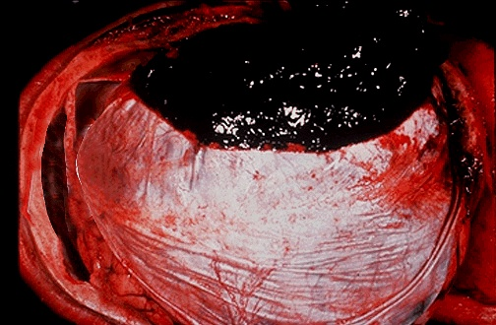
A 24 year male is brought into A&E unconscious following a motorcycle accident. Attempts are made to resuscitate him however he dies. The below image is seen at autopsy.
What is the diagnosis?
What is the cause of this condition?

Slide 20
Epidural Haematoma
Rupture of the middle meningeal artery

Slide 21
A 35 year old woman is brought in for autopsy following her death in a MVA. She had a history of myasthenia gravis. At autopsy a mass is found in the mediastinum.
What is this mass likely?

Slide 22
A 35 year old woman comes at A&E with look sensation and weakness to both lower limbs. It started with numbness in the feet but over the last few days it has progressed to the legs. History is only significant for a bloody diarrhea two weeks prior. Examination reveal loss of reflexes at the knee and ankles. A lumbar puncture is done puncture is scheduled to be done.
What is the likely diagnosis?
What would you expect the lumbar puncture to show?
What is the likely cause of the bloody diarrhea?

Slide 23
Guillain Barre Syndrome
Albuminocytologic dissociation
Campylobacter Jejuni

Slide 24
A 65 year old man comes in for new onset of seizures. A few days following admission he develops aspiration pneumonia and dies. At autopsy a mass is found in the right cerebrum exhibiting mass effect and compressing the right ventricle. The borders are poorly defined and it has a center of necrosis with surrounding haemorrhage.
What is the likely diagnosis?

Slide 25
Glioblastoma multiforme

Slide 26
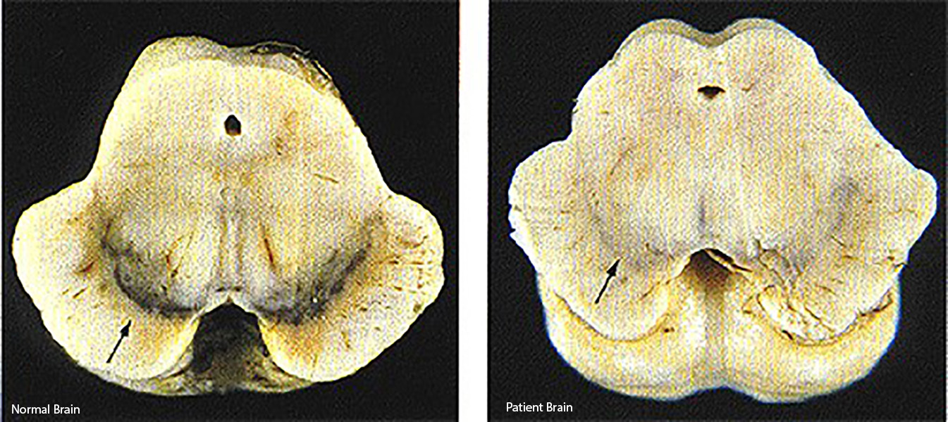
A 65 year old male is brought in for autopsy. His past medical history is only significant for a movement disturbance and a tremor treated with levodopa. ON examination of the brain the following is discovered.
What is the diagnosis?

Slide 27
Parkinson's Disease

Slide 28
A 35 year old male comes in with a complaint for severe headache that started 1 hour ago, associated with nausea and vomiting. He has a history of adult polycystic kidney disease. On examination he has positive Kernig and Brudzinski sign.
What is the likely diagnosis?

Slide 29
Subarachnoid haemorrhage secondary to ruptured berry aneurysm

Slide 30
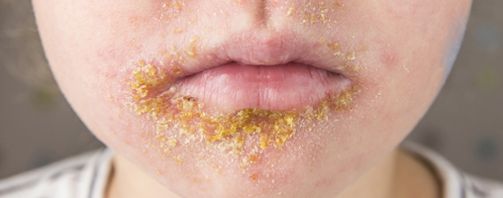
A 5 year old boy is brought into the clinic with a complaint of a rash to the mouth. The rash is comprised of pustules and papules, and some appear to have broken down and formed a golden yellow crusted appearance. A swab is done and gram stain comes back gram positive cocci in chains.
What is the likely diagnosis?
What is the cause of this infections?

Slide 31
Impetigo
Group A Strep
(Staph is gram positive cocci in clusters)

Slide 32
A 23 year old sexually active female comes to the clinic with a complaint of painful ulcers to the vagina. On examination she has multiple painful shallow ulcers with a erythematous base. She has no vaginal discharge and no cervical motion tenderness but has bilateral tender lymphadenopathy.
What is the likely diagnosis?
IN the absence of PCR, how would you confirm your diagnosis?

Slide 33
Herpes simplex virus
Direct fluorescence antibody, viral culture (Low sensitivity), Tzanck smear

Slide 34
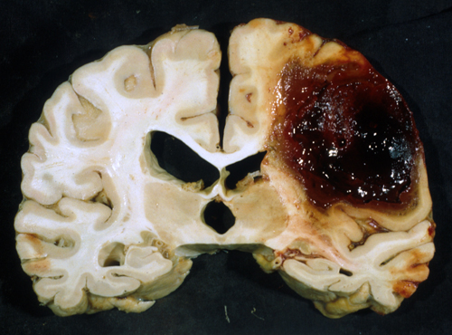
Notes:
A 70 year old male smoker with longstanding hypertension and DM develops sudden onset of left upper and lower limb weakness. He is brought to A&E where he rapidly progress, to seizures, coma and death. At autopsy the following is seen.
What is the diagnosis?
Intraparenchymal (intracerebral) hemorrhage
What is classically seen as the underlying mechanism of this condition?
Rupture of Charcot-Bouchard microaneurysms
What is the underly cause of the above pathology?
HTN
.

